Slide 1
Bringing About Political Change
Liverpool Hope University,
February 21st 2012.
David Alton

Slide 2
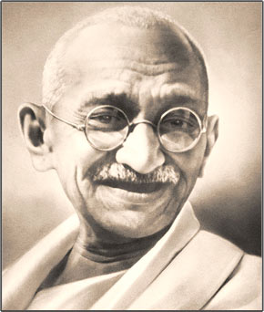
Mahatma Gandhi : “You must be the change you want to see in the world”

Slide 3
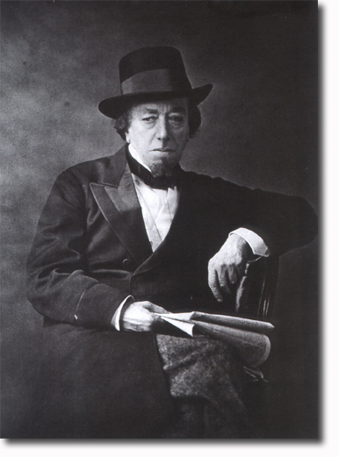
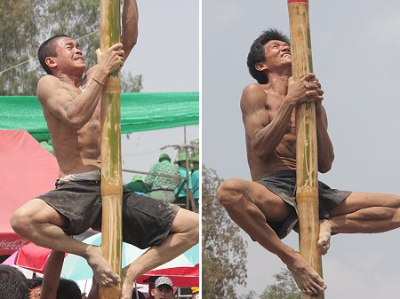
“I have climbed to the top of the greasy pole“
- Benjamin Disraeli

Slide 4
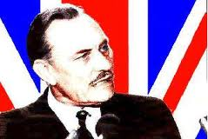
“All political lives, unless they are cut off in
midstream at a happy juncture,
end in failure, because that is the nature
of politics and of human affairs”
- Enoch Powell

Slide 5
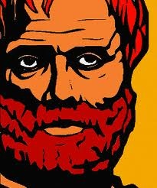
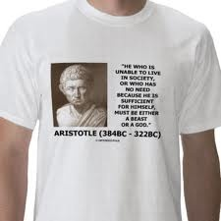
Aristotle had a high view of “the polis” and insisted that “we are not solitary pieces in a game of chequers” but all players in a common life.

Slide 6
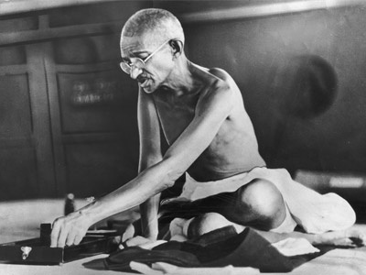
“To forget how to dig the earth and to tend the soil is to forget ourselves”

Slide 7
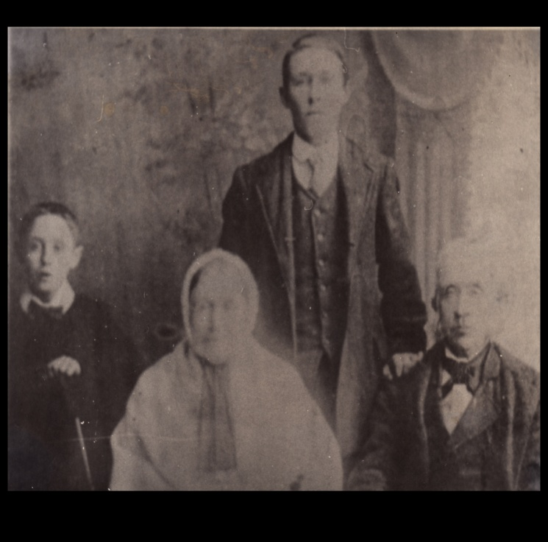
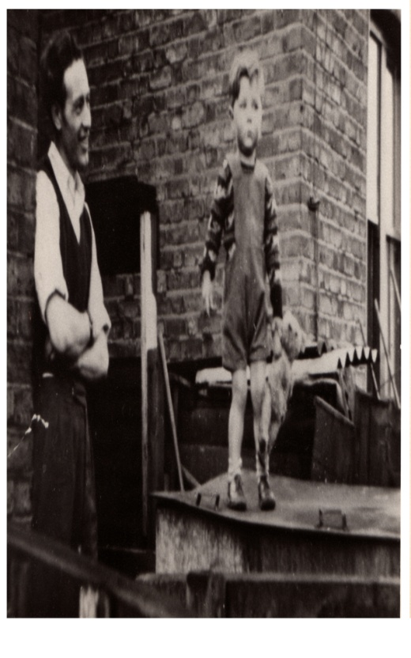
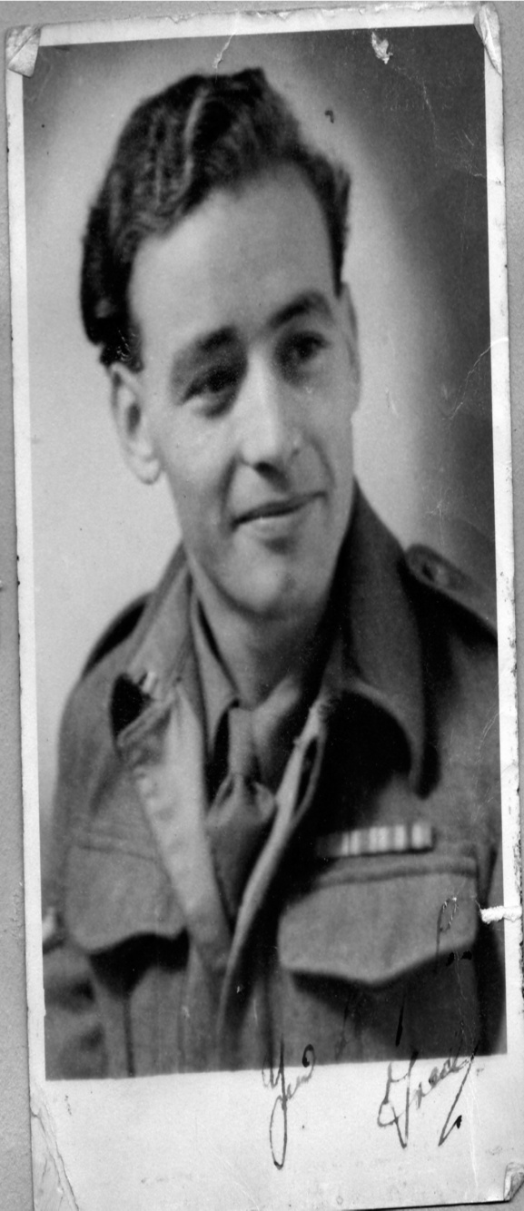
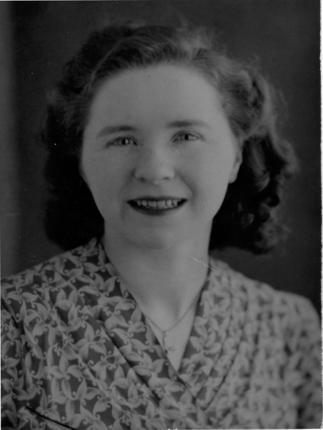
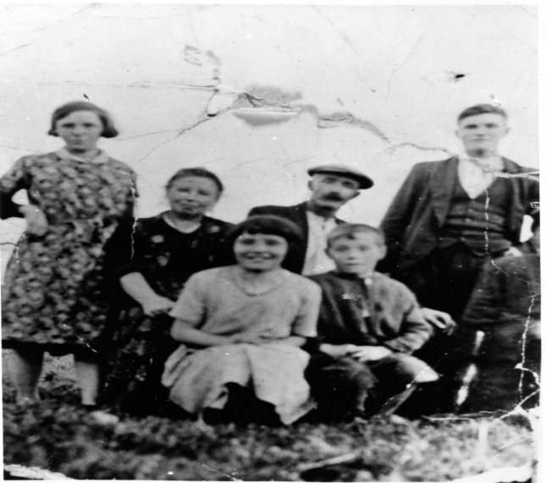

Slide 8
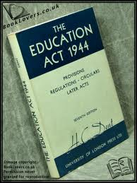
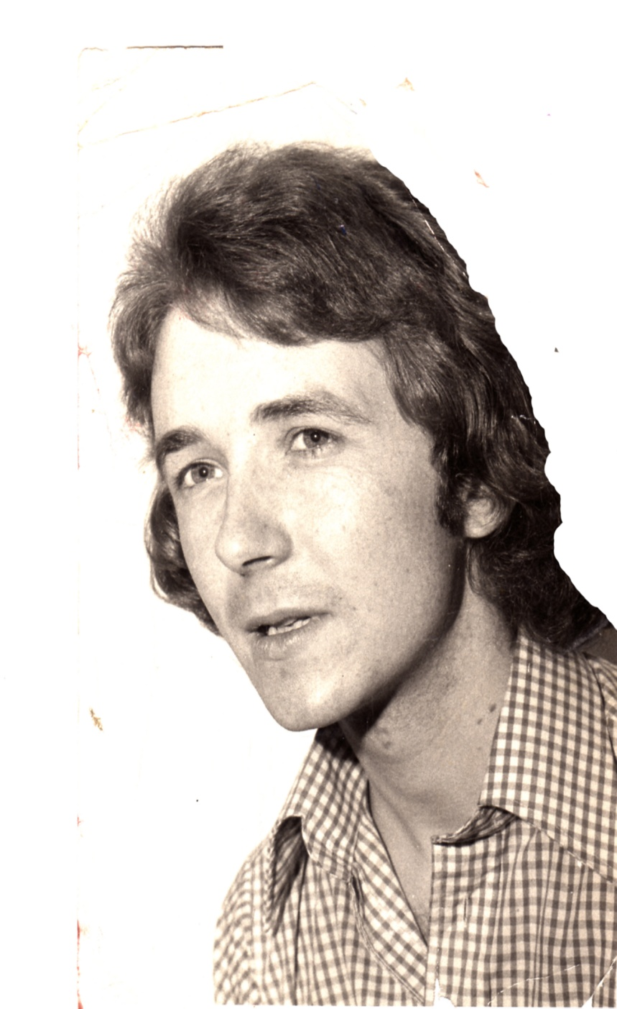

Slide 9
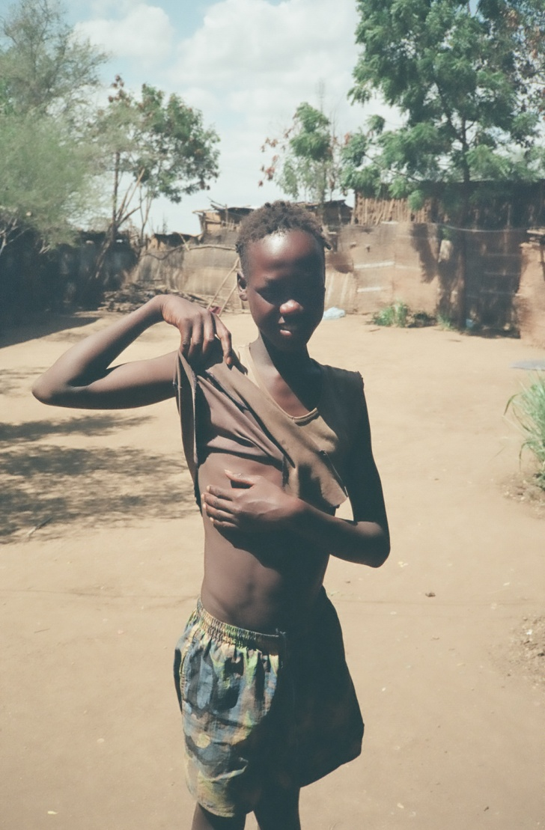
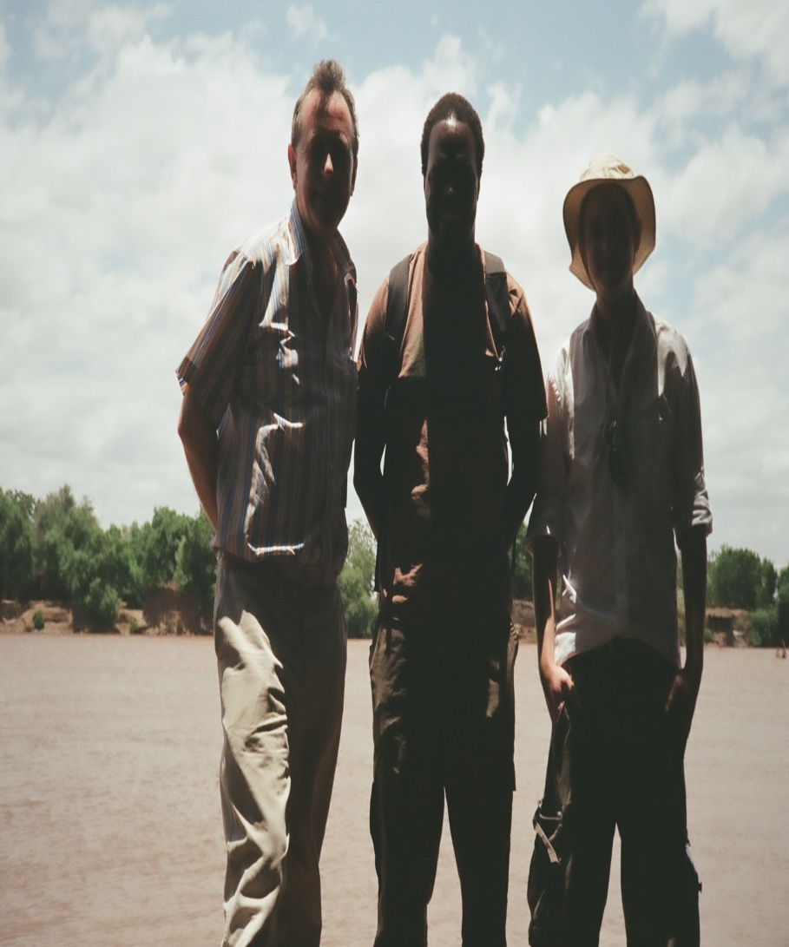
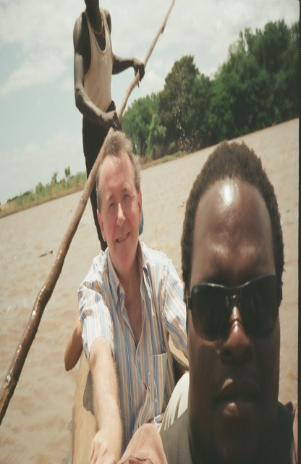
Joseph Amukoo With Fr.Stephen Ochieng in Turkana

Slide 10
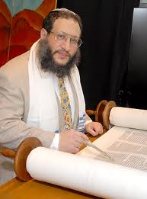
“the man who saves a single life saves the world.”

Slide 11
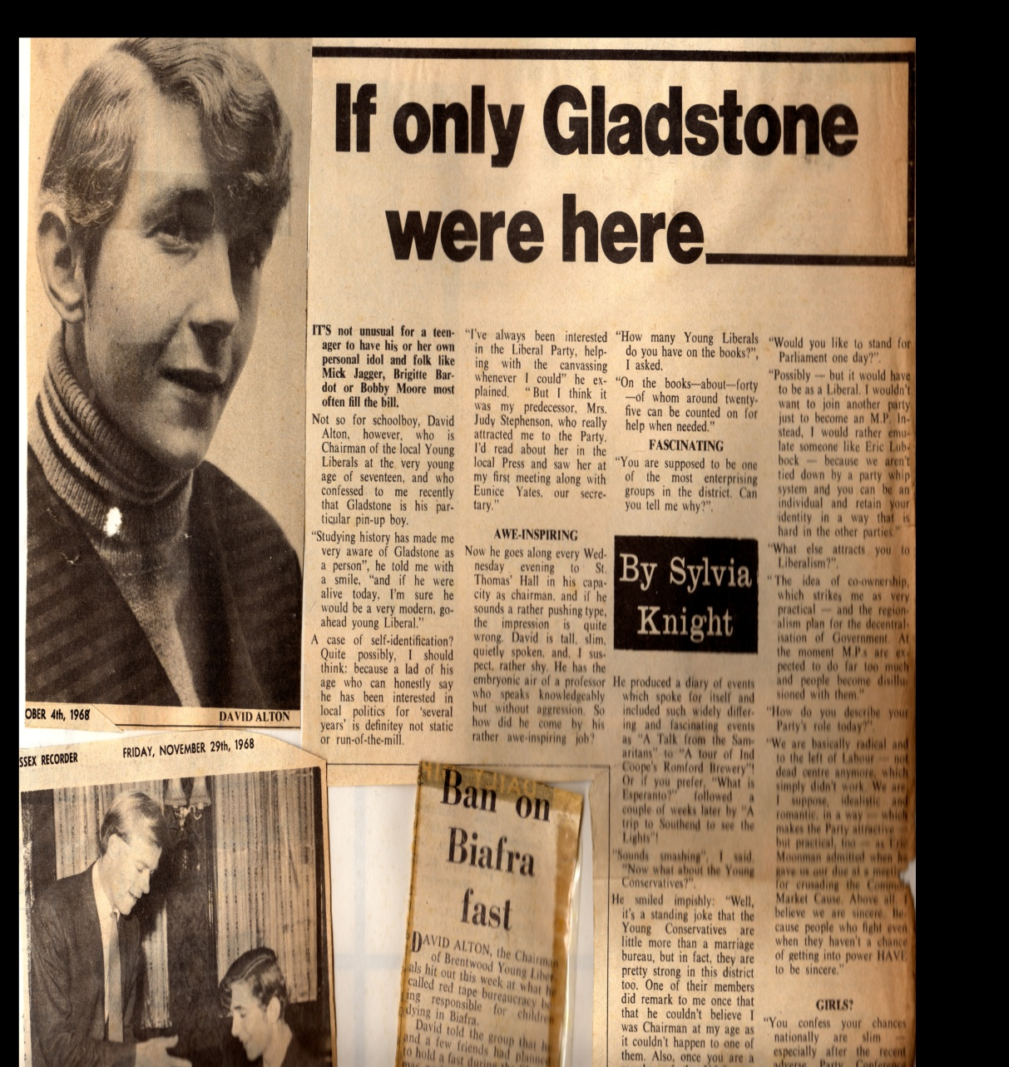
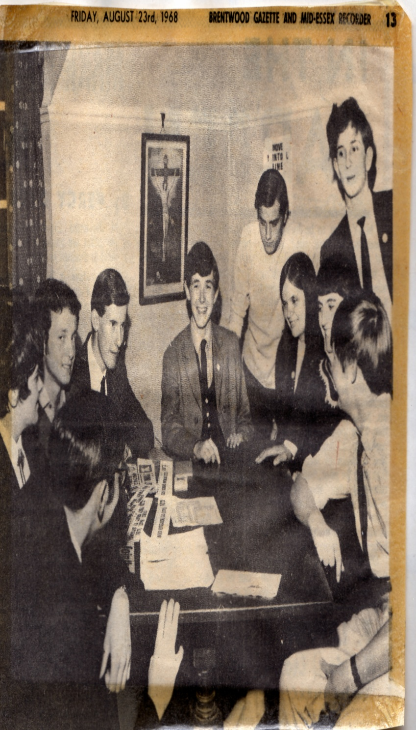

Slide 12
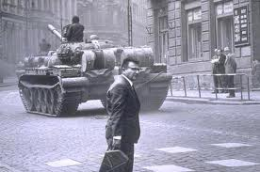
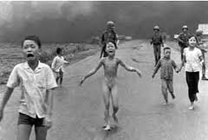
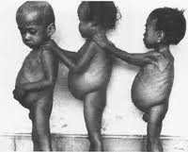
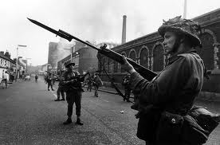
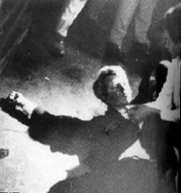

Slide 13
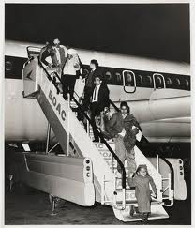
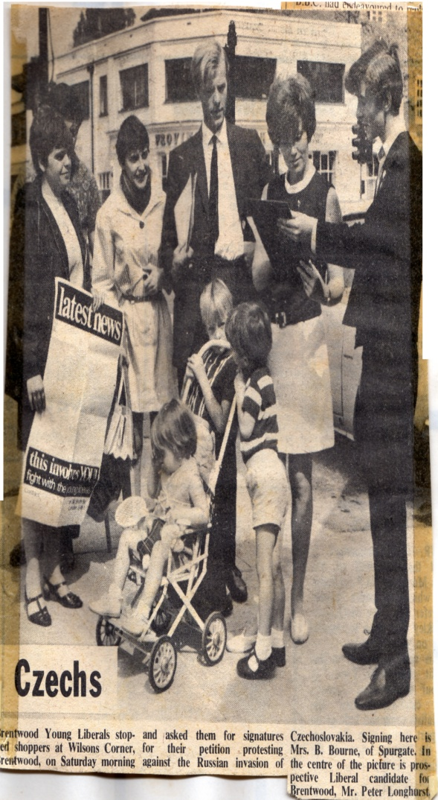
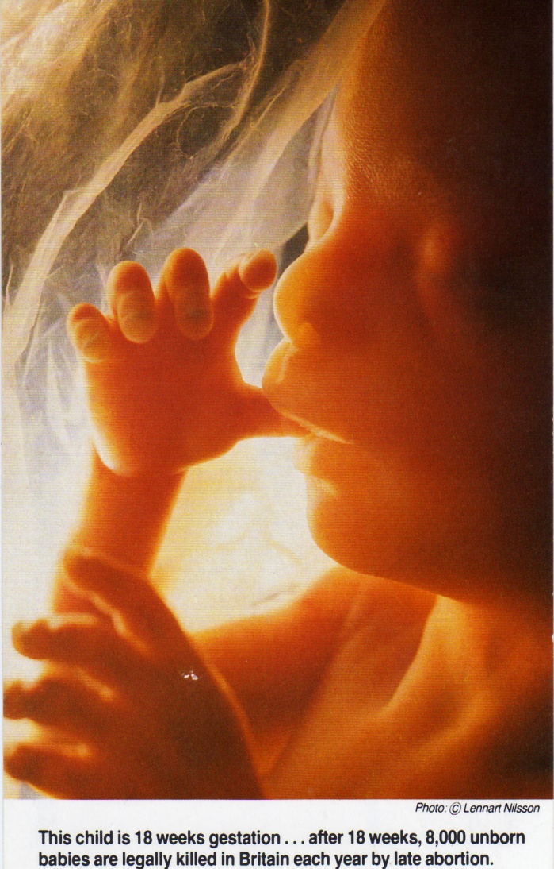
1967-68 Kenyan Asians stripped of citizenship; Soviets send tanks into Prague; Abortion legislation enacted.

Slide 14
From the beginning I have believed that no life is so futile or worthless that it does not command the right to be defended with determination and vigour. Regardless of gestational age or political status, colour or creed, orientation or gender, class or origin, all men and women at every stage of their lives deserve the protection of those who hold political office, make laws, and determine events.

Slide 15
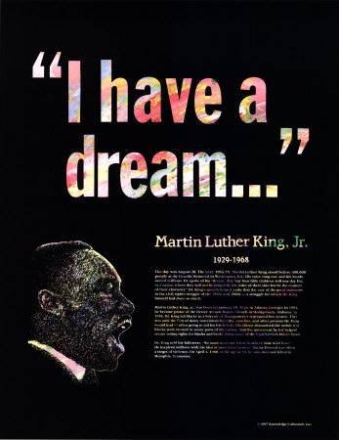
“A promise that all men, yes, black men as well as white men, would be guaranteed the "inalienable Rights" of "Life, Liberty and the pursuit of Happiness. It is obvious today that America has defaulted on this promissory note, insofar as her citizens of colour are concerned.”

Slide 16
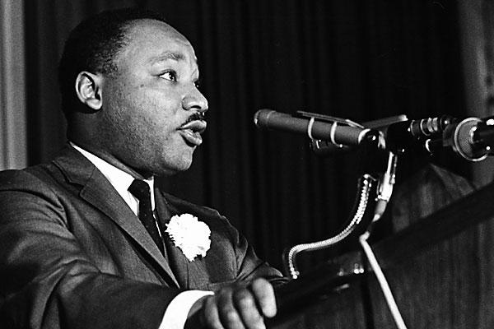
“Change does not roll in on the wheels of inevitability, but comes through continuous struggle. And so we must straighten our backs and work for our freedom. A man can't ride you unless your back is bent.”

Slide 17
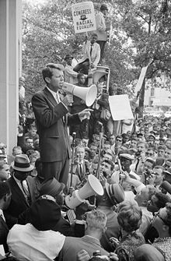
“Let no one be discouraged by the belief there is nothing one person can do against the enormous array of the world's ills, misery, ignorance, and violence. Few will have the greatness to bend history, but each of us can work to change a small portion of events. And in the total of all those acts will be written the history of a generation.”

Slide 18
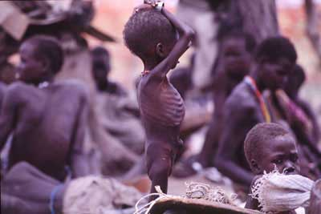
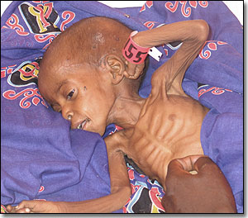
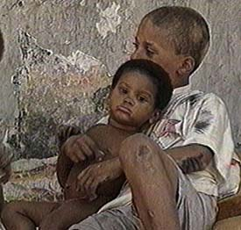
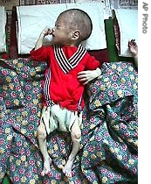
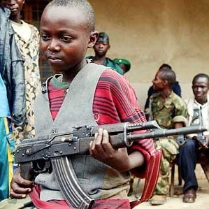
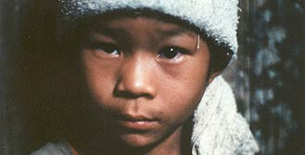
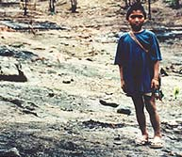
Man’s Inhumanity To Man

Slide 19
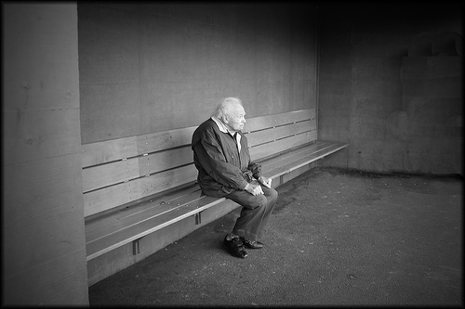
“the world is so big and I am so small I do not like it at all at all”. “The Condition of England Question: w www.davidalton.net ” “sharp elbowed Britain.”

Slide 20
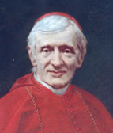
“A man would do nothing if he waited until he could do it so well that no one could find fault”
“We are not born for ourselves, but for our kind, for our neighbours,
for our country: it is but selfishness, indolence, a perverse fastidiousness,
an unmanliness, and no virtue or praise, to bury our talent in a napkin”

Slide 21
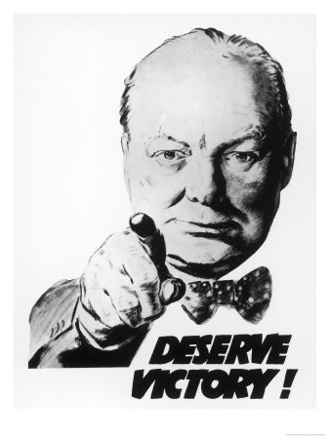
“to improve is to change; to be perfect is to change often.”

Slide 22
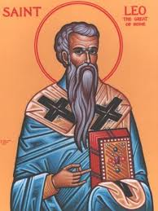
“Grant O Lord, that we may begin
with holy fasting, this campaign
of Christian service” – Leonine Sacramentary

Slide 23
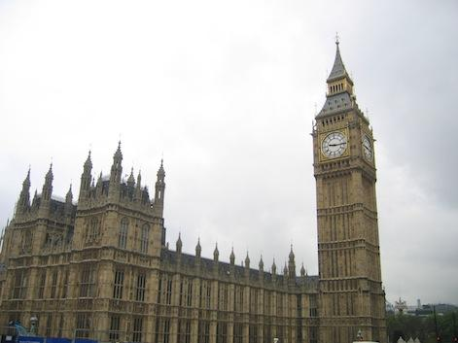
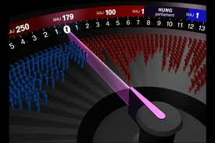
They always vote at their party’s call and never ever think for themselves at all….W.S.Gilbert

Slide 24
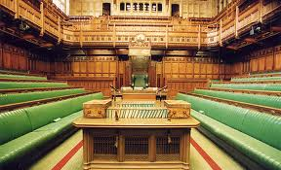
A Member of Parliament should put their conscience, their constituents, their country and their principles before party or popularity.

Slide 25
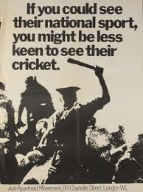
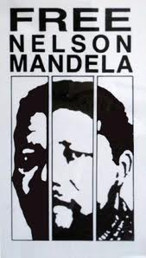

Slide 26
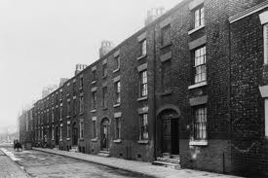
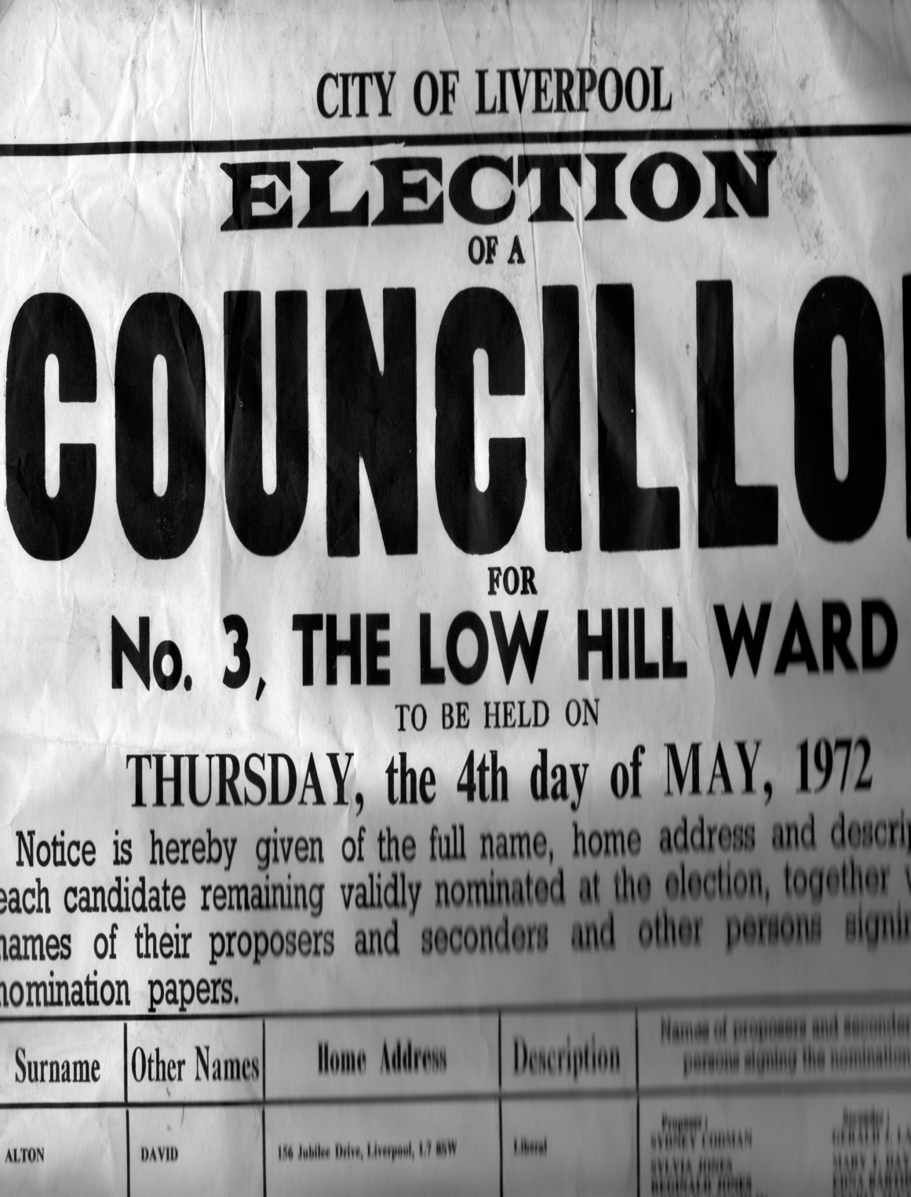
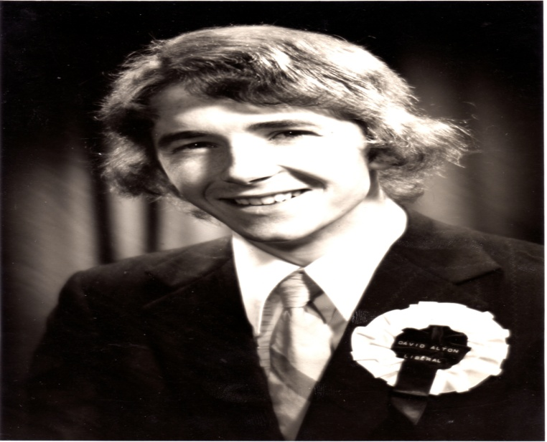

Slide 29
Parliament first met in 1265 in Westminster Hall

Slide 30
The Tolpuddle Martyrs, the Chartists, the Abolitionists, the Suffragettes,

Slide 31
"Here the struggle for religious freedom has been strongly connected with the struggle for democracy itself" Shami Chakrabati, Director of Liberty

Slide 32
The Quakers, William Wilberforce, Thomas Clarkson, Granville Sharpe, Olaudah Equiano, Josiah Wedgewood, John Newton, and the Liverpool MP William Roscoe.

Slide 33
“I have no sufficient data to warrant calculation but I suppose not less than one hundred thousand slaves are exported annually from all parts of Africa, and that more than one half of these are exported in English ships.” – John Newton

Slide 34
The last letter written by the great John Wesley –
whose “heart was strangely warmed” on his conversion on May 24th 1738
was to Wilberforce and asked “what villainy is this?”
He told Wilberforce to put his trust in God and to work for an end to such evil –
“a scandal of England of religion and of human nature.”
He told Wilberforce to be a force for change and an “Athanasius contra mundum”
– literally to be like the 4th century Christian Bishop, Athanasius,
“Athanasius against the world.”

Slide 35
“As to its politics, this country has much less, I think, to fear than to hope;
unless through a corruption of its religion –
against which, as Conservative or Liberal, I can perhaps say I have striven all my life long.”

Slide 36
Keir Hardie,
Arthur Henderson, George Lansbury.

Slide 37
“We look forward to the time when the power of love will replace the love of power, and then will our world know the blessings of peace.” - W.E.Gladstone,
Prime Minister Four Times,
Son of Liverpool – his statue stands in St.John’s Gardens behind St.George’s Hall

Slide 38
“Escape from Camp 14” – to be published by Penguin March 2012

Slide 39
Pyongyang University of Science and Technology – with Dr. James Kim and Baroness Cox

Slide 40
“if not me who?” -“if not now, when?”

Slide 41
Helsinki With A Korean Face
Berlin, 1989

Slide 43
Daw Aung San Suu Kyi - and giving evidence at the American Congress about the plight of Burma’s Karen people.

Slide 44
The Arab Spring and the plight of the region’s minorities

Slide 45
Question to a Palestinian…how long have you been a Christian? “2,000 years ago was the reply.”

Slide 47
Pakistan’s murdered Minister for Minorities: Shabaz Bhatti
Bhatti said that his stand would “send a message of hope to the people living a life of disappointment, disillusionment and despair” adding that his life was dedicated to “the oppressed, the down-trodden and the marginalised” and to “the struggle for human equality, social justice, religious freedom and the empowerment of religious minorities’ communities.”

Slide 48
No one in the world can change Truth. What we can do and should do is to seek truth and to serve it when we have found it.
The real conflict is the inner conflict. Beyond armies of occupation and the hecatombs of extermination camps,
there are two irreconcilable enemies in the depth of every soul: good and evil, sin and love.
And what use are the victories on the battlefield if we ourselves are defeated in our innermost personal selves?"

Slide 49
“Good is never accomplished except at the cost of those who do it,
truth never breaks through except through the sacrifice of those who spread it” –
John Henry Newman

Slide 50
Liverpool Hope University Bringing About Political Change
David Alton
-Professor Lord Alton of Liverpool –
www.davidalton.net

