Slide 1

Educating for good science and good ethics
Educating for Virtue
Lord Alton of Liverpool - PUST 2011

Slide 2
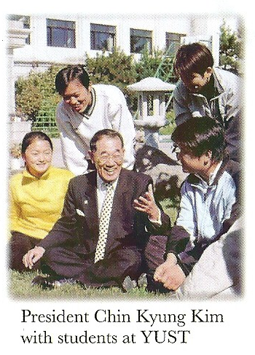
“I believe in the power of Education.”
“to be efficient, effective and productive in modern society.”

Slide 3
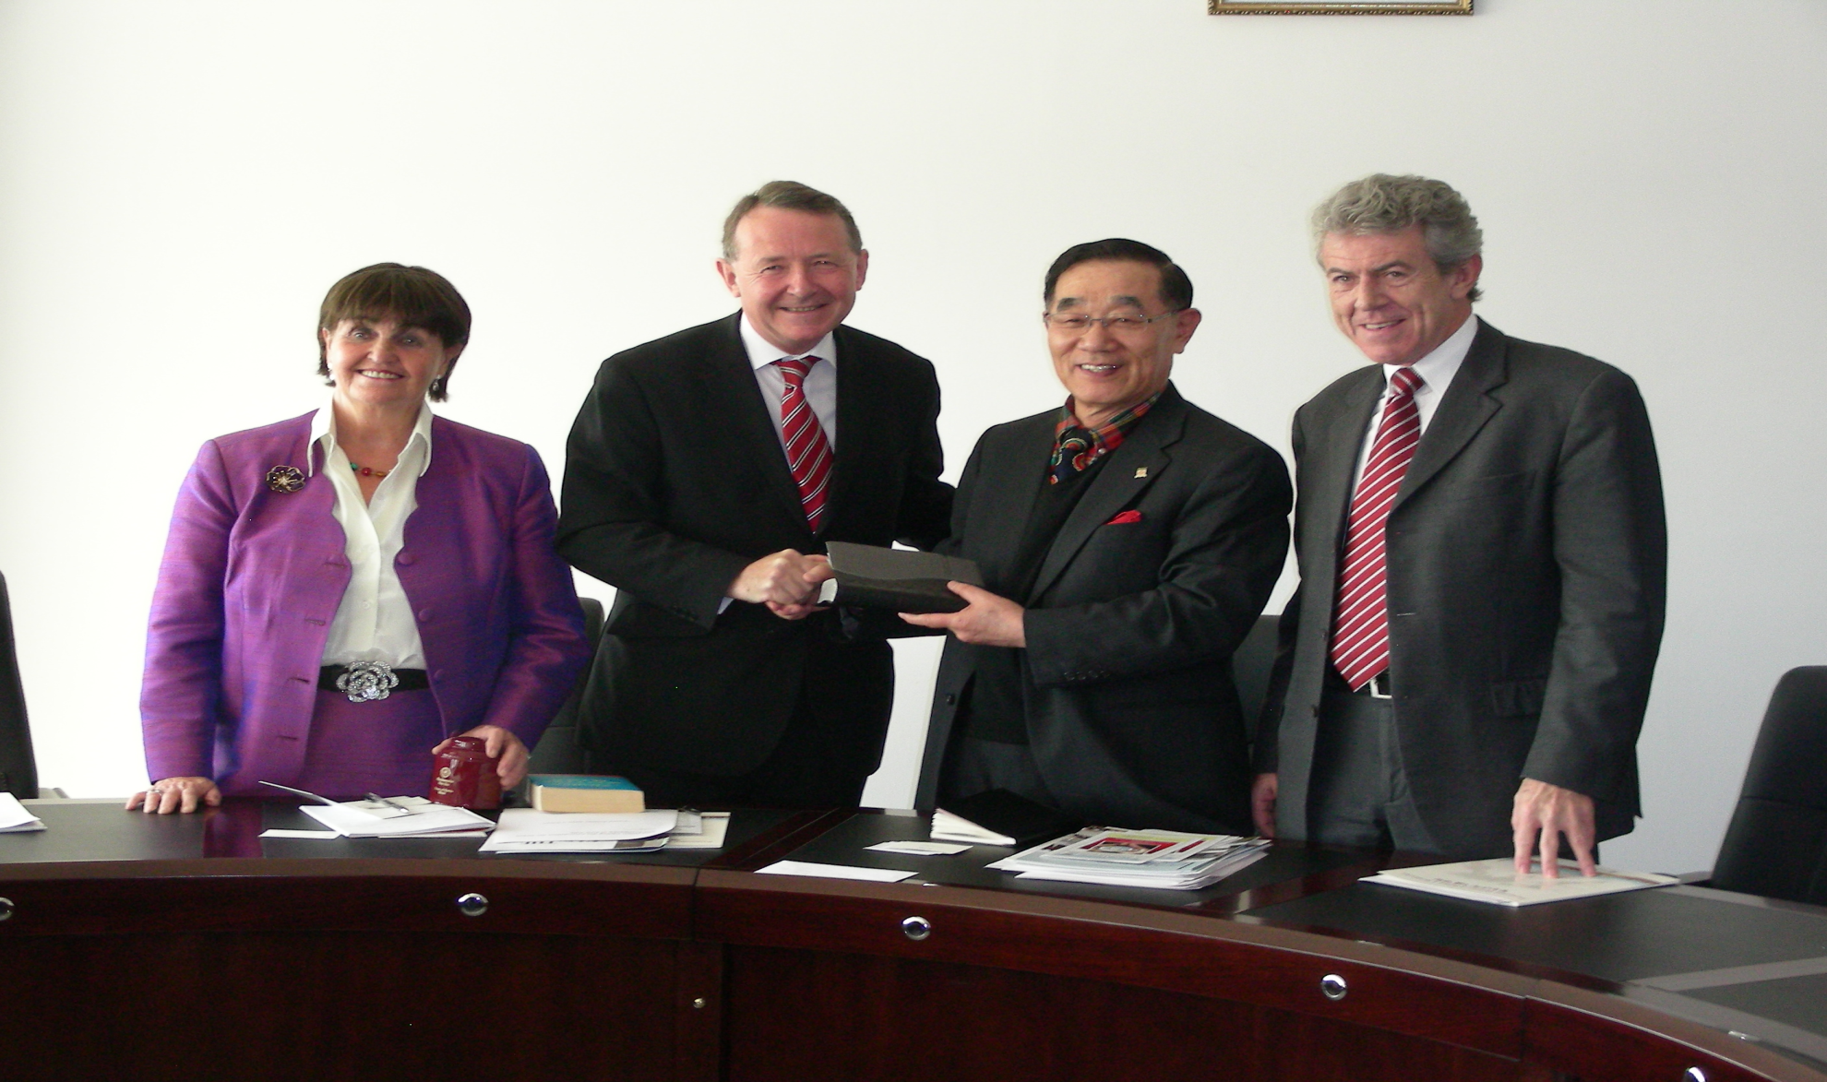
Pyongyang University of Science and Technology – with Dr. James Kim and Ambassador Peter Hughes

Slide 4
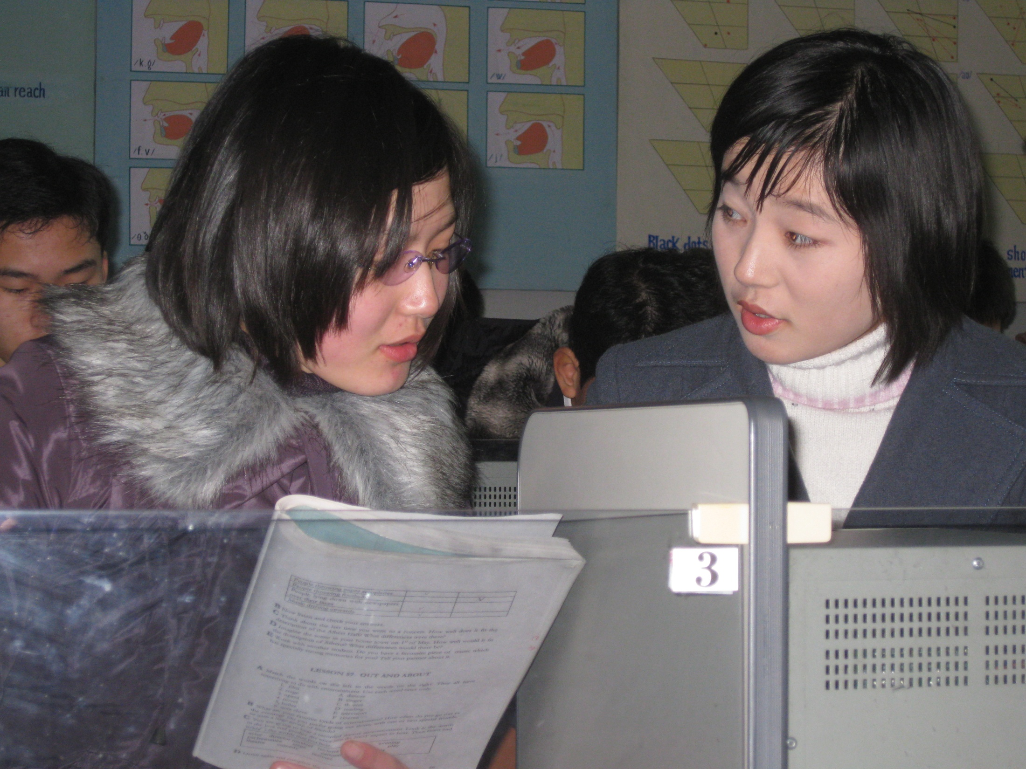

Slide 5
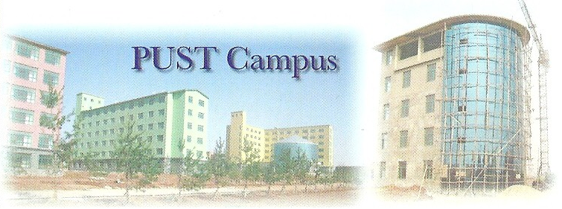
Dr.Kim:
“political and economic efforts alone do not result in peace and prosperity…education can, however, plant seeds of the values that are critical in reaching our desired end. These values include understanding; respect; sacrifice and reconciliation.”

Slide 6
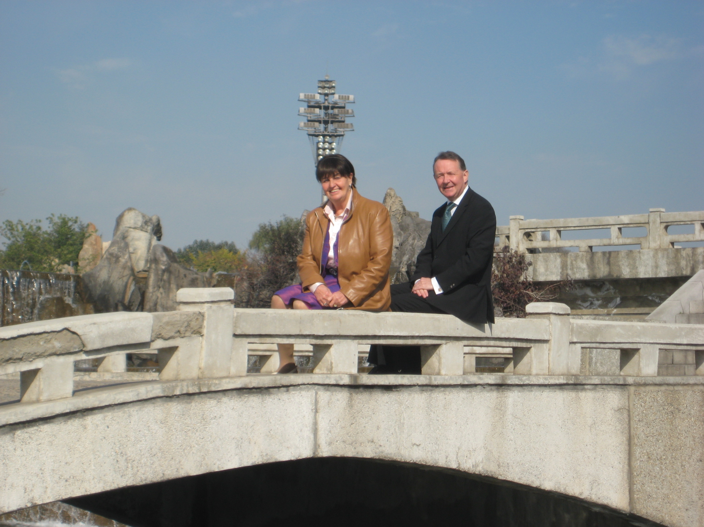

2010 Visit “Building Bridges Not Walls.”

Slide 7
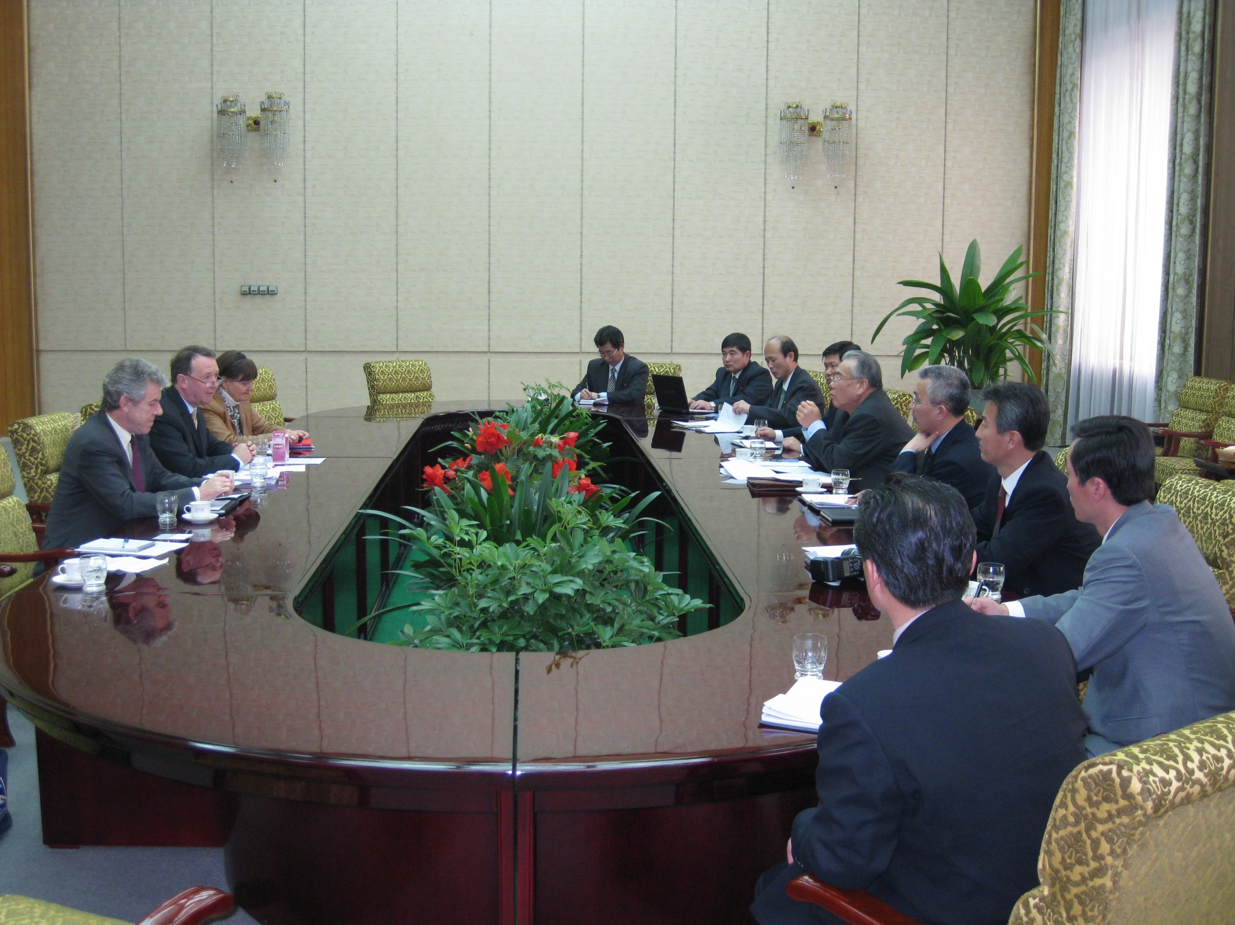

Slide 8
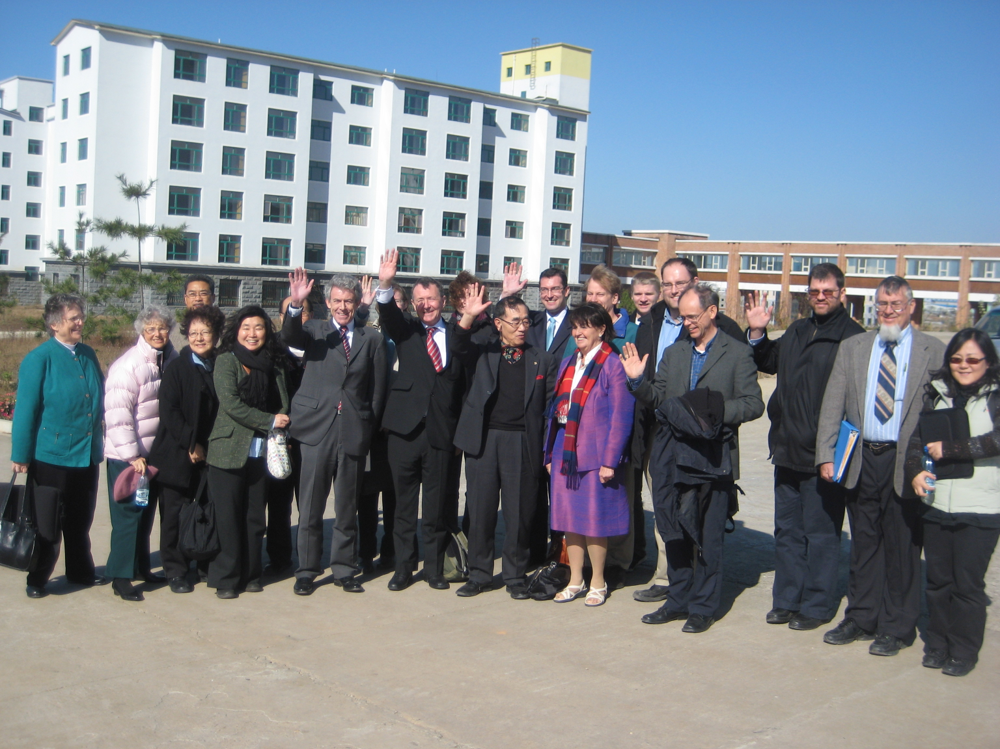
PUST on 248 acres – 600 students; teaching in English – producing a generation of future Korean leaders.

Slide 9

- Five points -
The subject of the lecture
An overview of the good and bad uses to which science can be put.
A summary
What the future holds.
What questions do we need to ask to find the most ethical path?

Slide 10
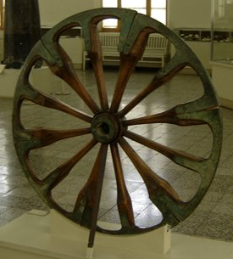
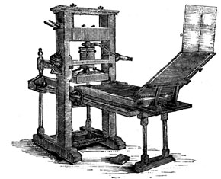
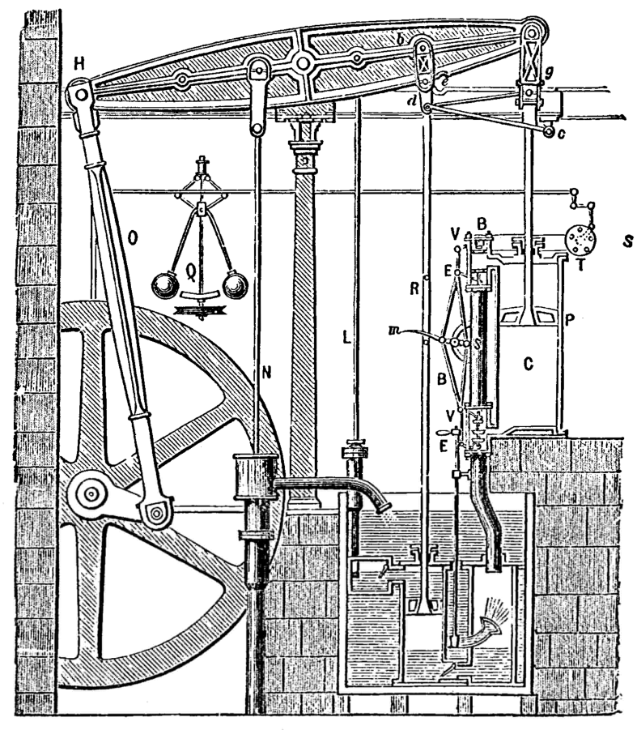
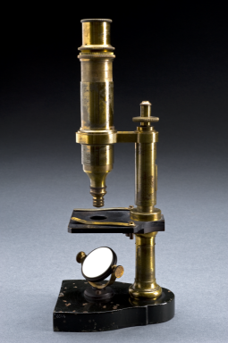
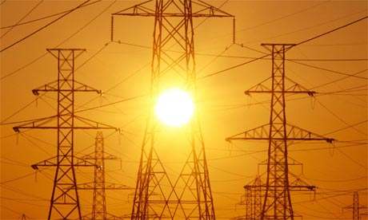
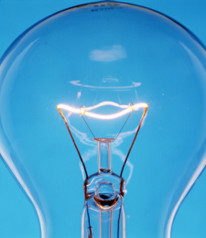
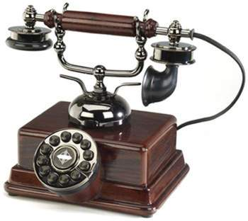
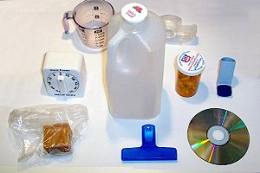
1. The subject of the lecture

Slide 11
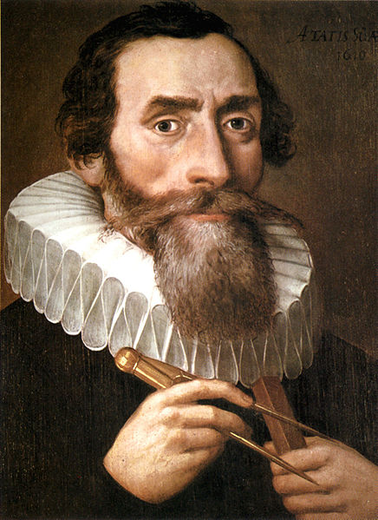
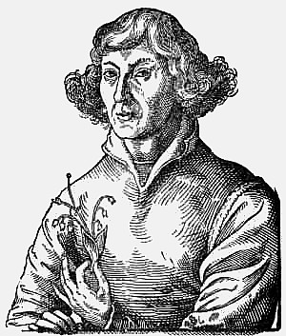
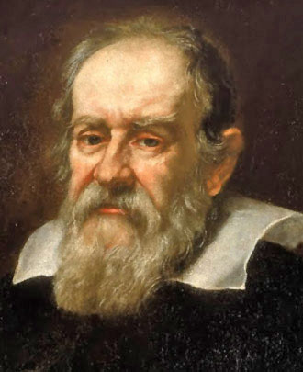
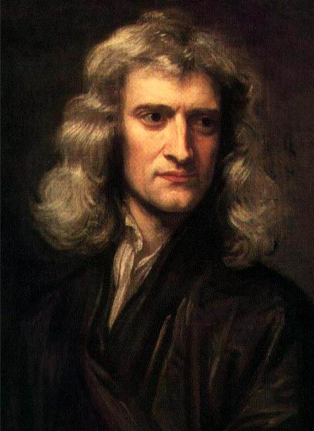
The subject of the lecture
Johannes Kepler
Nicolaus Copernicus
Galileo
Galilei
Isaac
Newton

Slide 12
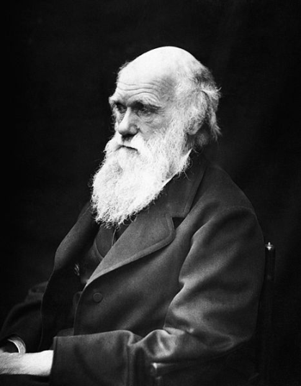
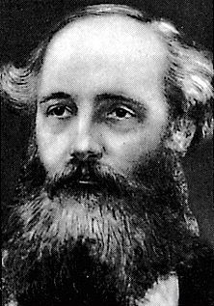
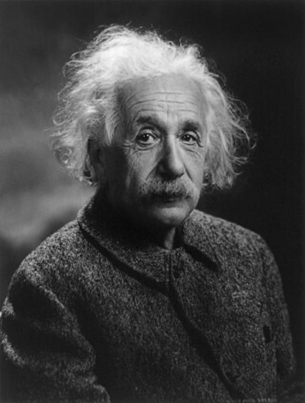
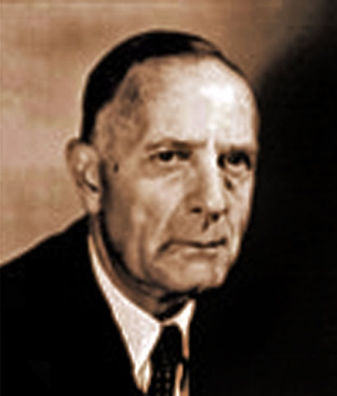
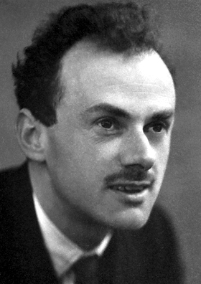
The subject of the lecture
Charles
Darwin
James Clerk-Maxwell
Albert
Einstein
Edwin
Hubble
Paul
Dirac

Slide 13
The subject of the lecture
During the last century mankind has made huge scientific advances, and that these have had unquestionable benefits for civilisation. Yet with these great achievements have come new challenges that we must overcome if this progress is to continue. The promotion of a good scientific education is essential if the multitude of problems we face are to be conquered.

Slide 14
The subject of the lecture
Some problems humanity faces:
Generation of safe, renewable energy in the face of growing global demand.
Feeding the world despite famines and increasing world population.
Saving lives through advances in medicine.

Slide 15
“We must reach for the skies”
“Good science and good ethics must march hand in hand.”

Slide 16
The subject of the lecture
Education of the citizen must above all underline the moral significance of self-knowledge – as agents in the way we live and affect others. We need citizens who embrace the idea of individual moral responsibility for their actions.
Unless we are able to conceive of ourselves as an agent or agents with regard to how we behave, it will be impossible to develop any sense of responsibility or judgement in the way in which we use science.

Slide 17
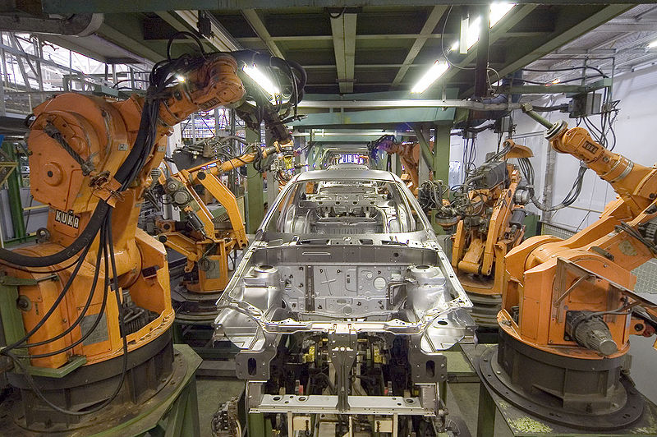
2. The good and bad uses of science
The introduction of a million industrial robots into a factory has consequences -
By automating essential but repetitive parts of the production process we can relieve workers from dull, menial tasks.
Discoveries have their consequences. In this case, it is leaving the workers without jobs, without income, without food and support for the families.

Slide 18
The good and bad uses of science
Climate change has become a serious issue for the international community.
The overwhelming scientific consensus is that the planet is changing in ways that will adversely affect lives everywhere, but particularly those in less well developed countries.
This is an issue that respects no borders and that all nations ignore at their peril.

Slide 19
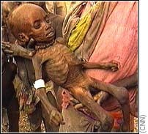
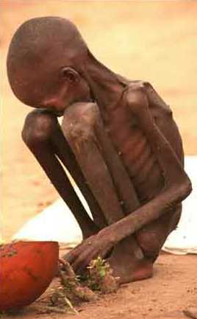
This is an issue that respects no borders and that all nations ignore at their peril.

Slide 20
The good and bad uses of science
The answer to this problem must come from the scientific community. There are precedents:
- Acid Rain
- CFCs and the Ozone Layer
- ‘Pea Souper’ fogs

Slide 21
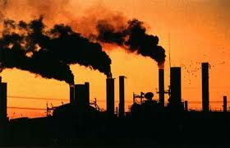
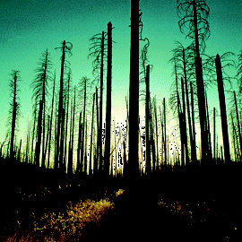
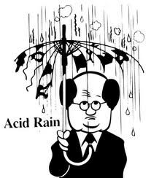

The good and bad uses of science

Slide 22
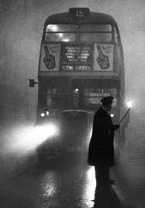
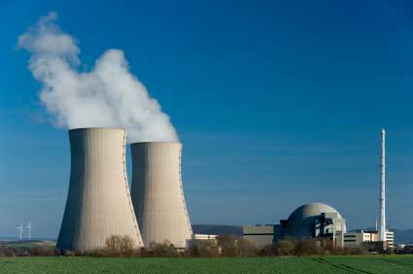
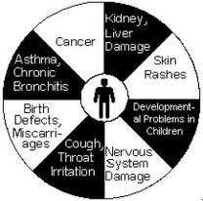
The good and bad uses of science

Slide 23
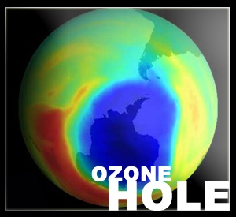
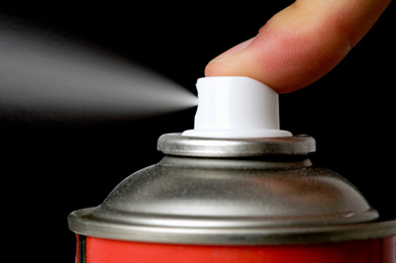
The good and bad uses of science

Slide 24
The good and bad uses of science
Now we must deal with the bigger problem that now faces us – the potentially catastrophic effects of releasing billions of tonnes of carbon dioxide into the atmosphere. Most climate scientists agree that if we do not cut down on these emissions, then many will soon pay the price.
We need new, clean methods of power production allowing us to become independent of fossil fuels, and carbon-capture technologies to prevent emissions at the source.

Slide 25
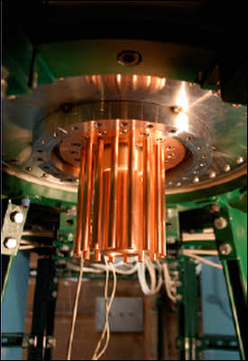
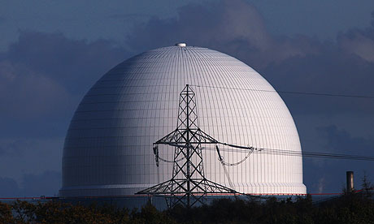
The good and bad uses of science
Nuclear power also has its part to play, despite the dark side of the technology. We must be wary of the problems caused by the difficulty of storing the radioactive waste products of nuclear fission, and of the potential for disasters.

Slide 26
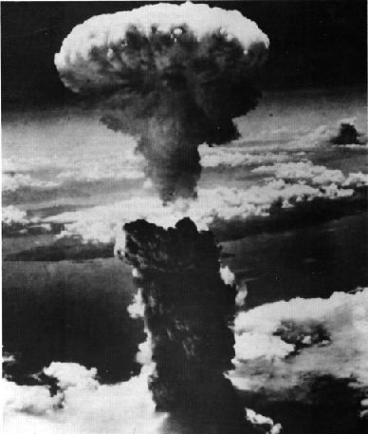
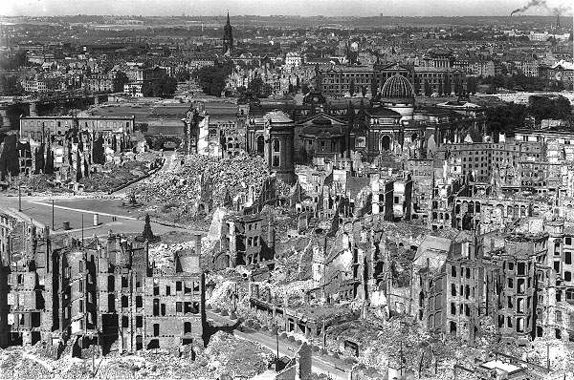
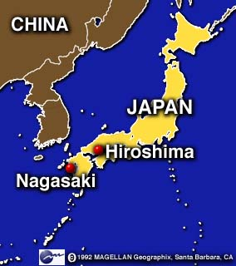
Hiroshima and Nagasaki

Slide 27
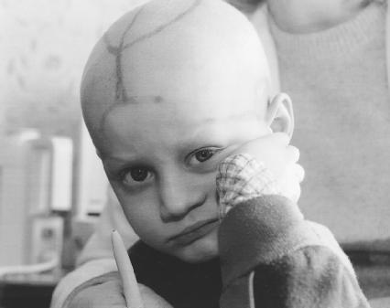
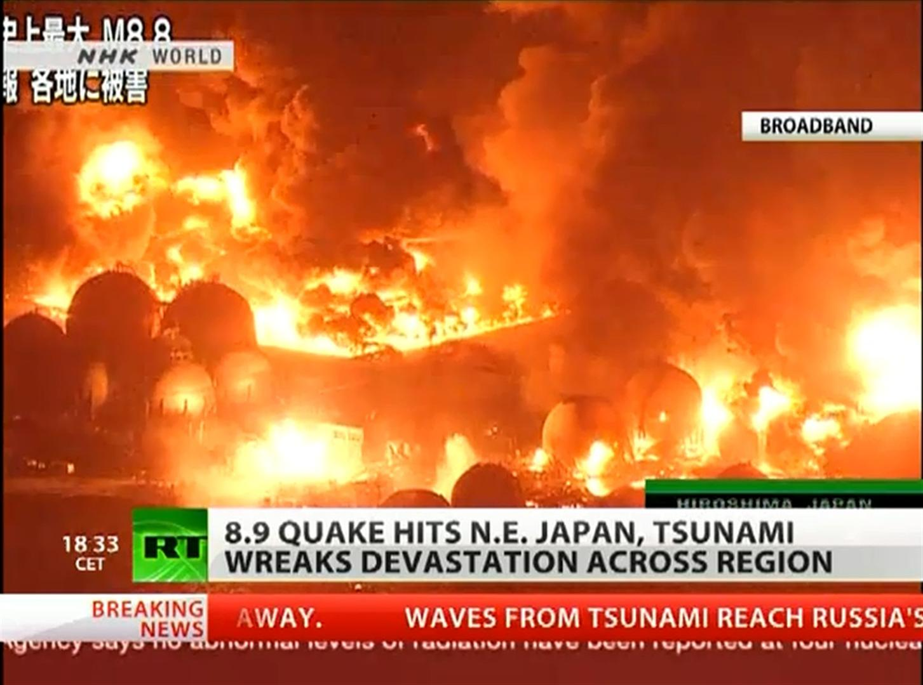
The good and bad uses of science
Chernobyl, Russia, 1986. Fukushima, Japan 2011

Slide 28
The good and bad uses of science
Developed safely, nuclear power could allow us to cut carbon emissions sooner rather than later. It is a technology symbolic of the struggle between the benevolent and malevolent uses of science.

Slide 29
The good and bad uses of science
Against the backdrop of these long-term, global problems to which science may hold the solutions, are more immediate, pressing problems, which are just as important.
I talked about drought and ensuing famine in Africa a moment ago, and at the beginning I said that our inability to feed everyone on the planet is one of the big problems humanity needs to solve; but again, if we use science wisely then this too may not be so intractable as it first appears.

Slide 30
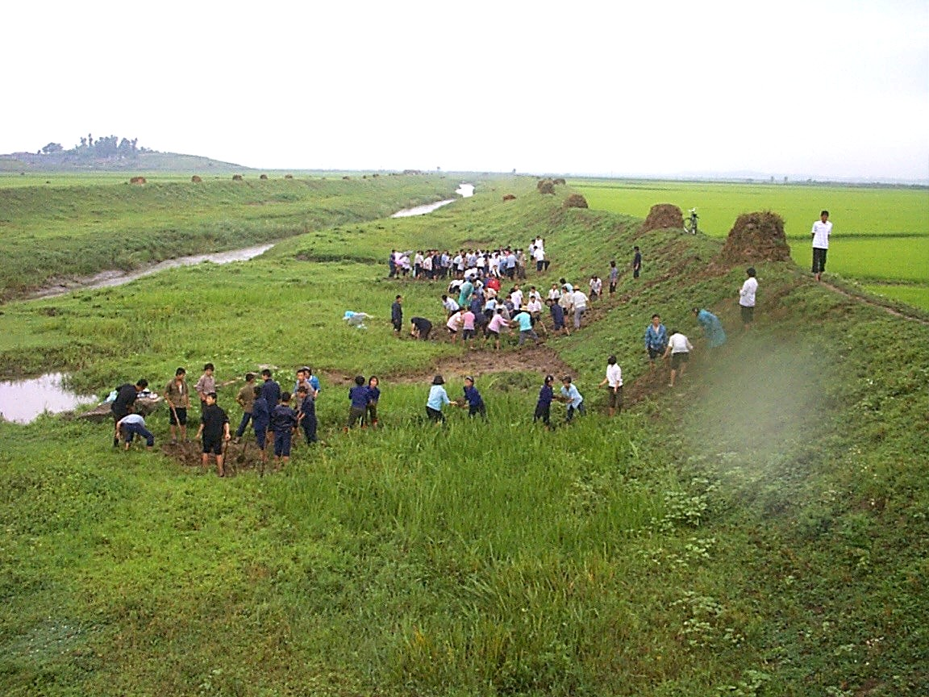
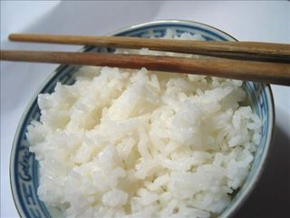
The good and bad uses of science
In North Korea itself, we can see how crop yields can be greatly increased by the introduction of irrigation systems, as was done in the paddy fields near Anju with the assistance of an Irish group called ‘Concern’. These increased the annual rice yield by around 30 tonnes per year.

Slide 31
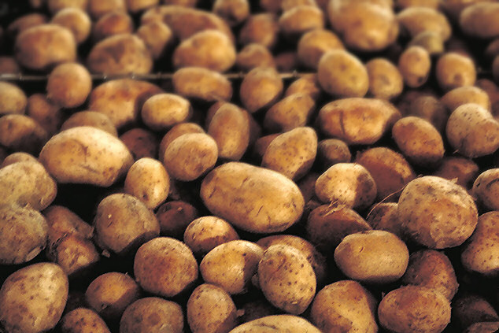
The good and bad uses of science
Genetic Modification technology has allowed another group, World Vision, to grow virus and drought-resistant potatoes here.

Slide 32
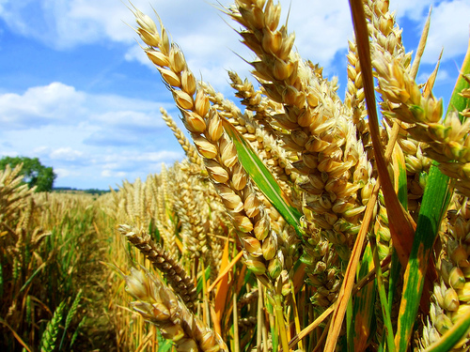
The good and bad uses of science
The technology is clearly very useful. It is an extension of the modification farmers in all countries have practiced for centuries, done by selective breeding of crops with desirable traits, but it is more direct and a lot quicker. Scientists must be aware of its good potential, but also of the ways in which it could be abused.

Slide 33
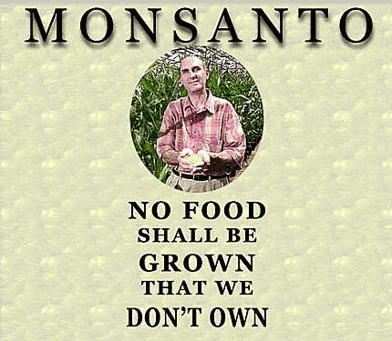
The good and bad uses of science
One company tried to research ways in which crops could be made to become sterile after one harvest, so that farmers would have to buy from them each year. This is not helpful: it is just profiteering.

Slide 34
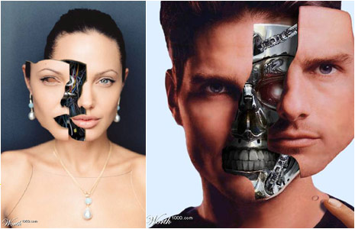
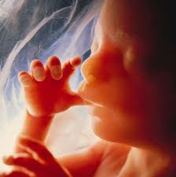
The good and bad uses of science
It would also be highly inadvisable to apply GM technology to humans. Many have argued that doing so would cause serious social problems due to the blurred distinction between those with modifications and those without.

Slide 35
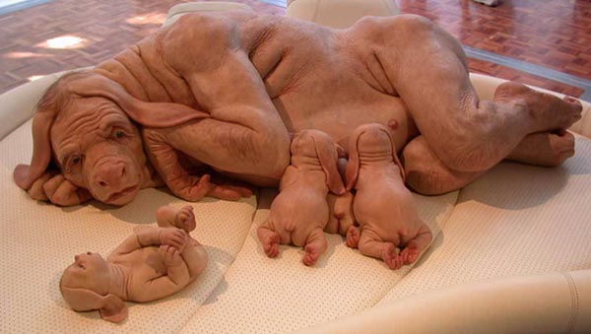
The good and bad uses of science
Once modifications have been made, they cannot simply be removed again. Moreover, using of this kind of technology on people would seriously violate human dignity. Testing modifications inevitably leads to some failures and it is morally indefensible to subject human life to that risk.

Slide 36

The good and bad uses of science
Medicine: For many people this is the branch of science most relevant to their own lives. Because here too we are dealing with human lives, the scientists engaged in medical research must be particularly careful to consider the moral implications of their work. Although medical advances make our lives longer and more comfortable, the end does not justify the means; some experiments must be off-limits.

Slide 37

The good and bad uses of science
Sometimes the immoral way is obvious.
In World War II German SS Officer Josef Mengele conducted so-called experiments on prisoners in the Auschwitz prison camp.
These involved such horrors as unnecessary amputation of limbs, injecting chemicals into the eyes of children and surgery without anaesthesia.

Slide 38

The good and bad uses of science
The absolute power Mengele was given over the camp prisoners corrupted him, and although he claimed that he did these evil things in the name of science, it was clear to witnesses that he was not doing them for any reason other than to exercise his own power.

Slide 39

The good and bad uses of science
It is a sobering thought that more than half of the participants at Hitler’s 1942 Wannsee Conference, which planned what was called “the final solution to the Jewish question” – that is the extermination and murder of Europe’s Jewish people – were either medical practitioners or in receipt of other academic doctorates. Nazi collaborators included a cast of scientists, doctors, judges, lawyers, philosophers and academics. It’s very easy to be corrupted.

Slide 40

The good and bad uses of science
In other cases, scientists may feel that what they are doing will lead to a useful outcome – a new treatment, a better understanding of the disease. Yet this does not mean that all methods are acceptable.

Slide 41

The good and bad uses of science
Stem-cell research: finding a way to produce cells that are able to divide and grow into any type of human tissue. Among other benefits, this would allow doctors to grow replacement organs for their patients and repair damaged nerves.
The problem: stem cells in adult humans do not have the capacity of the variety found in growing human embryos.

Slide 42

The good and bad uses of science
Some scientists were willing to experiment with embryonic stem cell, even though this destroys the human embryo they were taken from. Others refused to do this, believing that destruction of human life is morally unjustifiable.
In 2006 a team led by the researcher Dr. Shinya Yamanaka were able to modify adult stem cells to give them the ability to produce all tissue types, thus side-stepping the moral issue.

Slide 43
The good and bad uses of science
Sometimes when there is no legislation preventing a certain line of research, scientists must decide for themselves whether the research is morally justifiable, or whether they should find another way.
Science is as much about satisfying our own curiosity about the world as it is a source of beneficial technology, but not at any cost; a good ethical education is essential if scientists are to be able to see clearly and make sound judgements on the direction they take their work.

Slide 44

The good and bad uses of science
The decisions scientists make about what work is permissible determines the direction we steer our societies, and it is of paramount importance that the correct choice is made.
Perhaps the biggest changes to the world in the last two decades have been brought about by the advancement of computer technology.

Slide 45

The good and bad uses of science
In 1990 a British scientist called Tim Berners-Lee working at CERN, an international particle physics laboratory located in Switzerland revealed a technology that would allow networks all over the world to communicate – the World Wide Web.
Many of the technologies I have mentioned so far are only possible because of the huge scope for collaboration between scientists this allowed. Crucially, its inventors were not trying to make a profit.

Slide 46

The good and bad uses of science
Despite this, the technology has its dangers. The computerisation of banking and trading inevitably means we should prepare to have to deal with ‘cyber-crime’; criminals trying to use computers to steal.
On the other hand, it is becoming increasingly important in less-developed countries, where the spread of computer technology is starting to improve standards of education, and its capacity to unite disparate people and nations is perhaps its greatest strength.

Slide 47

The good and bad uses of science
It should be clear by now that while it is essential for scientists to think about the ethics of their work, it is not always straightforward to find the most ethical path. When they do recognise it, it is important to act.
In the nineteenth century Alfred Nobel, a Swedish chemist, invented dynamite and gelignite, powerful but stable explosives, to be used for mining and engineering purposes. His intention was to make explosive mining safer and prevent accidents.

Slide 48
The good and bad uses of science
Instead, his inventions were adapted for military purposes. This led to his unfair vilification, culminating in 1888 in his obituary in a French newspaper, mistakenly published after the death of his brother.
“The merchant of death is dead”
“He became rich by finding new ways to kill people faster than ever before.”

Slide 49


The good and bad uses of science
To ensure his legacy to the world was more positive, Dr. Nobel left almost his entire fortune to the establishment of a series of prizes in recognition of outstanding advances in the following:
Physics
Chemistry
Medicine
Literature
Peace

Slide 50
The good and bad uses of science
The Nobel prizes are now famous; they are Alfred Nobel’s legacy, and the thing he is most remembered for. He realised that despite his good intentions, his inventions had been used for unethical purposes, and so he dedicated his fortune to the advancement of ethical science – that is why although most of the prizes are for scientific endeavour, he also established a peace prize, awarded for contributions to world peace through the negotiation of peace treaties, reduction of standing militaries and development of closer ties between nations.

Slide 51

The good and bad uses of science
One recipient of the Peace prize was the Polish-born physicist Joseph Rotblat. I was privileged to meet him and to give the citation at my university in Liverpool, where I am a professor, when we conferred on him an honorary academic award.
He might initially seem to you an unlikely recipient: it was he whose experiments in nuclear fission that demonstrated that it was possible to set up a chain reaction that would lead to a sustained release of energy. He calculated that this release of energy could occur in a fraction of a second, leading to a massive explosion.

Slide 52
The good and bad uses of science
Before the Second World War broke out, he moved to the University of Liverpool, and so was not in Poland when Germany under the Nazis invaded.
He understood that his work could be used to manufacture a new, powerful type of bomb, and towards the end of the war, he joined the Manhattan project, believing that the Nazis were developing a nuclear bomb, and hoping to produce one first to act as a deterrent. Within a year it became clear that the Nazis had abandoned their project, and he left the project. He was the only scientist to leave the project on moral grounds before the production of the first bomb.

Slide 53

The good and bad uses of science
When the atomic bombs were dropped on Hiroshima and Nagasaki in Japan, Rotblat was appalled at the use his work had been put to. He became a medical physicist and began to research the effects of radiation, and helped demonstrate the harmful effects of the fallout from the bombs.
This helped lead to the Partial Nuclear Test Ban treaty, where many of the major nuclear powers of the time agreed to cease testing weapons above ground.

Slide 54
The good and bad uses of science
Rotblat campaigned vigorously against the nuclear arms race for the rest of his life and was eventually awarded the Nobel peace prize for this.
During his acceptance speech, he advocated the creation of an ethical code of conduct for scientists, of the kind he had adopted himself; an oath of moral responsibility for the consequences of their work; a vow to always act ethically. He concluded his speech with the words “Above all, remember your humanity.” – For it is in the moral principles common to all of us that the path to ethical science is to be found.

Slide 55

3. How do we find the most ethical path?
What questions do we need to ask as we scrutinise the world of science; what are the principles on which scientific work should be based and how do we instil a high concern for ethics into young scientists through education?
I argued earlier that it is essential that citizens gain a sense of individual moral responsibility and accept the duties and obligations that come with the privilege of sharing in the common life of a nation or community. Educating for good citizenship is educating us to know ourselves.

Slide 56
How do we find the most ethical path?
If we were to educate for citizenship and ethics we would enshrine the duties of each person: to live peaceably; to participate in civic institutions and the processes of local and national government; to contribute to the resourcing of commonly beneficial institutions; to acquire knowledge and to encourage the pursuit of knowledge in children; to learn respect for the needs of others; to behave ethically; and to appreciate how legitimate rights have been acquired, and to cherish them.

Slide 57

How do we find the most ethical path?
In the West, Aristotle's ancient virtues can continue to inform the debate about how we educate for good ethics and good citizenship. They are:
Justice
Wisdom
Temperance
Courage
Magnanimity
Tolerance
Munificence
Prudence
Gentleness

Slide 58

How do we find the most ethical path?
In the East, Aristotle's belief in the promotion of personal virtue sits well alongside the Confucian concept of ren: “compassion” or “loving others.” For Confucius, such concern for others is demonstrated through the practice of forms of the Golden Rule:
“What you do not wish for yourself, do not do to others.”
“Since you yourself desire standing then help others achieve it; since you yourself desire success then help others attain it.”
He teaches that such altruism can be accomplished only by those who have learned self-discipline.

Slide 59
How do we find the most ethical path?
If such indispensable virtues – which united East and West - are not passed from generation to generation, civic fabric is bound to crumble.
The virtues are acquired by practice. They are internal qualities perfecting the interior persona and, thus deeply affecting society as a whole.

Slide 60

How do we find the most ethical path?
In ‘The City in History’ Lewis Mumford said:
"Before modern man can gain control over the forces that now threaten his very existence, he must resume possession of himself. This sets the chief mission for the city of the future: that of creating a visible regional and civic structure, designed to make man at home with his deeper self and his larger world, attached to images of human nature and love which cultivate humanity; traditional family and community structures sacrificed in the name of progress.”

Slide 61

How do we find the most ethical path?
Education, and formation of the masses, must enrich the intellect, cultivate virtues and good tendencies, and engender a spontaneous uprightness of the will, and shape instincts and conscience. If it does not then technology and science will be used for purposes which threaten humanity. Good science and good ethics must be fellow travellers.

Slide 62

How do we find the most ethical path?
If science is guided by these strong principles then it takes on real power to better the lot of humanity as a whole. What is more, by recognising that we are all working towards these goals, which means working for all, not just for oneself, we can foster lasting peace and prosperity with the nations of the world working together in scientific endeavour. What cannot be achieved by one alone can be achieved by many, and it is no surprise that many of the greatest projects being worked on today are international efforts. I want to talk about three in particular; and this brings me to my fourth point.

Slide 63

4. What the future holds

Slide 64




What the future holds
CERN:

Slide 65





What the future holds
The International Space-Station:

Slide 66






What the future holds
Nuclear Fusion Power:

Slide 67

5. Summary
Science has the potential to cause problems for humanity, but also to bring us solutions. It has the power to harm, but also the power to help. It should always be at the service of humanity and work for the common good.
The only way to ensure that the pursuit of science is in the interests of mankind is, through education, to instil a sense of moral responsibility and an understanding of ethics in the next generation, so that they can evaluate right and wrong for themselves and always look for the most ethical route.

Slide 68

Summary
Every State takes its inspiration from the values of its citizens and these values of duty, respect, responsibility, reciprocity, and good stewardship of what has been entrusted to us must be passed from generation to generation. A high sense of ethics does not come about by itself. And how then does this affect the pursuit of science?
If I can paraphrase Albert Einstein, science that is devoid of ethics is lame; ethics or philosophy without an understanding of science is blind. At all costs we must avoid a clash of fundamentalism, what the English writer, Matthew Arnold, in his poem, “Dover Beach” described as a place “where ignorant armies clash by night.”

Slide 69

Summary
Einstein asserted that misuse of science could only be countered “by those who are thoroughly imbued with the aspiration toward truth and understanding. …I cannot conceive of a genuine scientist without that profound faith.”

Slide 70

Summary
H. G. Wells, understood what would happen if we fail to appreciate the role of education in fostering civilised society, where personal civic responsibility is cultivated in each person, insisting that
"Maintaining civilisation is a constant race between education and catastrophe".
To avoid catastrophe, then, we must educate and always educate for virtue.

Slide 71


“If you want to plant for one season, plant a seed; if you want to plant for ten years, plant a tree; but if you want to plant for life, give a young man or woman an education.”

Slide 72


Summary
Charles Dickens immortalised the Victorian headmaster, Thomas Gradgrind, in Hard Times. As a teacher Gradgrind is obsessed with facts and the pursuit of materialism and he never sees education as being about values or about the deepening of a man’s mind. His is an emotionally cold world, devoid of love or encouragement; it is a world of numbers and memorised rote learning but not a world of humanity, compassion, or gentle intellectual inquiry.

Slide 73
Summary
Gradgrind is ultimately a teacher of failure and in his personal life he is a father of failure – his son becoming a thief.
Education must always be about far more than the memorising of facts. That is a belief which I know is part of the spirit and ethos of PUST.

Slide 74

Summary
Let me end with the first words of the Confucian classic, “The Great Learning”, where it is said
“The way of great learning consists in manifesting one’s bright virtue, consists in loving the people, consists in stopping in perfect goodness.”
I hope that “the great learning” will animate many of you here today and that through it you will achieve that “perfect goodness.”

Slide 75
THE END

