Slide 1
What Easter Means To Me
David Alton
April 2012
www.davidalton.net

Slide 2
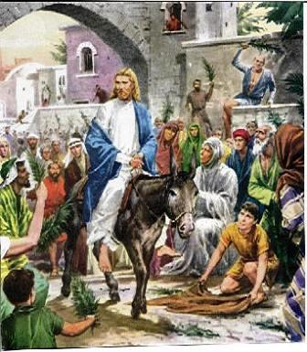

Slide 3
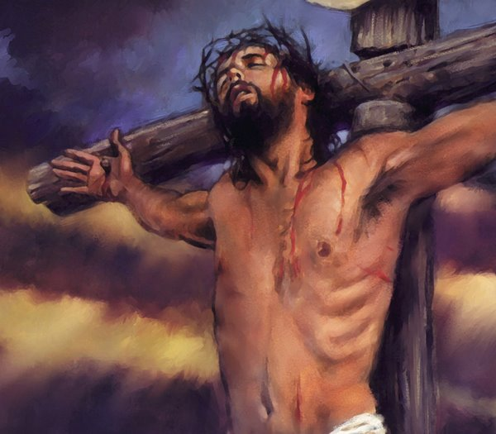

Slide 4
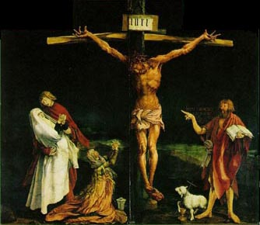

Slide 5
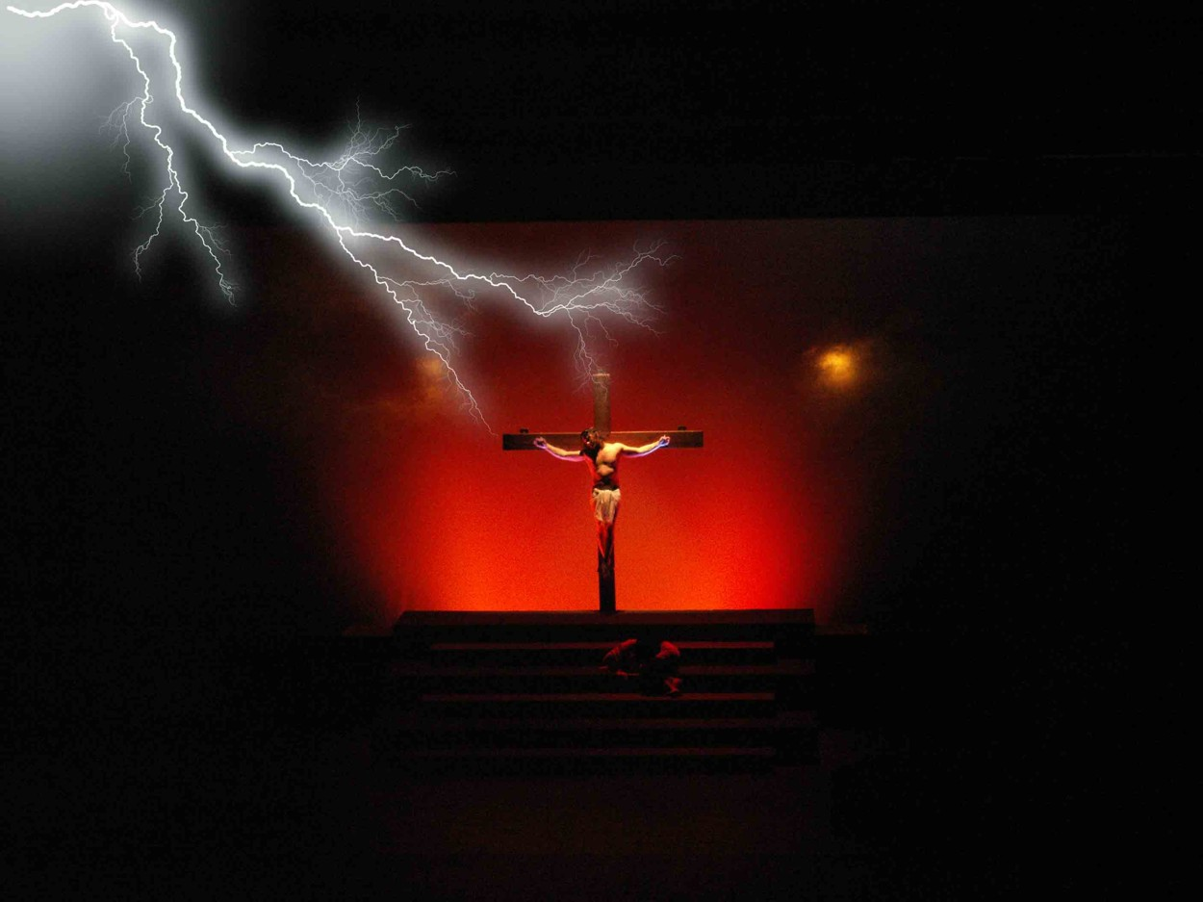

Slide 6
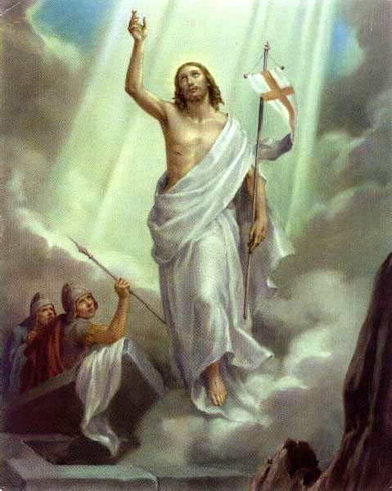

Slide 7
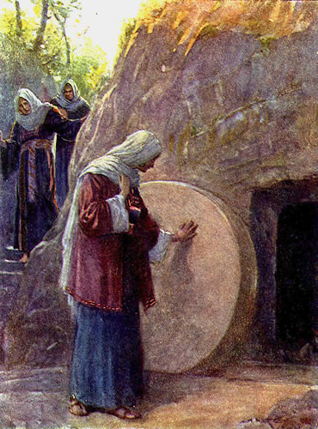

Slide 8
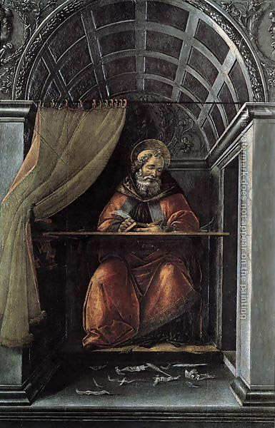
“And he departed from our sight that we might return to our heart, and there find Him. For He departed, and behold, He is here” – St.Augustine of Hippo

Slide 9
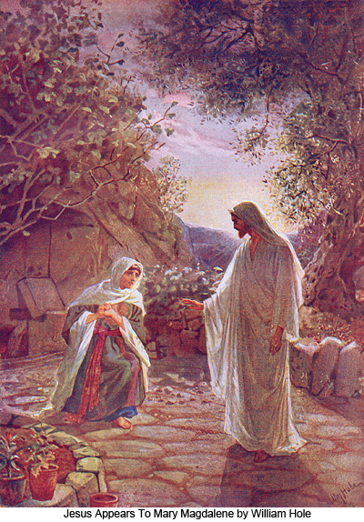

Slide 10
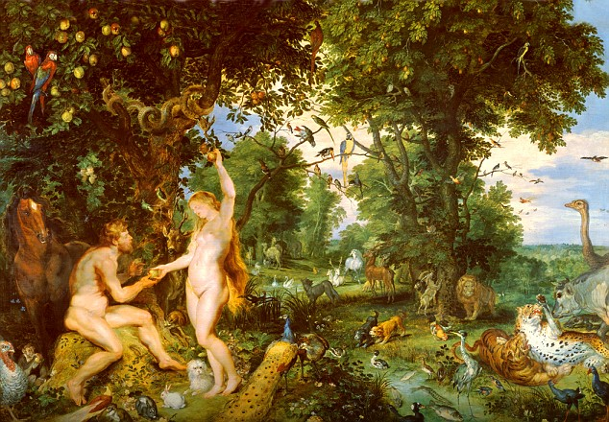
The Bible Begins and Concludes in a Garden

Slide 11
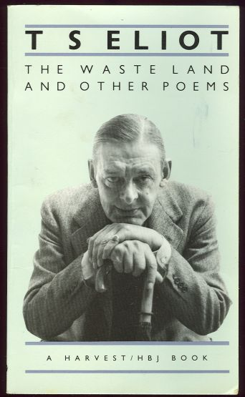
April is the cruellest month, breeding
Lilacs out of the dead land, mixing
Memory and desire, stirring
Dull roots with spring rain.
Winter kept us warm, covering
Earth in forgetful snow, feeding
A little life with dried tubers.

Slide 12


Slide 13
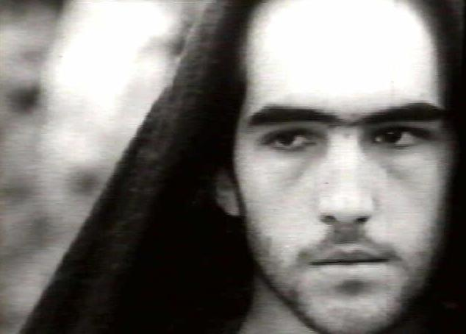
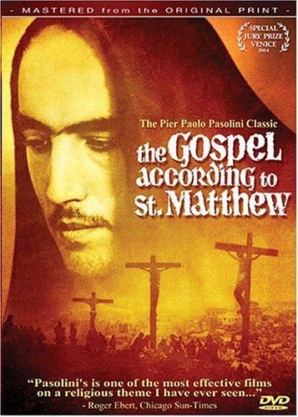

Slide 14
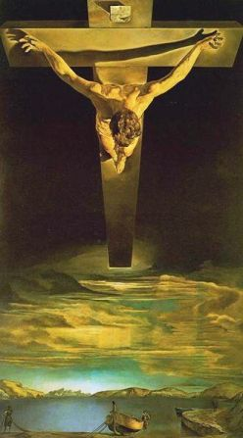

Slide 15
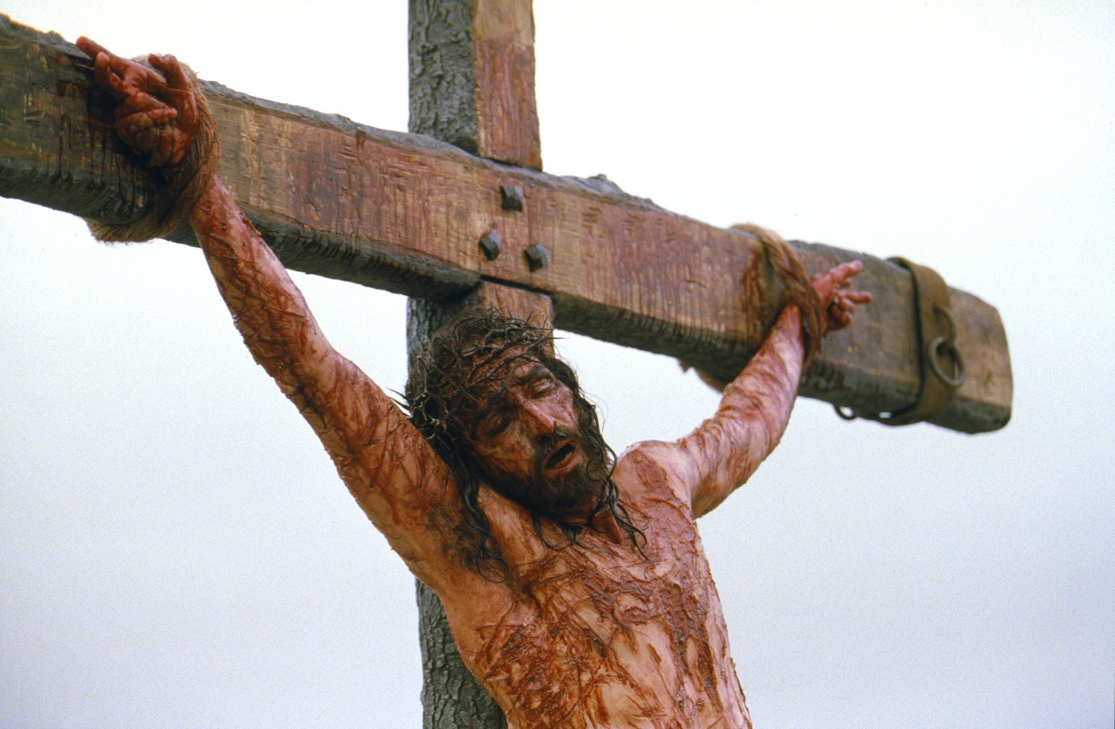

Slide 16
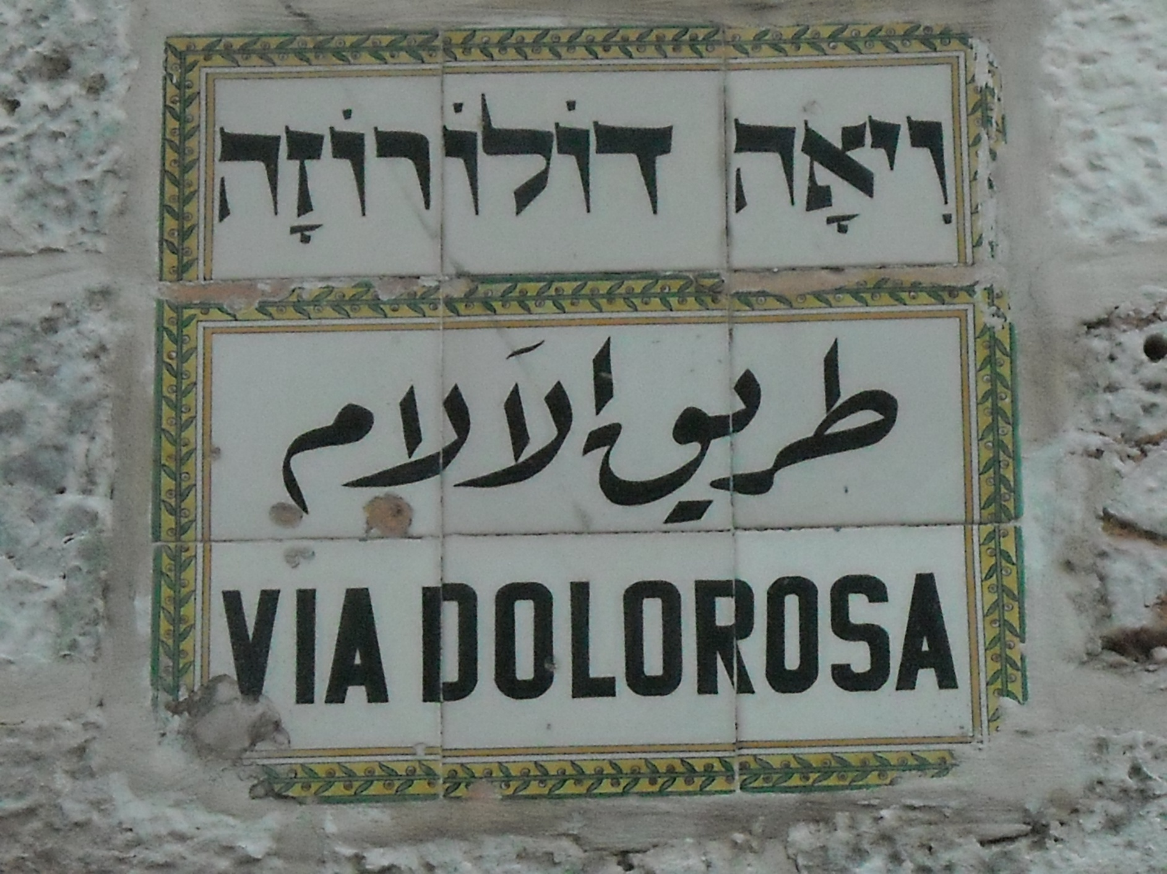

Slide 17
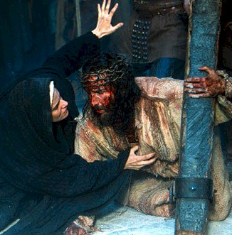

Slide 18
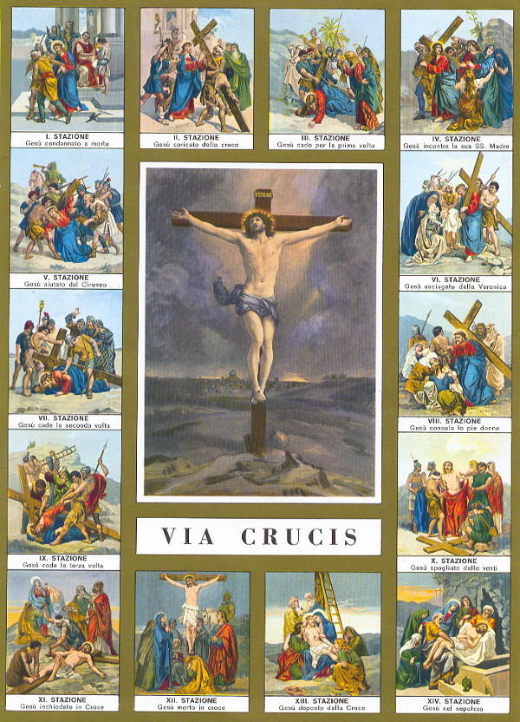

Slide 19
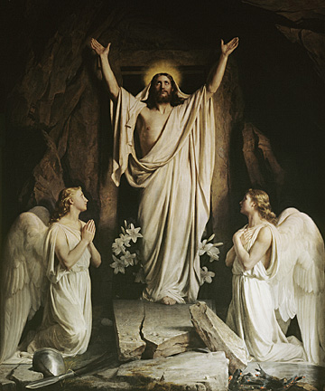

Slide 20
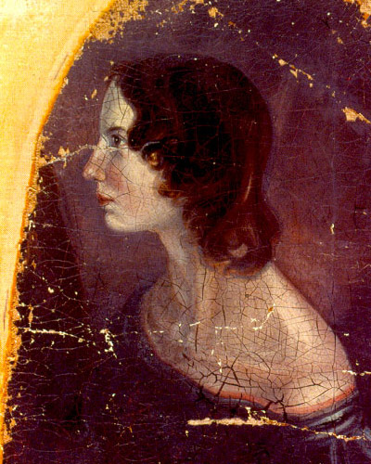
“There is not room for Death,
Nor atom that his might could render void:
Thou - Thou art Being and Breath,
And what Thou art may never be destroyed”
- Emily Bronte

Slide 21
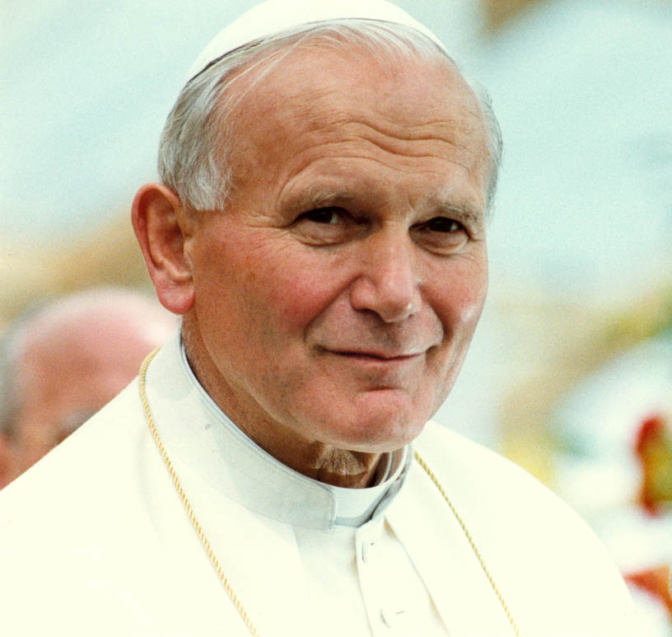
“ the new springtime of the human spirit.”

Slide 22


Slide 23
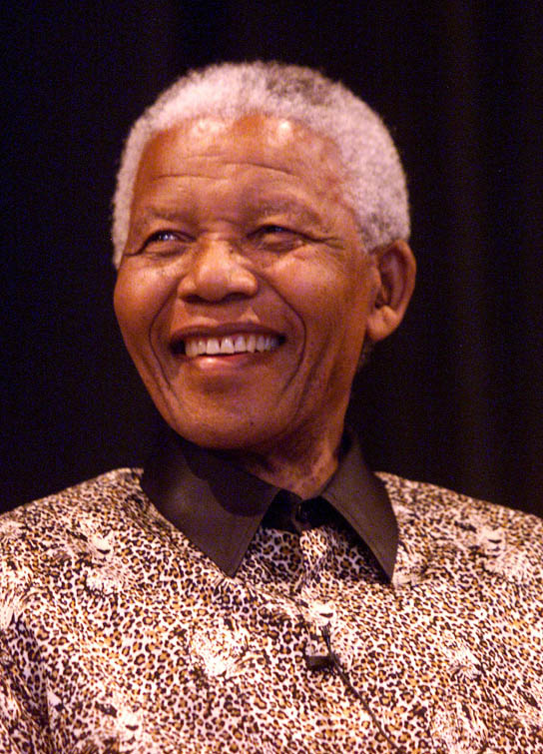
umuntu ngumuntu ngabantu – a person is a person because of other people.

Slide 24
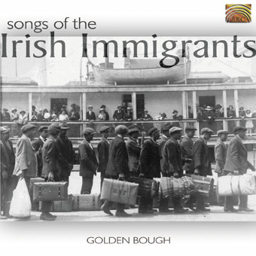
“it is in the shelter of each other’s lives that the people live.”

Slide 25
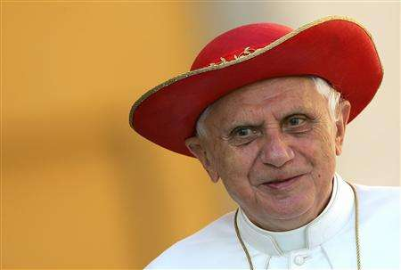
Deus Caritas Est
“Abject poverty is an offence
against human dignity.”

Slide 26
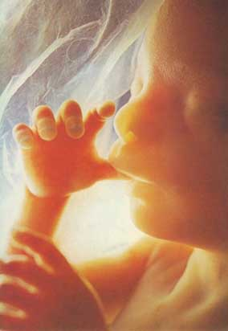
7 million babies aborted since 1967;
600 each day;
disabled babies aborted up to birth;
Since 1991 2 million human embryos destroyed;
therapeutic cloning since 2001;
animal human hybrid embryos 2008.

Slide 27
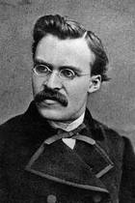
“You have your way. I have my way. As for the right way, the correct way, and the only way, it does not exist.
Friedrich Nietzsche

Slide 28
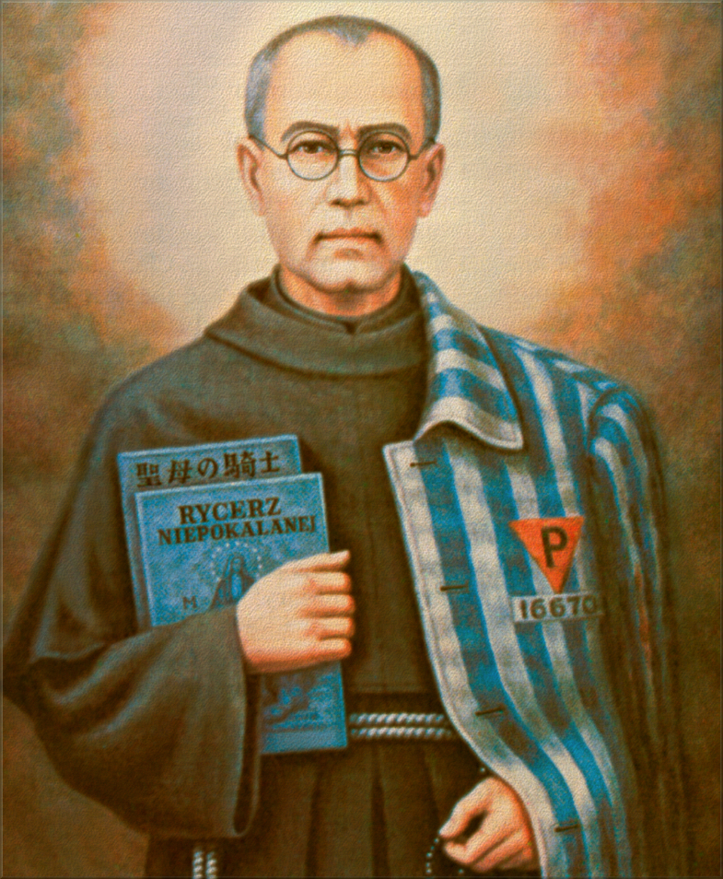

Slide 29
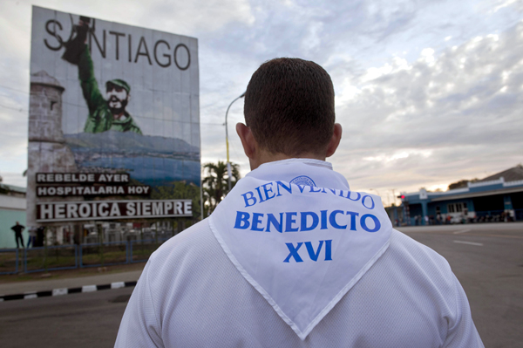
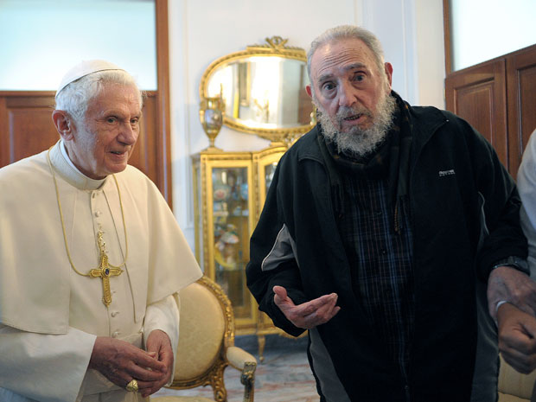
2012 Pope Benedict in Cuba with Fidel Castro

Slide 30
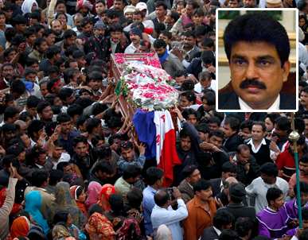
Shahbaz Bhatti murdered in 2011

Slide 31

"I am a Christian, and indeed a Roman Catholic, so that I do not expect ‘history’ to be anything but a long defeat - though it contains (and in a legend may contain more clearly and movingly) some samples or glimpses of final victory."
- Tolkien

Slide 32
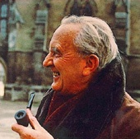
“I might say that if the tale is 'about' anything it is not as seems widely supposed about 'power.' …It is mainly concerned with Death and Immortality.”
- Tolkien in 1958 in a letter to Rhona Beare

Slide 33
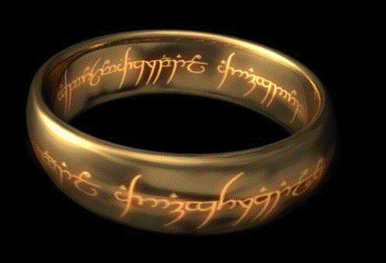
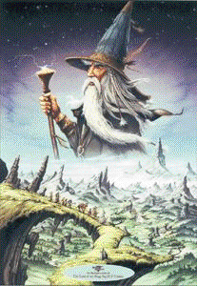
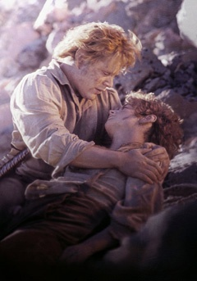
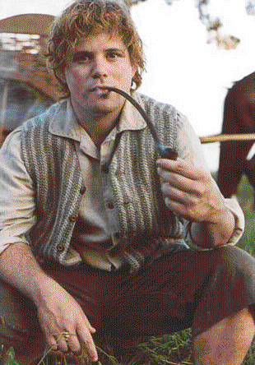
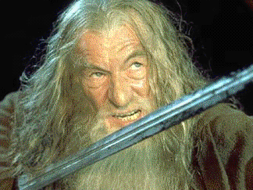
The long defeat of history is turned into victory
The Fellowship of the Ring:

Slide 34
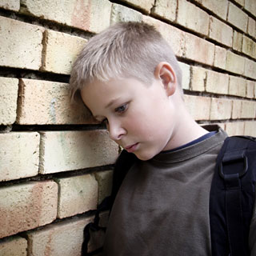
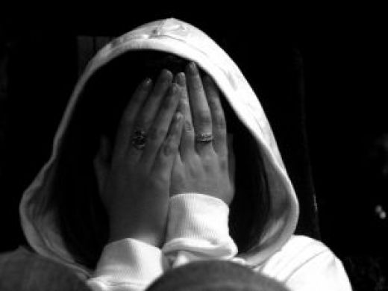
The Via Dolorosa of Child Abuse

Slide 35

The Brothers Karamazov
“I feel joy and peace for the first time after so many years. There is heaven in my heart…Now I dare to love my children and to kiss them” - Dostoyevsky
Properly understood, Easter gives each of us the same opportunity to start again.

Slide 36
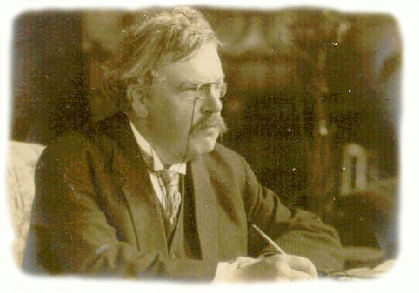
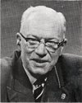
William Barclay and G.K.Chesterton
"pride is the ground in which all other sins grow, and the parent from which all other sins come."
“Pride doesn’t go before a fall, it is the fall.”

Slide 37
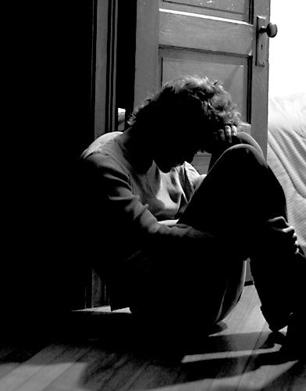

Slide 38
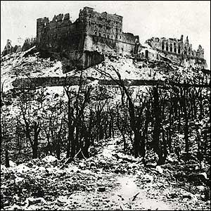
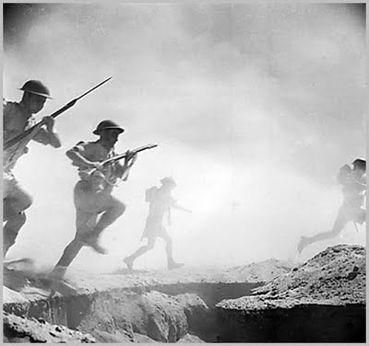

Slide 39
House of Lords Select Committee
“Dying is not only a personal or individual affair. The death of a person affects the lives of others, often in ways and to an extent which cannot be foreseen. We believe that the issue of euthanasia is one in which the interest of the individual cannot be separated from the interest of society as a whole”.

Slide 40
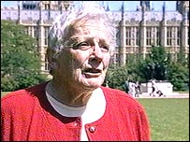
Don’t Waste Our Resources
If you’re demented, you’re wasting people’s lives - your family’s lives - and you’re wasting the resources of the NHS”.
- Baroness Warnock, The Times, October 10th 2008.

Slide 41
Gender Abortions
Eugenic Abortions
Destruction of Human embryos
Animal human hybrid embryos
The killing of the infirm and elderly
What is the answer to the culture of death: The 6th Commandment

Slide 42
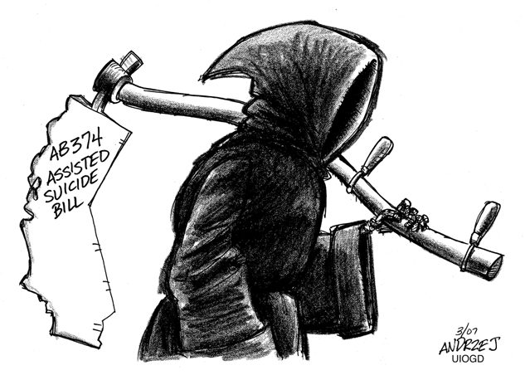
Usurping the role of the Creator and denying the possibility of a good death

Slide 43
"Three rings for the Elven-kings under the sky,
Seven for the Dwarf-lords in their halls of stone,
Nine for Mortal Men doomed to die…"
The Silmarillion puts it like this:
"Death is their fate, the gift of Iluvatar, which as Time wears even the Powers shall envy. But Melkor has cast his shadow upon it, and confounded it with darkness, and brought evil out of good and fear out of hope."
A Culture of Life v A Culture of Death

Slide 44
Evangelium Vitae
“To claim the right to abortion, infanticide and euthanasia, and to recognise that right in law, means to attribute to human freedom a perverse and evil significance: that of absolute power over others and against others. This is the death of true freedom.”

Slide 45

"The highest form of hope is to triumph over despair; to hope is to run the risk. It is, in fact, the risk of risks."
Georges Bernanos

Slide 46
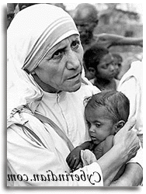
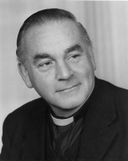


Slide 47
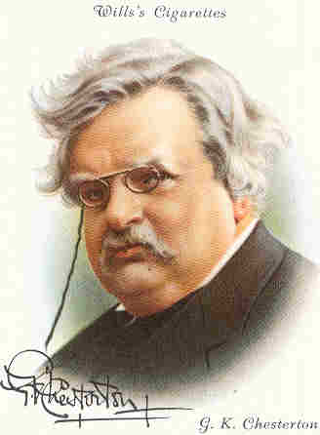
"These are the days when the Christian is expected to praise every creed except his own."

Slide 48
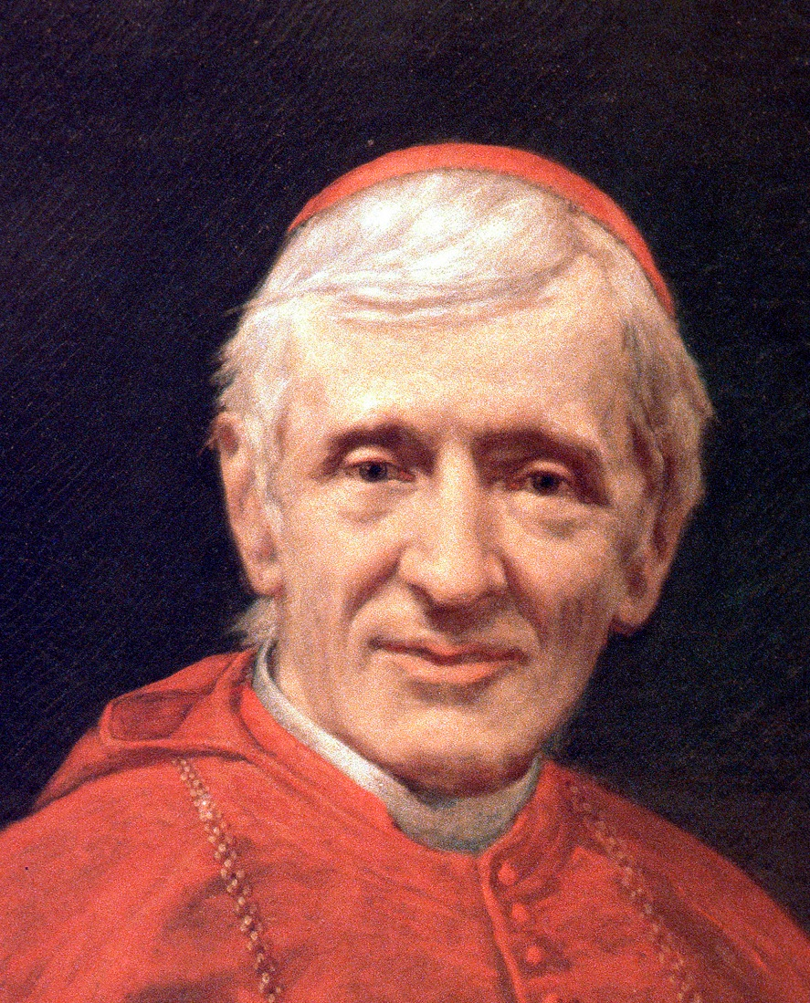
“A man would do nothing if he waited until he could do it so well that no one could find fault.”
Cardinal John Henry Newman

Slide 49
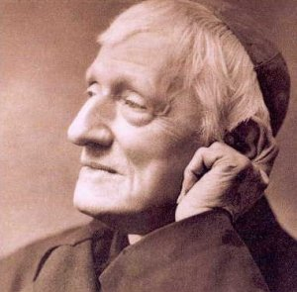
John Henry Newman
“We are not born for ourselves , but for our kind, for our neighbours, for our country: it is but selfishness, indolence, a perverse fastidiousness, an unmanliness, and no virtue or praise, to bury our talent in a napkin”

Slide 50
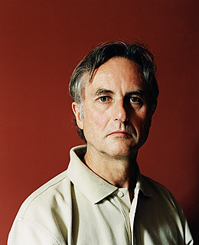

Richard Dawkins and Philip Pullman

Slide 51



Slide 52


“refreshing the parts other beers cannot reach.”

Slide 53
“Undoubtedly there is a God – now stop worrying and enjoy your life.”

Slide 54

“Wherever the Catholic sun does shine there is always laughter and good red wine. At least, I have always found it so, Benedicamus Domino!”

Slide 55



Slide 56

Faith can be more like a hospital pass….

Slide 57



Slide 58



Slide 59

“if there were no God, there would be no atheists”
- G.K.Chesterton

Slide 60


India cannot be proud of the way it treats the Dalits or its religious minorities

Slide 61




Slide 62

C.S.Lewis
Educators are “the conditioners”

Slide 63

The Road To Jericho

Slide 64

Contemporary Slavery: North Korea – 200,000 in its gulags

Slide 65


Shin Dong-Hyok
Shin Dong-Hyok --: on April 6th 1996, he was forced to watch as his mother and brother were publicly executed

Slide 66



Yoo Sang-joon: a Korean Raoul Wallenberg

Slide 67

Jeon Young-Ok
Jeon Young-Ok: “They tortured the Christians the most.
They were denied food and sleep.
They were forced to stick out their tongues and iron was pushed into it."

Slide 68

8,000 Korean Martyrs

Slide 69


CHINA

Slide 70


Tibet: 6,000 monasteries destroyed

Slide 71





Slide 72

The empty tomb in Jerusalem

Slide 73

“the undiscovered country from whose bourn no traveller returns”

Slide 74

Ernst Bloch
“It wasn't the morality of the Sermon on the Mount which enabled Christianity to conquer Roman Paganism, but the belief that Jesus had been raised from the dead. In an age when Roman senators vied to see who could get the most blood of a steer on their togas--thinking that would prevent death--Christianity was in competition for eternal life, not morality."

Slide 75

The sages have a hundred maps to give
That trace their crawling cosmos like a tree,
The sages have a hundred maps to give
That trace their crawling cosmos like a tree,
They rattle reason out through many a sieve
That stores the sand and lets the gold go free:
And all these things are less than dust to me
Because my name is Lazarus and I live –
Chesterton, The Convert, 1922.

Slide 76

Do not ask where was God at Auschwitz, ask where was man?”

Slide 77
An Easter Carol – Phillip Brooks
Tomb, thou shalt not hold Him longer;
Death is strong, but Life is stronger;
Stronger than the dark, the light;
Stronger than the wrong, the right...”

Slide 78
What Easter Means To Me
David Alton
April 2012
www.davidalton.net

