Slide 1
Promoting and Preserving Catholic Culture and Identity In Such a Time As This
Celebrate 2013
www.davidalton.net

Slide 2
Catholic culture and Catholic identity – an impossible dream?
Self evidently, in a society which suggests it is illegal to wear a cross; to say prayers before a public meeting; to celebrate uniquely Christian festivals, feasts or seasons; unacceptable to hold views on the human person or marriage which are not majoritarian; or to run institutions on uniquely Catholic lines, it is inevitably going to make it difficult to sustain our Catholic identity – difficult perhaps, but despite the changing nature of our world, Is the preservation of Catholic Culture an Impossible Dream?”

Slide 3
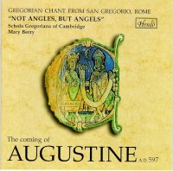
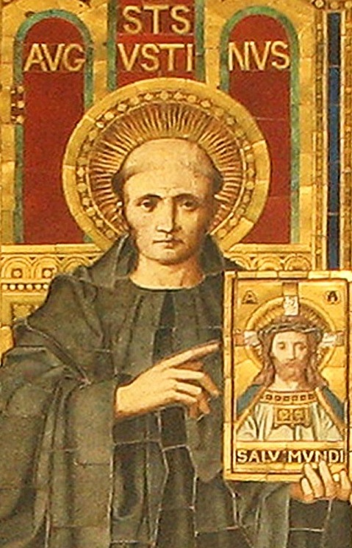
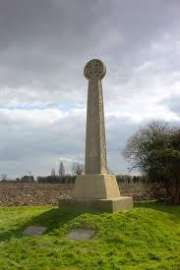
St.Augustine arrives at Ebbsfleet in 597

Slide 4
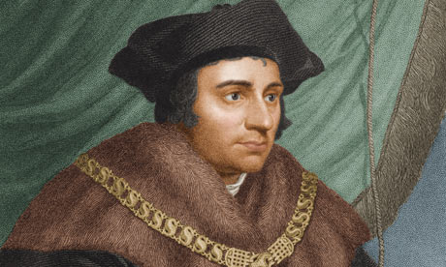
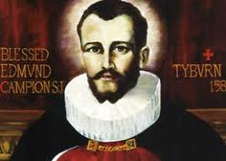
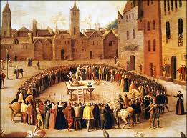
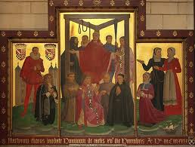
Execution of Thomas More in 1535 and Edmund Campion in 1581

Slide 5
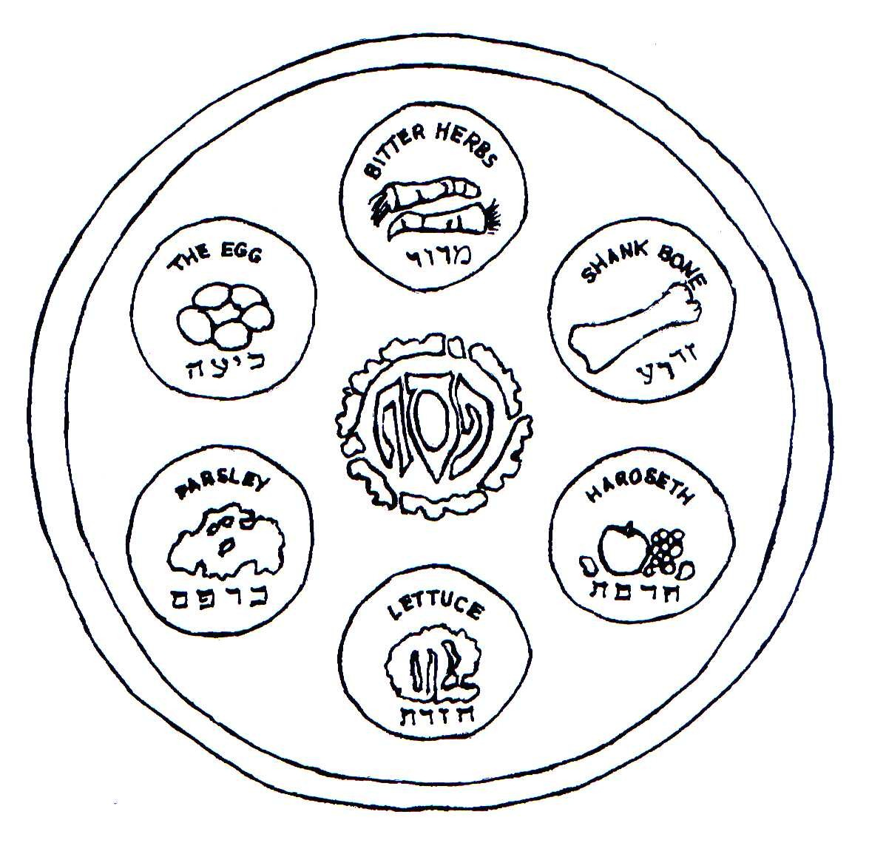
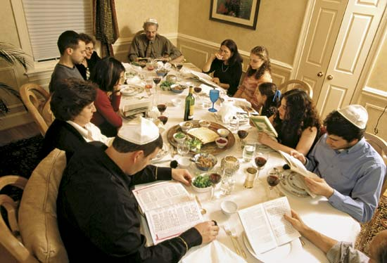
The Seder Meal

Slide 6
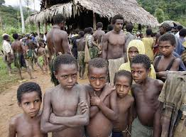
To educate a child you need the whole tribe

Slide 7
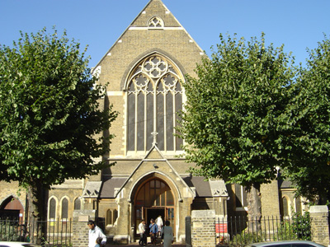
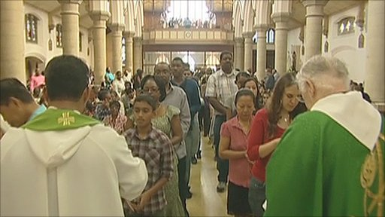
St.Anthony’s Forest Gate, London.

Slide 8
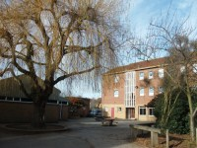
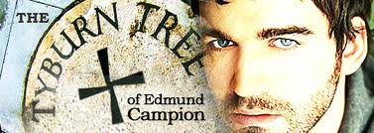
Edmund Campion School, Hornchurch – founded by Jesuits in 1962

Slide 9
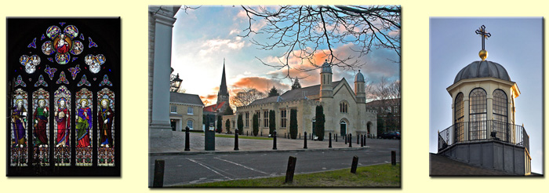
My excellent primary school education was provided by Sisters of Mercy and along with all the rudiments of elementary education I was taught the basics of the Catholic faith. Parochial life and school life were completely interwoven – and whether it was May or Corpus Christi Processions, preparing for first holy Communion or Confirmation, helping at church bazaars, joining the parish cub and scout packs, serving Sunday Mass, or raising money for children in the Congo, it was all part of the web and weave of Catholic identity and Catholic culture.

Slide 10
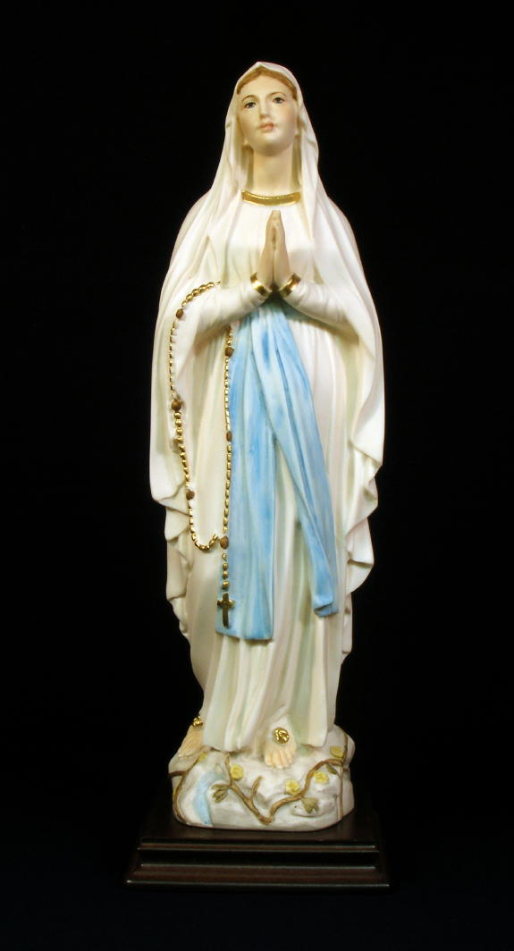
As you walk through the door of that school fifty years later you are still met by the gaze of the Lady who watches over the place. Underneath her statue is a plaque marking the death of the school’s first headmaster, Fr.Michael Fox SJ. He invested every last bit of energy in building the school and getting it open. Fr.Fox died just weeks later. If sacrifice for the common good is at the heart of Catholic identity perhaps that plaque tells its own story.

Slide 11
Hay on Wye Literary Festival
One particularly vituperative and vitriolic attack on the Catholic Church, by a lady author promoting her latest book at the Hay on Wye Literary Festival, said “no respectable person should have anything to do with the Catholic Church.” I don’t know what her personal experiences had been but I didn’t recognize the caricature and nor would the parents of the 750,000 children who battle to get their children into the countries 2,200 Catholic schools.

Slide 12
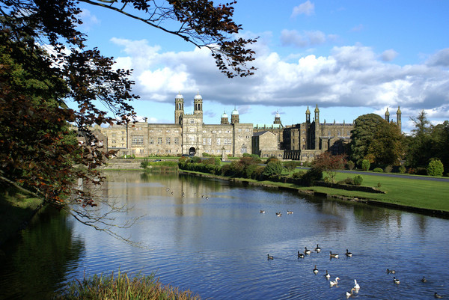
Stonyhurst College

Slide 13
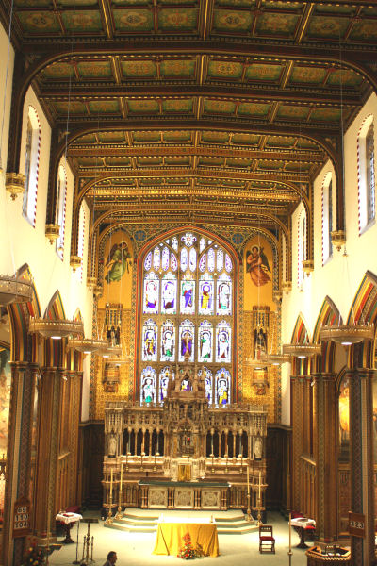
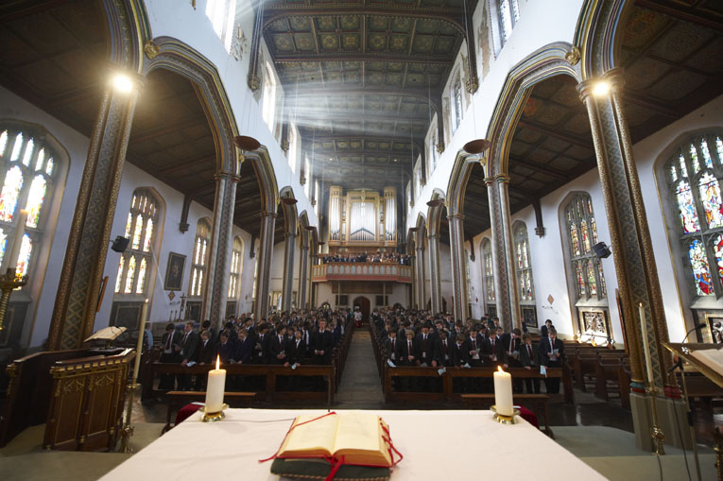
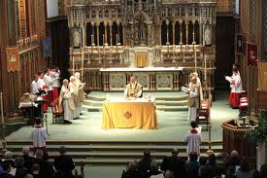
St.Peter’s Church Stonyhurst

Slide 14
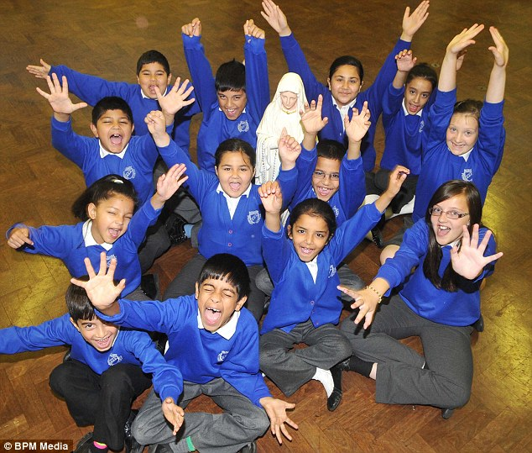
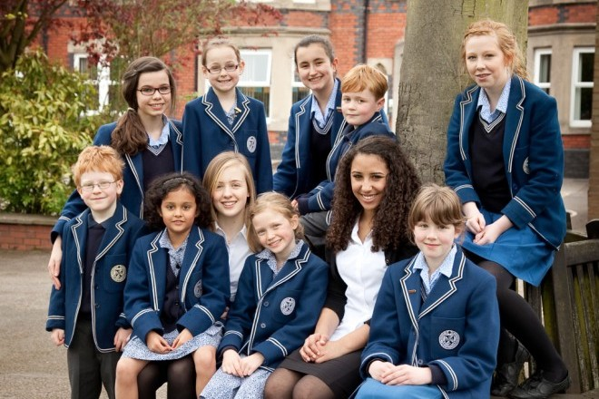
In the reign of Elizabeth II, we have seen an extraordinary blossoming of Catholic educational provision. When she ascended the throne, sixty years ago, there were 2.8 million Catholics in England and Wales. Today, there are over 4 million. In 1952 there were 1,488 voluntary aides schools, today there are 2,131 – and a further 147 independent Catholic schools. They form 10% of the country’s schools. In 1952 525,437 children were educated in Catholic schools. Today it is nearly 837,000. Whether we do enough to cultivate our identity and to tell our story in those schools is a legitimate question – but these schools represent an amazing opportunity.

Slide 15
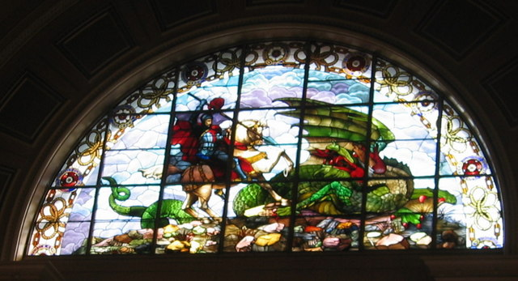
St.George’s Hall Liverpool

Slide 16
If you were to hold up a mirror to our diverse nation you would find nowhere more representative than Catholic schools – with 31% f pupils from ethnic minority backgrounds (compared with 26% nationally); and that 18.6% live in the most deprived areas (14.3% nationally).
That these schools are chosen destinations for the churched and unchurched alike is demonstrated by waiting lists and demand. That they achieve good results is testified by their above average Contextual Value Added scores (57% for primary and 65% for secondary compared with 50% and 53.2% nationally) and 74% of Catholic primary schools are judged good or outstanding by Ofsted (66% nationally). At age 11 Catholic schools outperform the national average in English and Maths SAT’s scores by 5% and at GCSE they outperform the national average by 6%. More important than all this is the mandate Catholic schools have to tell our children the story of Faith and to pass on our identity to them.

Slide 17
The Catholic School on the Threshold of the Third Millennium says we must restore to “the educational process te unity which saves it from dispersion amid the meandering of knowledge and acquired facts, and focuses on the human person in his or her integral, transcendent, historical identity.” It’s where the Mystery of the Word made flesh and the mystery of man, his purpose and destiny, become clear. Ideally, this approach will be reinforced by strong family and parish community ties.

Slide 18
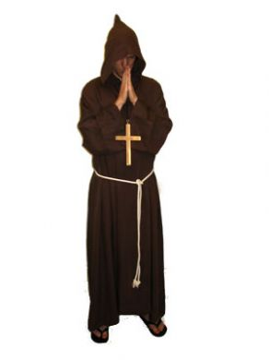
It was a Benedictine monk who offered the wry observation that in the end the real purpose of Catholic education is about teaching a person how to face death. Beyond the SATs and Contextual Added Value scores lies a more profound reason for wanting a Catholic education for your children – it is the desire to know God, to know the man made in His image, to know how to live and how to die. There would be no point in keeping the word Catholic in the names of our schools if they cease to educate for our relationships with one another, with God and for the never ending struggle between vice and virtue.

Slide 19
A.M.D.G. Ad maiorem Dei gloriam
Stonyhurst’s story demonstrates that a steadfast faith and patriotic love of country are not incompatible Their school has produced more saints and beatti than any other, along with seven Victoria Crosses. It planted several daughter schools and Jesuit educational values – creating men and women for others – have inspired many who work in Britain’s Catholic schools. In turn it supports schools for the poor in Zimbabwe and promotes three things: AMDG – that everything will be committed to the greater glory of God; Quant je puis – to do all that I can; and to form men and women for others.

Slide 20
At a time when the Church often looks defensive and feels itself under attack, it is worth reiterating that Britain’s Catholic schools are a great success story for the Catholic Church. They have proved to be an extraordinarily safe environment with an ethos which forms good citizens and good values; providing a ladder of learning which has offered phenomenal opportunities and social mobility – a singular contribution to stability and the common good. Their mandate is a love of God and a love of man. All of us who have experienced it, as parents, teachers, governors, or a child in a Catholic school – and I have been all three in both the voluntary aided and independent sectors – believe that our schools represent the fulfilment of what must have seemed impossible to the bedraggled founders of Stonyhurst and the mainly poor immigrant families who built the wave of schools which followed the 1944 Education Act.

Slide 21
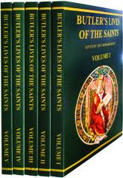
Archbishop Hinsey sent R.A.Butler a copy of Butler’s Lives of the Saints

Slide 22
Catholic Herald 1943
“…As a whole it is fairly true to say that our Catholic reactions to the thought of .a new Education Bill can largely be construed by our enemies as those of a body concerned with sectarian rather than rational and fully Christian training. Such an idea is, of course, preposterous; but it is true enough that many of our opponents hold it.
It is high time we did more to bring to the notice of the whole citizen body of this country the simple truth that Catholics more than anyone else care desperately for the establishment of a just social order, equal educational and vocational opportunity, and the fullest dissemination of information and perfect training for a useful life. More than that, we want to make sense of all these proposals by making sure they have a Christian foundation— the surest guarantee of their permanence”.

Slide 23
Making the dream unattainable…
Schools and institutions which are truly and faithfully Catholic – and do not diminish their mandates as to be indistinguishable from their secular counterparts – are the most successful and the ones in greatest demand. Accommodation of the mores of society or the ideology of the State – in order to preserve funding streams or because those running the institutions have themselves become unchurched and no longer believe in the principles which led to the establishment of the institution – will certainly make the dream unattainable.

Slide 24
The Catechism of the Catholic Church (2221) insists that “the right and duty of parents to educate their children is primordial and inalienable.” It also says that the State must permit parents to choose a school which ‘corresponds to their own convictions” . The Church holds that it ranks as an injustice when the State alone seeks the right to maintain schools or merely tolerates independent schools. Canon Law insists that “Catholic parents must have a real freedom in their choice of schools.”

Slide 25
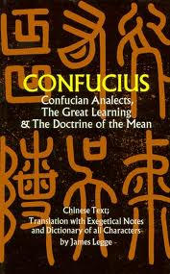
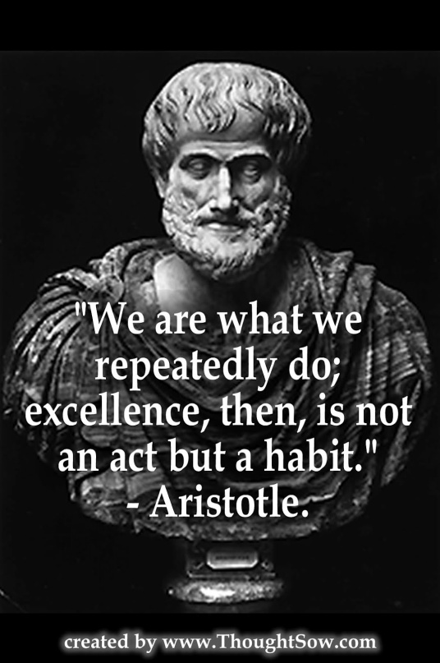
The first words of the Confucian classic, “The Great Learning”, says that “The way of great learning consists in manifesting one’s bright virtue, consists in loving the people, consists in stopping in perfect goodness.”
That love of the “the great learning” and the stress which another of the ancients, Aristotle, places on the educating for virtue, represents the best investment which we can make for future peace, harmony and prosperity. In both the East and West we must fully understand the necessity of investing in education and in promoting a virtuous education; not one which is values free..

Slide 26
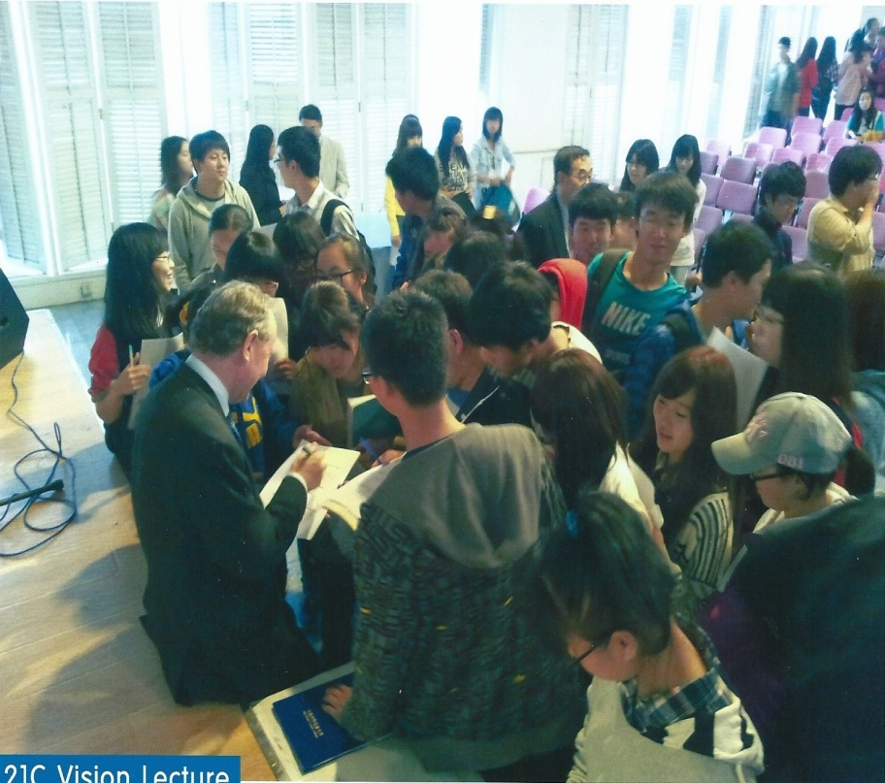
There is an Oriental proverb which states that “if you want to plant for one season, plant a seed; if you want to plant for ten years, plant a tree; but if you want to plant for life, give a young man or woman an education.”

Slide 27
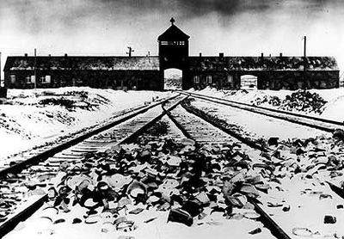
Hitler’s 1942 Wannsee Conference, planned what was called “the final solution to the Jewish question”

Slide 28
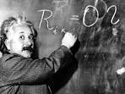
Einstein asserted that misuse of science could only be countered “by those who are thoroughly imbued with the aspiration toward truth and understanding. …I cannot conceive of a genuine scientist without that profound faith.” Imbuing such a faith must surely be a central objective of education.

Slide 29
Hinduism sees the idea of ahimsa as pivotal. Ahimsa proclaims a rejection of the use of force and all that is harmful. For Mahatma Gandhi the ancient ahimsa was promoted as non-violence in all spheres of life including the political realm.
Alongside the cultivation of harmony the objective of educators should be the inculcation of compassion and the promotion of peace.
For the Buddhist all life is suffering. But karuna – the concept of compassion in Buddhism - mitigates the suffering through an outpouring of compassion and encourages each encounter with humanity and nature to be based on metta - loving-kindness.
For Jews the Hebrew word shalom (like the Arabic word salaam, used by Muslims, and derived from the same word root) has a more substantive meaning than the English word peace. Jews use the word as a benediction or a blessing and the implicit prayer that the person so greeted will reach a place of contentment, happiness wholeness and inner peace.

Slide 30
Mahatma Gandhi once said: “You must be the change you want to see in the world” whilst Confucius offered sage advice to anyone who wants to see change: “To put the world right in order, we must first put the nation in order; to put the nation in order, we must first put the family in order; to put the family in order, we must first cultivate our personal life; we must first set our hearts right.”

Slide 31
The Catholic convert and Nobel Peace Laureate and eighth President of South Korea, Kim Dae Jung, understood the importance of personal transformation as the preparation for political life. In his Prison Letters, he wrote that: “We have to be reborn every day and make fresh progress every day. The object of our conquest is ourselves. We have to fight and conquer that self that is complacent, the self that tries to escape, the self that is arrogant and the self that is carried away by a single moment of success.”

Slide 32
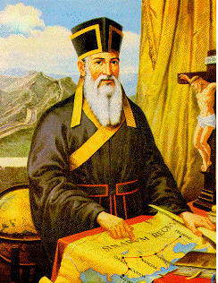
Chinese officials awarded Ricci the epithet “Wise Man of the Great West.” Ricci’s willingness to understand and embrace science and learning allowed him to also share his belief in God and the tenets of Christianity. He didn’t water down his identity but evangelised through fides et ratio – faith and reason.

Slide 33
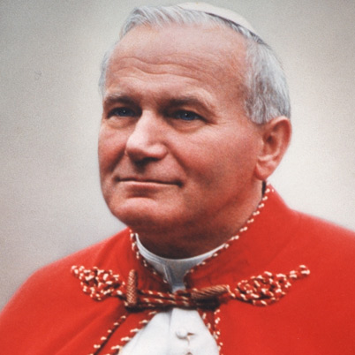
As followers of God’s Son we must therefore be willing to be “signs of contradiction” and “not to be afraid” - as Pope John Paul II put it – and willing to question the materialism, consumerism and anti life attitudes of our society; and we must be signs of hope in a despairing world. …If we fail to promote our cultural identity we will rapidly forget our special story and both those who follow us and society more generally will lose a pearl of great price.

Slide 34
“Good is never accomplished except at the cost of those who do it, truth never breaks through except through the sacrifice of those who spread it” and we should be encouraged by his admonition that “If a man waited until he was perfect he would wait for ever.” – John Henry Newman. So what are we waiting for? www.davidalton.net

