Slide 1
Paying a Price For Belief
Brentwood: March 12th 2014.
.
www.davidalton.net

Slide 2
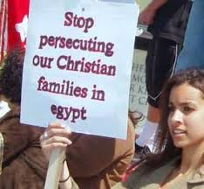
Barely a day passes without reports of some new atrocity being committed against Christians. These are four stories from the last few days from just one country - Egypt

Slide 3
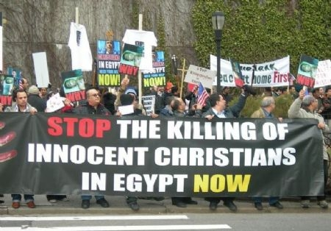
More than 100,000 Copts have left Egypt during nine months last year

Slide 4
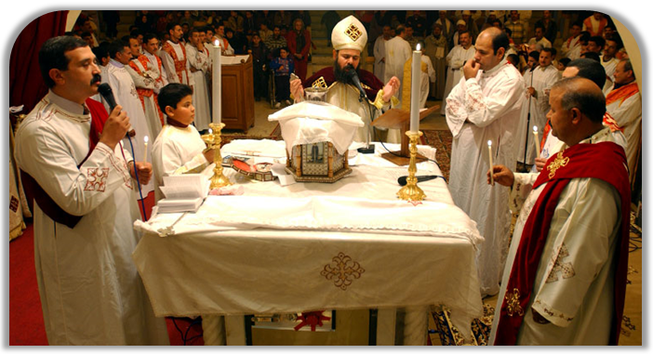
"Copts are not emigrating voluntarily; they are coerced into that by threats and intimidation of hard-line Salafists, and the lack of protection they are getting from the Egyptian regime".

Slide 5
We are in complete denial about the existence of religiously motivated persecution in countries like Nigeria or Syria, Pakistan, Indonesia, Sudan, Iran, Egypt, China and North Korea.

Slide 6

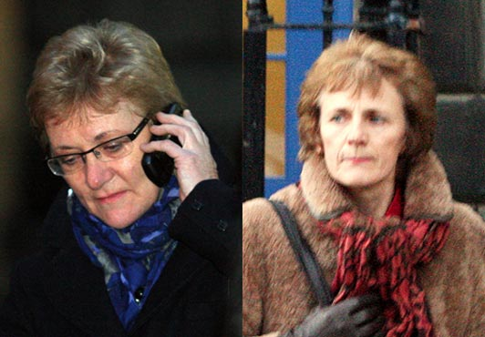
Scottish Catholic midwives ordered to take part in abortions

Slide 7
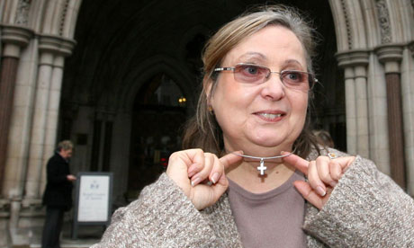
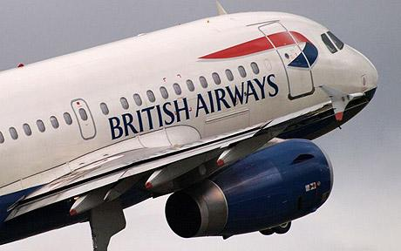
British Airways go to Court to stop Nadia Eweida from wearing a cross around her neck

Slide 8
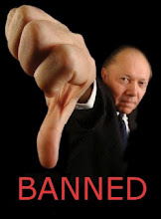
Yorkshire College removes Easter and Christmas from the calendar in case it offends people; Perth Hospital told to remove Communion Table; Bideford Council told to ban prayers.

Slide 9
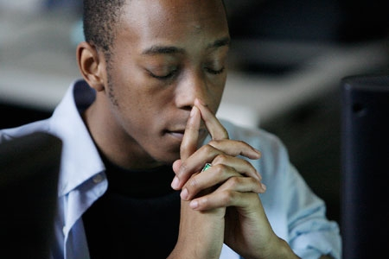
A poll showed that more than four out of five churchgoers
(84 per cent) think that religious freedoms,
of speech and action, are at risk in the UK. A similar proportion (82 per cent)
feel it is becoming more difficult to live as a Christian in an increasingly secular country.

Slide 10
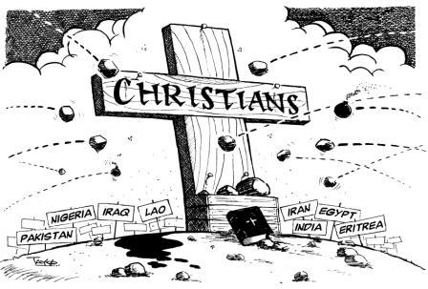
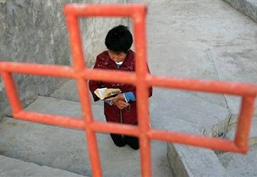
The two greatest fault lines of our times are the fault lines between Christianity and secularism and Christianity and Islam.

Slide 11
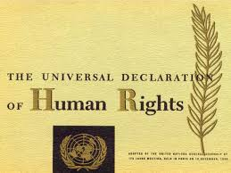
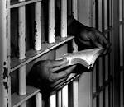

Slide 12
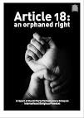
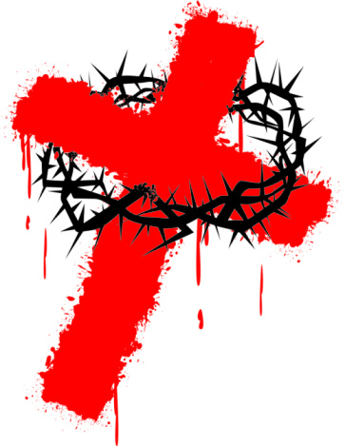
“Everyone has the right to freedom of thought, conscience and religion;
this right includes freedom to change his religion or belief, and freedom,
either alone or in community with others and in public or private,
to manifest his religion or belief in teaching, practice, worship and observance.”
Article 18 - An Orphaned Right

Slide 13

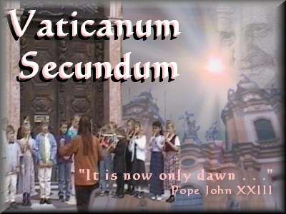
"A society which promotes religious freedom will be enlivened and enriched; one that doesn't will decay".
-Dignitatis Humanae, 1965

Slide 14
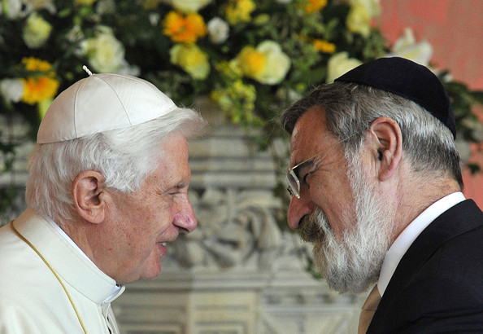
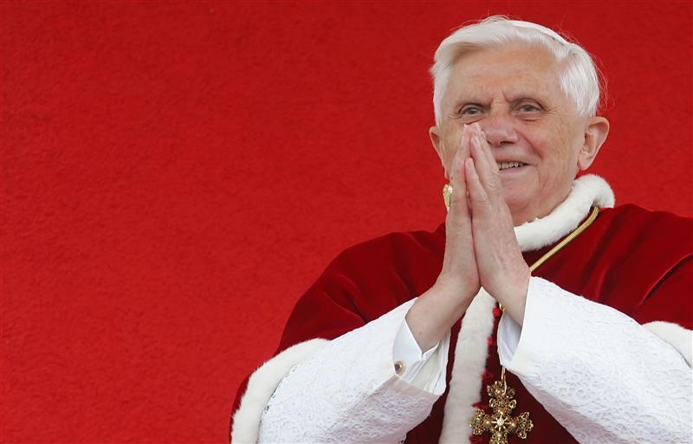
“Strengthening religious freedom consolidates social bonds, nourishes the hope of a better world, and creates favourable conditions for peace and harmonious development, while at the same time establishing solid foundations for securing the rights of future generations.”

Slide 15
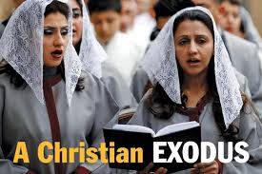
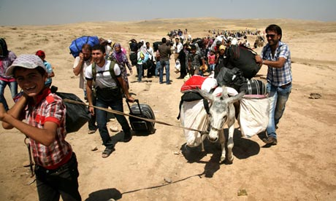
In Syria, Christians, some of whom fled from the persecution in neighbouring Iraq, have been caught in the unremitting cross fire and targeted by radical Islamist groups

Slide 16
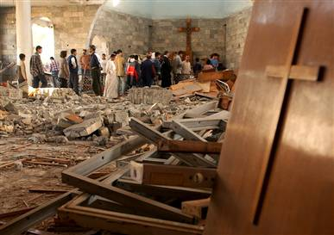
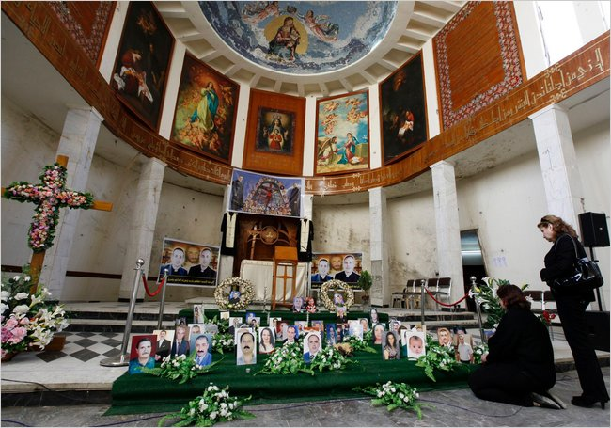
In October 2010, 58 Christians were killed during evening mass at Our Lady of Perpetual Help, the Syrian Catholic cathedral in Baghdad: 1.4 million Christians reduced to 150,000.

Slide 17
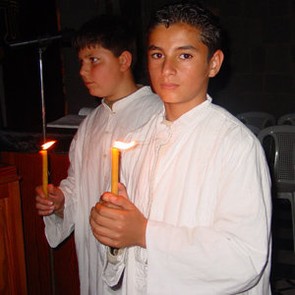
"Churches in the Middle East are threatened in their very existence” – Pope Benedict

Slide 18
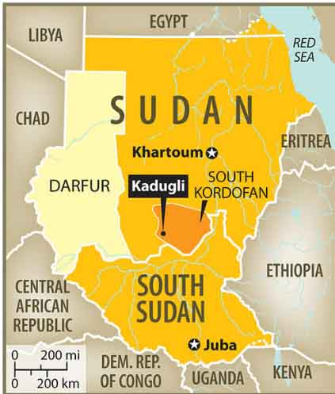
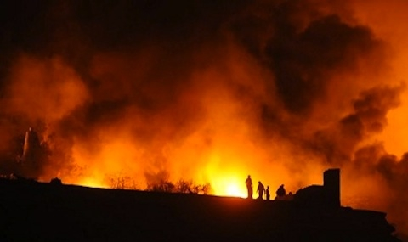
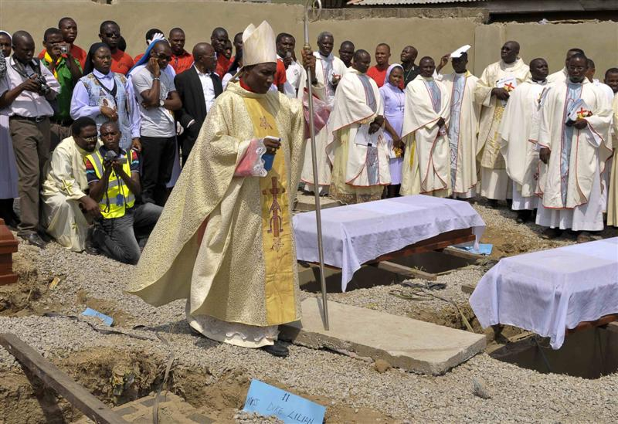
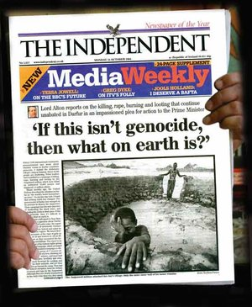

Slide 19
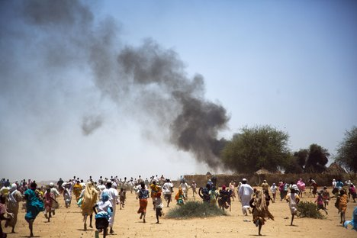
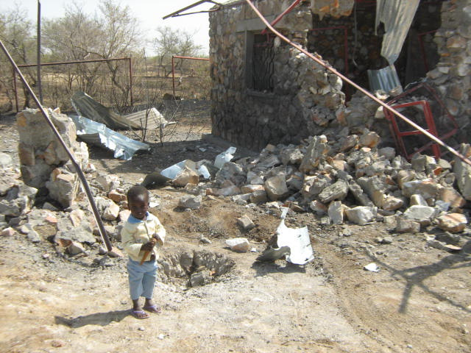
South Kordofan – Sudan – the second genocide of the 21st century.

Slide 20
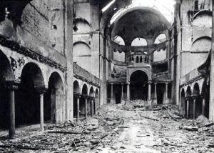
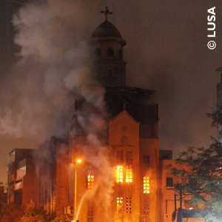
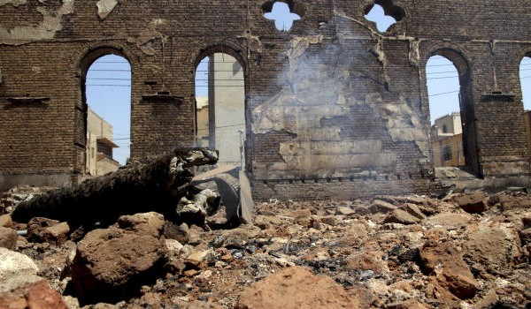
Egypt’s Kristallnacht

Slide 21
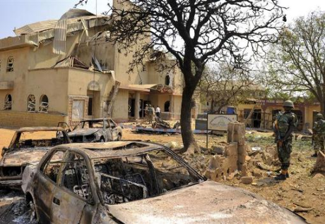
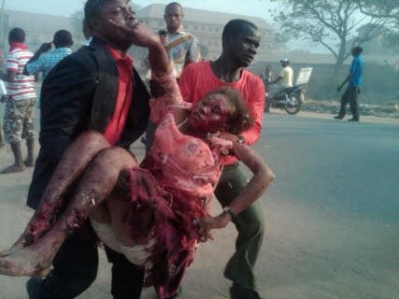
Nigeria: Boko Haram openly say their interim goal is "to eradicate Christians from certain parts of the country.“ 250 killed in 2012.

Slide 22
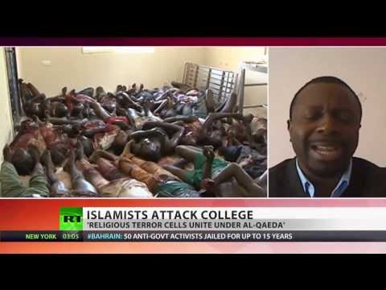
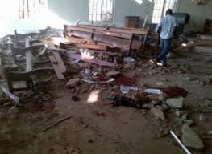
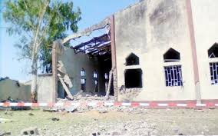

Slide 23
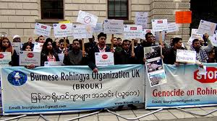
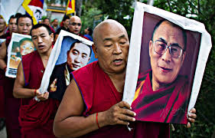
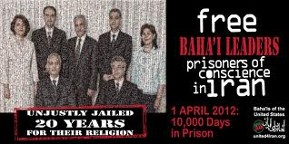

Slide 24
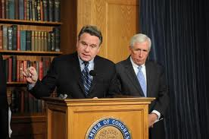
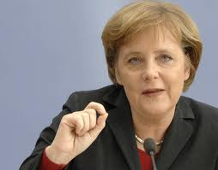
Congressman Chris Smith (R-N.J.): Christians “remain the most persecuted religious group the world over.”
Chancellor, Angela Merkel, says that Christians are the most persecuted group in the world today.

Slide 25
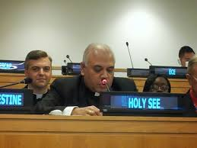
Giving evidence to Congress Archbishop Francis A. Chullikatt, permanent observer of the Holy See Mission at the United Nations described “Flagrant and widespread persecution of Christians rages in the Middle East even as we meet.”

Slide 26
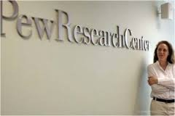
According to a Report by the Pew Centre between 2006 and 2010, Christians were harassed in 139 countries around the world.

Slide 27
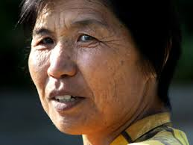
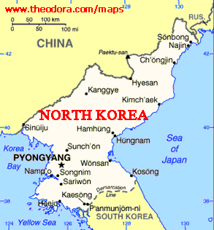
Hea Woo gave a graphic and powerful account of her time inside a the camp - where torture and beatings are routine, and where prisoners were so hungry they were reduced to eating rats, snakes, or even searching for grains in cow dung. In such places the dignity of human life counted for nothing.

Slide 28
"Sometimes we had soup with nothing in it, just full of dirt. In some places whole families were put into camps. They separated the men from the women and even if they saw each other they couldn't talk to each other. The guards told us that we are not human beings, we are just prisoners, so we don't have any right to love. We were just animals. Even if people died there, they didn't let the family members outside know. "

Slide 29
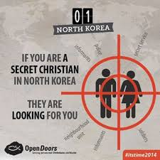

Slide 30
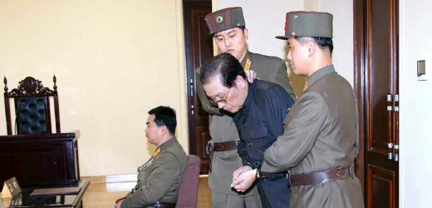
Kim Jong Un’s uncle: Chang Song Taek

Slide 31
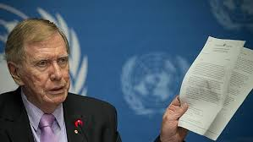
If you were to bench-mark the findings of the recent United Nations Commission of Inquiry into the abuse of human rights in North Korea, against the thirty articles set out in the 1948 Universal Declaration of Human Rights, it would be difficult to find a single article which Kim Jong-un’s regime does not breach.

Slide 32
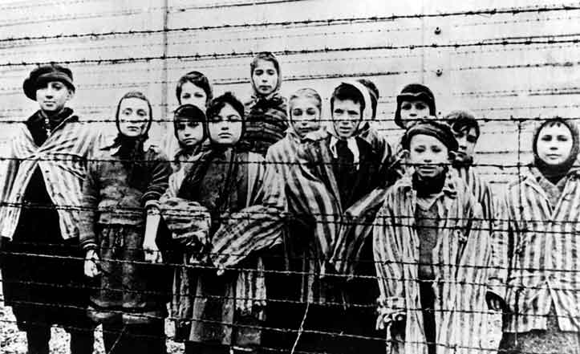
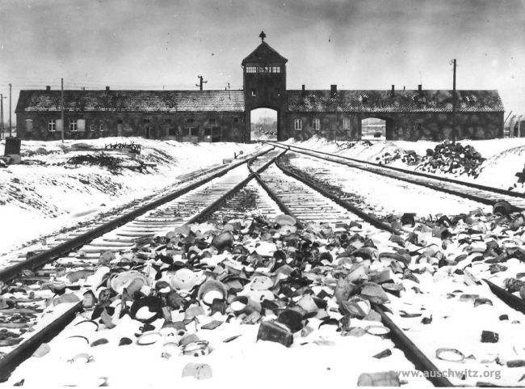
The 1948 Declaration was born in the in the criminality of twentieth century totalitarianism and the gas chambers of Bergen-Belsen and Auschwitz.

Slide 33
“the gravity, scale and nature of these violations reveal a State that does not have any parallel in the contemporary world”. These “unspeakable atrocities” , include “extermination, murder, enslavement, torture, imprisonment, rape, forced abortions and other sexual violence, persecution on political, religious, racial and gender grounds, the forcible transfer of populations, the enforced disappearance of persons and the inhumane act of knowingly causing prolonged starvation” and warrant a referral to the International Criminal Court (ICC).

Slide 34

In paragraphs 26-31 the COI state: “there is almost a complete denial of the right to freedom of thought, conscience and religion”; that religious faith has been supplanted by a cult of “absolute obedience to the Supreme Leader” and “the State considers the spread of Christianity a particularly serious threat.”

Slide 35

On my third visit to North Korea I was allowed to speak to the congregation at the Changchung Catholic church and met with members of the congregations at the other churches.

Slide 36

North Korea has only one permitted Catholic church: and no resident priest permitted in 60 years.

Slide 37



Slide 38
Beyond the show churches Judge Kirby says that “Christians are prohibited from practising their religion and are persecuted. People caught practising Christianity are subject to severe punishments in violation of the right to freedom of religion and the prohibition of religious discrimination”.

Slide 39

At Anju – 80 kilometres north of Pyongyang - believers have met in the rubble of their church for 50 years

Slide 40




Yoo Sang-joon: a Korean Raoul Wallenberg

Slide 41

Jeon Young-Ok’s Evidence
Jeon Young-Ok: “They tortured the Christians the most.
They were denied food and sleep.
They were forced to stick out their tongues
and iron was pushed into it."

Slide 42




Slide 43


“If the police break into the cathedral, I will be in the very front.
Behind me, there will be reverends and nuns. After we are wrestled down, there will be students.”
Cardinal Stephen Kim”
(see: http://davidalton.net/2012/07/14/two-korean-kims-two-remarkable-and-brave-men/

Slide 44



Catholic Opposition Leader Kim Dae Jung – jailed for six years – becomes South Korea’s President and a Nobel Peace Prize laureate: at this time pray for Korea as it faces grave new dangers.

Slide 45


Pope John Paul II described a community of Christians “unique in the history of the church"
St.Andrew Kim – the first Korean priest to be martyred. Around 10,000
Catholics died for their faith in Korea – and continue to do so: “The Korean Martyrs” by Msgr.Richard Rutt.

Slide 46







Slide 47


In a vivid account, recorded in “March Till They Die” by an Australian Columban priest, Fr.Philip Crosbie, seized in 1950, with two Irishmen, Monsignor Thomas Quinlan and Fr.Frank Canavan, and an American Maryknoll priest, Bishop Patrick Byrne, he described how they were put on starvation rations.

Slide 48


Fr Crosbie wrote of Bishop Byrne’s roadside burial: “The only sign of his rank was a light cassock of black silk, with red buttons and piping. The buttons under their covering of red cloth were of metal. Some day they may help to identify the remains.”

Slide 49

PAKISTAN:
“Minorities, to whichever community they may belong, will be safeguarded. Their religion, faith or belief will be secure. There will be no interference of any kind with their freedom of worship. They will have their protection with regard to their religion, faith, their life and their culture. They will be, in all respects, the citizens of Pakistan without any distinction of caste and creed.” - Jinnah

Slide 50

Pakistan: In a population of over 172 million people, only about 1.5% (3 million) is Christians -half Catholic, half Protestant.

Slide 51


March 2nd marked the third anniversary of the assassination of Clement Shahbaz Bhatti, murdered in cold blood and in in broad daylight in Pakistan’s capital, and still no one has been brought to justice.

Slide 52




A devout Catholic, Shahbaz Bhatti stands in a long tradition – from Thomas Beckett to Thomas More, Maximilian Kolbe to Oscar Romero .

Slide 53


A Faith worth Dying For….Pakistan’s murdered Minister for Minorities: Shabaz Bhatti
Bhatti said “I want to share that I believe in Jesus Christ, who has given his own life for us. I know what is the meaning of the cross, and I am following the cross, and I am ready to die for a cause.”

Slide 54

Shahbaz Bhatti said his stand would “send a message of hope to the people living a life of disappointment, disillusionment and despair” adding that his life was dedicated to “the oppressed, the down-trodden and the marginalised” and to “the struggle for human equality, social justice, religious freedom and the empowerment of religious minorities’ communities.”

Slide 55


Slide 56


“Our lives begin to end the day we become silent about things that matter

Slide 57

“Let no one be discouraged by the belief there is nothing one person can do against the enormous array of the world's ills, misery, ignorance, and violence. Few will have the greatness to bend history, but each of us can work to change a small portion of events. And in the total of all those acts will be written the history of a generation.”

Slide 58



Bhatti’s last breaths were uttered in defence of Asia Bibi, the illiterate Christian mother of five, jailed in 1999, for alleged blasphemy against Islam, and sentenced to death.
Dr.Paul Bhatti’s work has led to death threats against him and he has now had to leave the country.

Slide 59

I genuinely am staggered at our indifference to the deaths of men like Shahbaz Bhatti or Iraq’s Archbishop Paulos Faraj Rahho, whose body was discovered in a shallow grave – one of an estimated 600 Iraqi Christians murdered as their churches have been bombed and desecrated

Slide 60







Slide 61


Slide 62





Slide 63



Slide 64


The Institute for Policy Analysis of Conflict identifies the radicalisation of young Indonesian men who have gone to Syria via Turkey. Their director Sidney Jones says:
“Jihadi humanitarian assistance teams now appear to be facilitating the entry of fighters as well”.

Slide 65


Their edict states that Christians are required “to pay Jizya tax on every adult male to the value of four golden dinars for the wealthy, half of that for middle-income citizens and half of that for the poor… They must not hide their status, and can pay in two instalments per year.”

Slide 66
Aymenn al-Tamimi says: “In case ISIS’s ambitions to a global caliphate were still not apparent to anyone, ISIS’s official Twitter account for Raqqa province had this to say on the imposition of the dhimmi pact: ‘Today in Raqqa and tomorrow in Rome.’”

Slide 67

King Hussein offered the wise advice to pray for God’s protection against,
“those who believe that they are the sole possessors of truth.”

Slide 68



Slide 69


The spiritual meadow is today a battlefield. Before the war the Christians of Syria accounted for between 4.5% and 10% of the population.

Slide 70


The city of Homs, the third largest in Syria, has now seen almost its entire Christian population of 50,000 to 60,000 flee for safety as fighting continues in that stricken country.
The number of Christians left in the city has reportedly fallen to below 1,000

Slide 71

A Jesuit priest, Father Paolo Dall’Oglio, who has spent most of his life championing reconciliation, was kidnapped in July 2013 after entering rebel-held territory. Opposition sources from Raqqah said that Paolo Dall’Oglio had been executed by extremist groups.

Slide 72

The militias, “stormed my house, giving me one hour to evacuate or else they will kill me ... I’m heartbroken. I’ve lost everything”.
Bishop Sleman says:
“There are many events that show that Christians are targeted, such as those of Maaloula, Sadad, Hafar, Deir Atiyeh, Carah, Nabk, Kseir, Rablé, Dmaineh, Michtayeh, Hassaniyeh, Knaïeh, and some villages of the Valley of Christians, Yabroud, Aafrd, the Jazirah region such as Hassaké, Ras El-Ain Kamechleh, and many other areas. Christians are increasingly targeted in horrible and unspeakable massacres”.

Slide 73

In Homs, a Dutch priest, Father Van der Lugt, trapped in the old city, described how residents cut off for more than a year developed chronic mental health problems following the breakdown of social order. He says, “Our city has become a lawless jungle”.

Slide 74


A total of 45 Christians were killed and 1,500 families were held hostage when Sadad was stormed by the Al-Nusra Front and an organisation called the Grandsons of the Prophet on 21st October 2013.

Slide 75


Damascus-based Melkite Patriarch Gregorios III of Antioch remarked: “How can somebody do such inhumane and bestial things to an elderly couple and their family?”

Slide 76


While we overlook and fail to understand the religious dimension to these terrible atrocities, and the imperative of harnessing thoughtful and moderate religious leaders from all traditions, we will utterly fail to end the persecution and the unspeakable violence.
We in the West, who enjoy so many freedoms and liberties, need to ask ourselves some tough questions about the disproportionate nature of the causes which we so readily embrace whilst ignoring the systematic violent ideology of an Islamist "Final Solution" directed at the Christian minorities.

Slide 77


If I was sitting in the rubble of a Syrian or Egyptian church, or in a gulag in North Korea, or had just seen my home destroyed or, even worse, my loved ones killed, I would think that our endless self absorbed debates, which often mirror the rights-driven agenda of the secular world, are self indulgence of a high order.

Slide 78
Many of our European Muslims are good, law-abiding people, who want the same things for themselves and for their families as the rest of us. They are not, as some foolishly and wrongly caricature them, an enemy within. But if they remain silent it will increasingly be seen as acquiescence. It will, however, require real courage to speak out against forces which have no respect for difference or diversity, or for life itself.

Slide 79



"who now remembers the Armenians?". Will our generation similarly ask the question "who now remembers the Christian minorities of the Middle East and North Africa?"

Slide 80

“In Germany they came first for the Communists and
I didn’t speak up because I wasn’t a communist. Then
they came for the Jews and I didn’t speak up because
I wasn’t a Jew. Then they came for the trades unionists
and I didn’t speak up because I wasn’t a trades unionist.
Then they came for the Catholics and I didn’t speak up
because I was a Protestant. Then they came for me –
and by that time no one was left to speak up for me.”
Pastor Martin Niemoller
Who will be left to speak for you?

Slide 81



From the crucifixion of Christ Himself, to the stoning to death of Stephen; from the execution of Peter, Paul and the early disciples, to the deaths of maybe as many as 100,000 people at the hands of emperors such as Nero and Diocletian;

Slide 82



“the blood of the martyrs is the seed of the church” – as many as 100,000 may have died refusing to renounce their religion

Slide 83


Ukraine: with Ivan Gel and Bishop Vasylyk – who between them spent more than 30 years in Soviet jails.

Slide 84


At London’s Tyburn between 1535 until 1681, 105 Catholic men and women gave their lives for their faith – a sacrifice which paved the way for the religious freedoms and liberties which we enjoy today.

Slide 85




“I protest before God and His holy angels, before Heaven and earth, before the world and this bar whereat I stand,
which is but a small resemblance of the terrible judgment of the next life,
that I am not guilty of any part of the treason contained in the indictment, or of any other treason whatever.”

Slide 86

“I recommend your case, and mine, to Almighty God, the Searcher of hearts, to the end that we may at last be friends in heaven, when all injuries shall be forgotten.”

Slide 87

"I wish it need not have happened in my time," said Frodo.
"So do I," said Gandalf, "and so do all who live to see such times. But that is not for them to decide. All we have to decide is what to do with the time that is given us."

Slide 88

“A man would do nothing if he waited until he could do it so well that no one could find fault”
“We are not born for ourselves, but for our kind, for our neighbours,
for our country: it is but selfishness, indolence, a perverse fastidiousness,
an unmanliness, and no virtue or praise, to bury our talent in a napkin”
Blessed John Henry Newman

Slide 89

Failure to take action….
We have been the silent witnesses of evil deeds.
What we shall need is not geniuses, or cynics, or misanthropes, or clever tacticians, but plain, honest, straightforward men.”

Slide 90
In our own times we must better comprehend the price which is paid for belief and allow the courage and heroism of those who suffer so greatly to shake us out of our apathy and our indifference.

Slide 91
Paying a Price For Belief
Brentwood: March 12th 2014.
.
www.davidalton.net

