Slide 1
Issues Facing Christians Today
Joel’s Bar:
Celebrate 2013
www.davidalton.net

Slide 2
The Children Test
“The test of the morality of a society is what it does for its children”

Slide 3
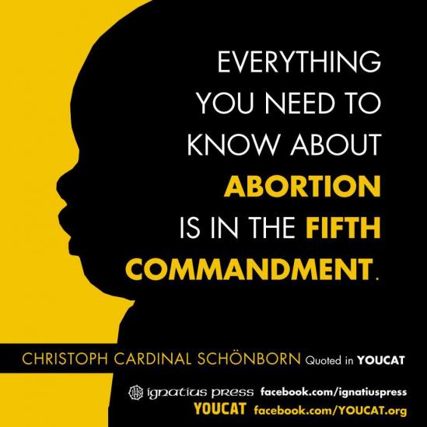
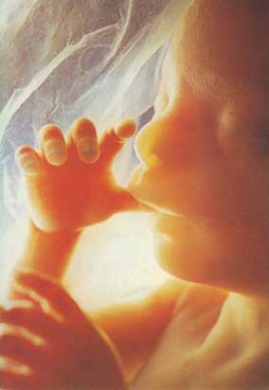
The Child In The Womb

Slide 4
The latest abortion statistics reveal that taxpayers spent £118m on abortions in one recent year, of which £75m went to private clinics; that of 6.3 million abortions, just 143 were where a woman’s life was in danger; and that 48,000 people have had more than one abortion– some as many as eight. There have been 42 million abortions annually throughout the world ; 115,000 every day; 600 in Britain every day; in the past 12 months there were 189,574 abortions.
The latest abortion statistics reveal that taxpayers spent £118m on abortions in one recent year, of which £75m went to private clinics; that of 6.3 million abortions, just 143 were where a woman’s life was in danger; and that 48,000 people have had more than one abortion– some as many as eight. There have been 42 million abortions annually throughout the world ; 115,000 every day; 600 in Britain every day; in the past 12 months there were 189,574 abortions.

Slide 5
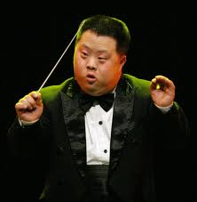
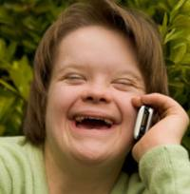
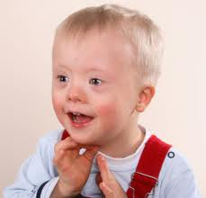
A Councillor from Cornwall was recently the centre of a row when he suggested it would be better that children with disabilities were “put down”. This is not as far-fetched or shocking as it sounds. According to Government figures, in the womb we now put down 90%of all babies with Down’s Syndrome and the law allow abortion up to birth on disabled children.

Slide 6
Our society values the right to have access to pornography more highly than the protection of children. Five million images of child abuse are in circulation on the internet, featuring some 400,000 children. 70% of teenagers have viewed on line pornography.

Slide 7
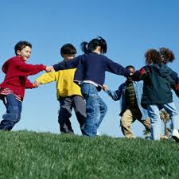
Three-quarters of a million British children have no contact with their fathers following the breakdown of their parents’ relationships.

Slide 8
1 million young people are not in education, employment , or training, and over 2.6 million are without work – a 17 year high in a flat-lining economy; or the 3.9 million children living in poverty in the UK or the 4,000 who call Childline each day

Slide 9
The UK has the worst problem with anti-social behaviour in Europe. More than 350,000children live with a parent who has a drug problem. 30% of teenagers binge drink weekly. There are 83,000 looked-after children in the UK. 23,528 under 18s (155 under 13s) in England use specialist substance misuse services. 50,552 children are on child protection registers or plans - up by 32,492 since 2006. In one recent year 16,846 sexual crimes were committed against children under 16 years.

Slide 10
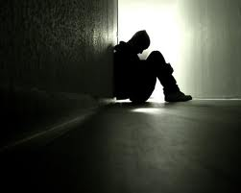
Last year, Samaritans answered 4.6 million calls from people in despair, which is one call every seven seconds. Samaritans say that ‘A conservative estimate is that there are 24,000 cases of attempted suicide by adolescents (10-19 years) each year in England and Wales, which is one attempt every 20 minutes” As they grow up suicide accounts for 20 per cent of all deaths among young people aged 15 to 24

Slide 11
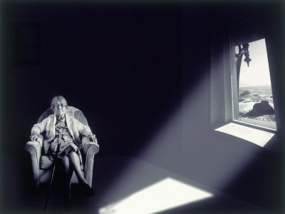
1 million elderly living in toxic loneliness, don’t see a friend or a neighbour during the course of a typical week; 26% of British households comprise just one person and on present trends, by 2016, 36% of all homes will be inhabited by a single person – a trend accelerated by family breakdown and phenomenal divorce rates – the highest in Europe.

Slide 12
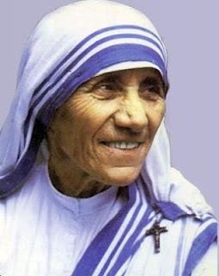
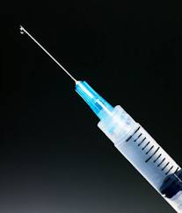
How we treat the elderly: better off dead
“why” Mother Teresa asked “does everyone sit looking at the door?”
She received the reply “It is because they are looking for the relatives who never come to visit them and who have no time for them”. Care and kill should never be used as synonyms and have no place in the healer’s art.

Slide 13
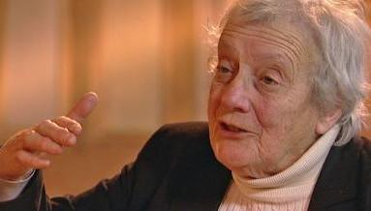
“If you’re demented, you’re wasting people’s lives - your family’s lives - and you’re wasting the resources of the NHS… putting it rather brutally, you’d be licensing people to put others down.”
.
- Baroness Warnock,
The October 10th 2008

Slide 14
In Holland statistics indicate that the number of euthanasia deaths in 2011 in the Netherlands increased by 18% to 3,695. This follows increases of 13% in 2009 and 19% in 2010. A 2005 House of Lords Inquiry predicted that Dutch-style Liberal Democrat laws would lead to 13,000 euthanasia deaths annually in Britain.

Slide 15
How we treat the elderly: better off dead
In Belgium there are calls for euthanasia for prisoners and it is reported that they have been harvesting organs from people who have been euthanized.

Slide 16
Crisis say that 2,309 people were reported by local councils across the country as sleeping rough on one night in Autumn 2012, up from 2,181 in the previous year’s count. This is on the previous year’s rise of 23%.

Slide 17
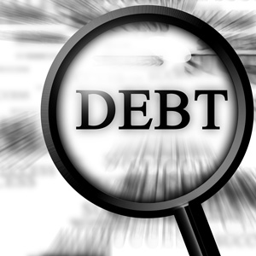
Sharp Elbowed Britain – Devil Take The Hindmost Britain Individuals now owe more in debt than the wealth generated by the entire country in a year. 331 people every day of the year will be declared insolvent or bankrupt. Significantly increased student loans have triggered indebtedness and there has been a large increase in student suicides - a 50 increase in the last four years.

Slide 18
Gun crime in the United Kingdom claims 30 victims every day; the average lifespan for people who get involved in gun crime in Manchester is a mere 24 years; one woman in every four will be the victim of violence in her own home during the course of her lifetime.

Slide 19
Britain 2013:
In times such as this, when a faithless society has become an indebted, atomised, lonely, and selfish society; a faithless society has become a culturally diminished society; a faithless society has become a fatherless society and a broken family society; a faithless society has become an anti-life society, there is a desperate need for a Mordecai and an Esther – both understanding the scale and nature of that which threatens us and the necessity of a brave response which draws together the practical and the spiritual.
Notes:
In times such as this, when a faithless society has become an indebted, atomised, lonely, and selfish society; a faithless society has become a culturally diminished society; a faithless society has become a fatherless society and a broken family society; a faithless society has become an anti-life society, there is a desperate need for a Mordecai and an Esther – both understanding the scale and nature of that which threatens us and the necessity of a brave response which draws together the practical and the spiritual.

Slide 20
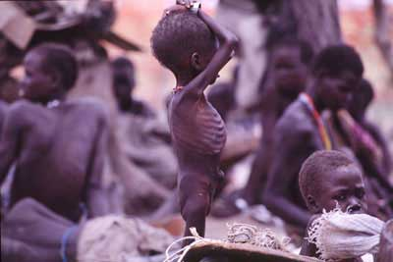
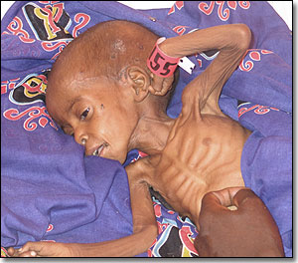
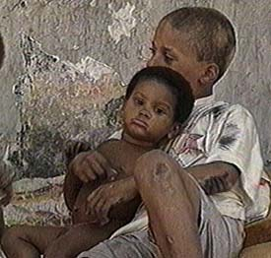
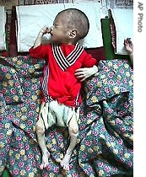
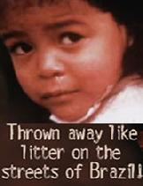
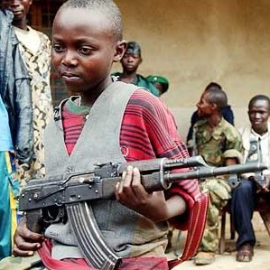
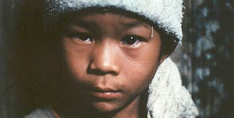
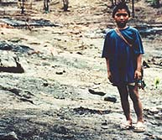
Man’s Inhumanity To Man

Slide 21
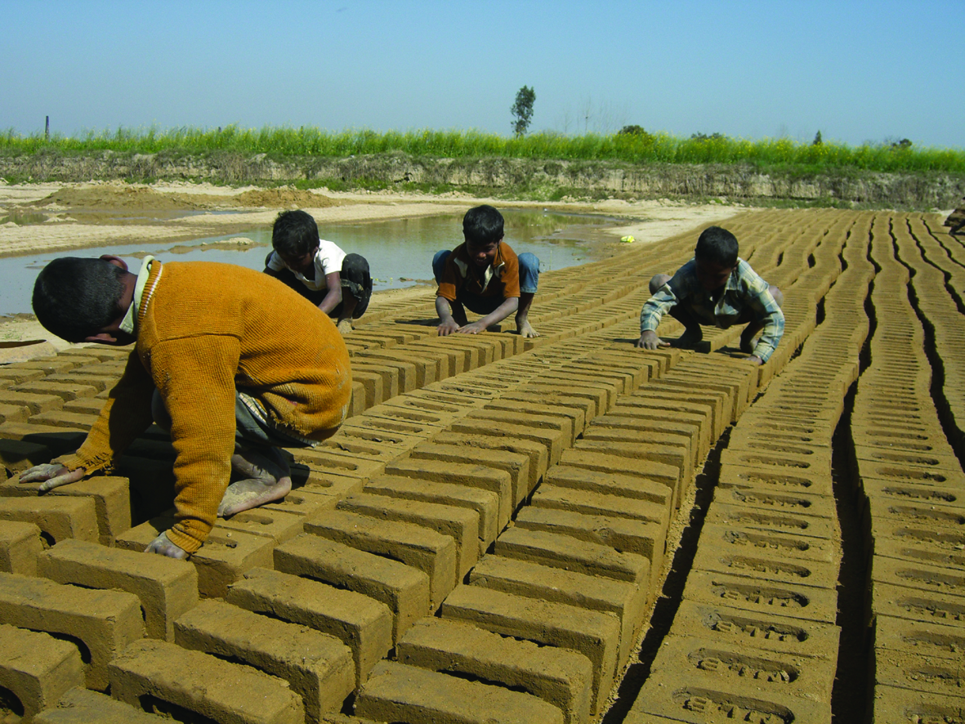
Broken or Crushed: The Dalits and the Caste System
170 million people remain in India as Dalits, in addition to the 400,000 in our own country.
March 4th 2013 in the House of Lords:
“ When the House considers that every single day in India every 18 minutes a crime is committed against a Dalit; every day three Dalit women are raped; two Dalits are murdered; two Dalit houses are burned; 11 Dalits are beaten; that many are impoverished; some half of Dalit children are under-nourished; 12% die before their fifth birthday; vast numbers are uneducated or illiterate; and 45% cannot read or write it is quite clear that we do not need more inquiries or studies.”

Slide 22
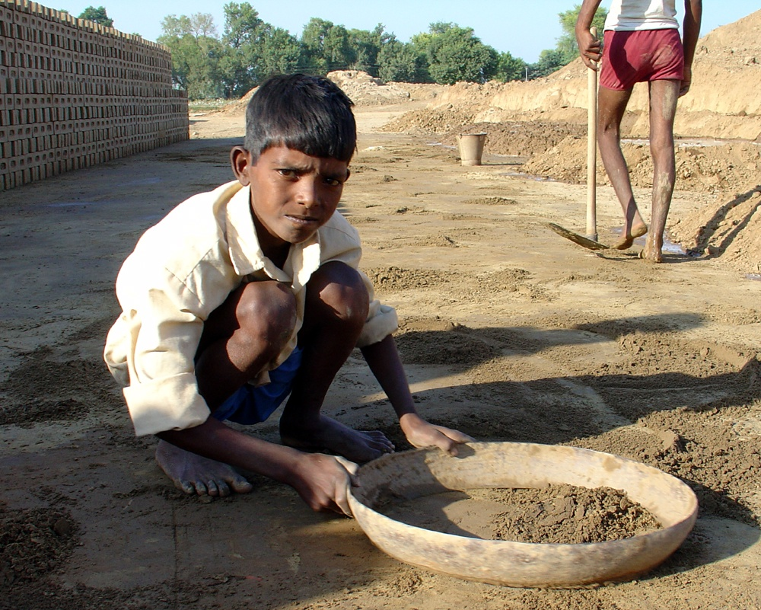
It’s not the terracotta pots that need breaking but the caste system. But human rights are violated and denied in innumerable ways.

Slide 23
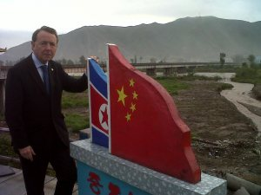
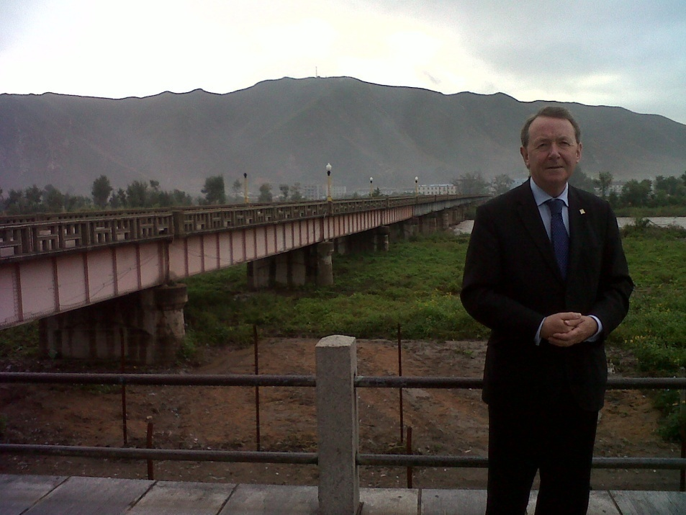
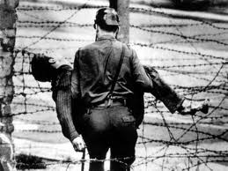
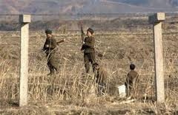
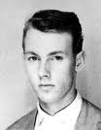

Slide 24
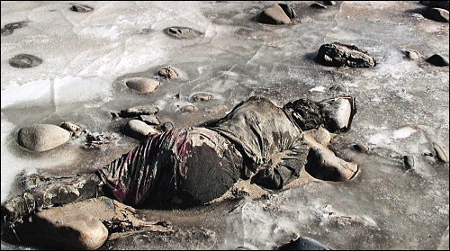
Life and Death on The North Korean Border
The Perils Of Escaping Across The River Tumen

Slide 25
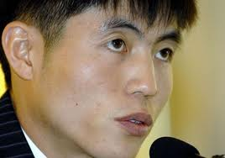

Slide 26
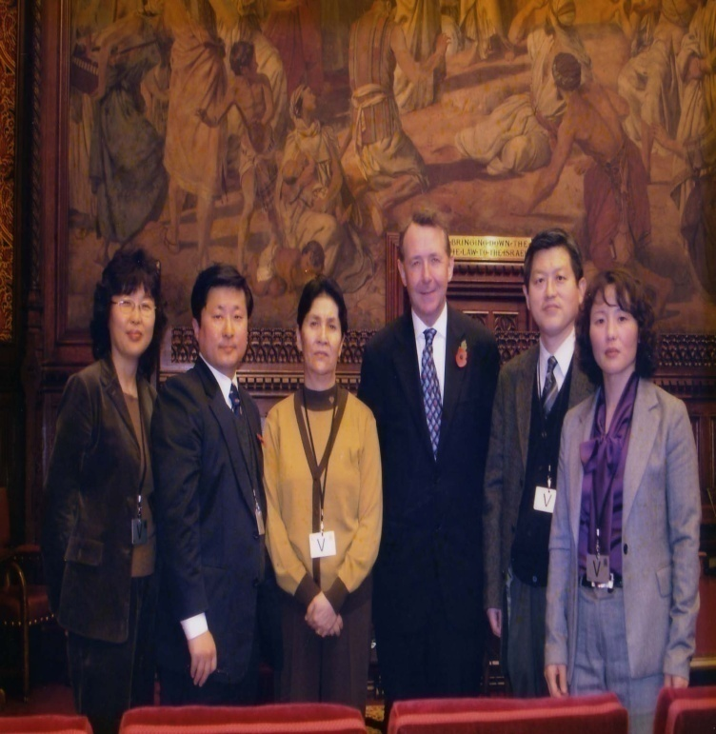
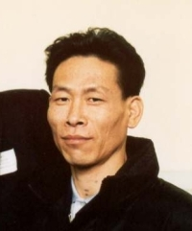
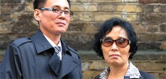
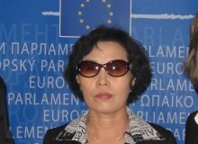
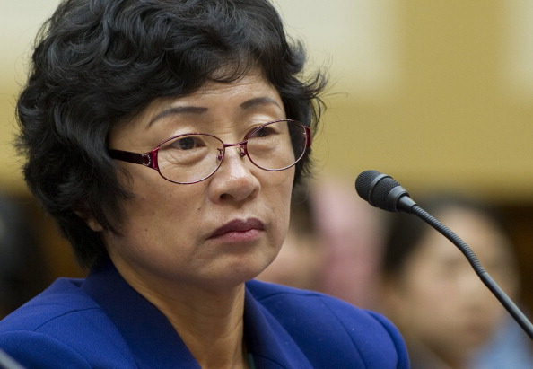
The Plight of Men, Women and Children – 200,000 in the gulags of North Korea

Slide 28
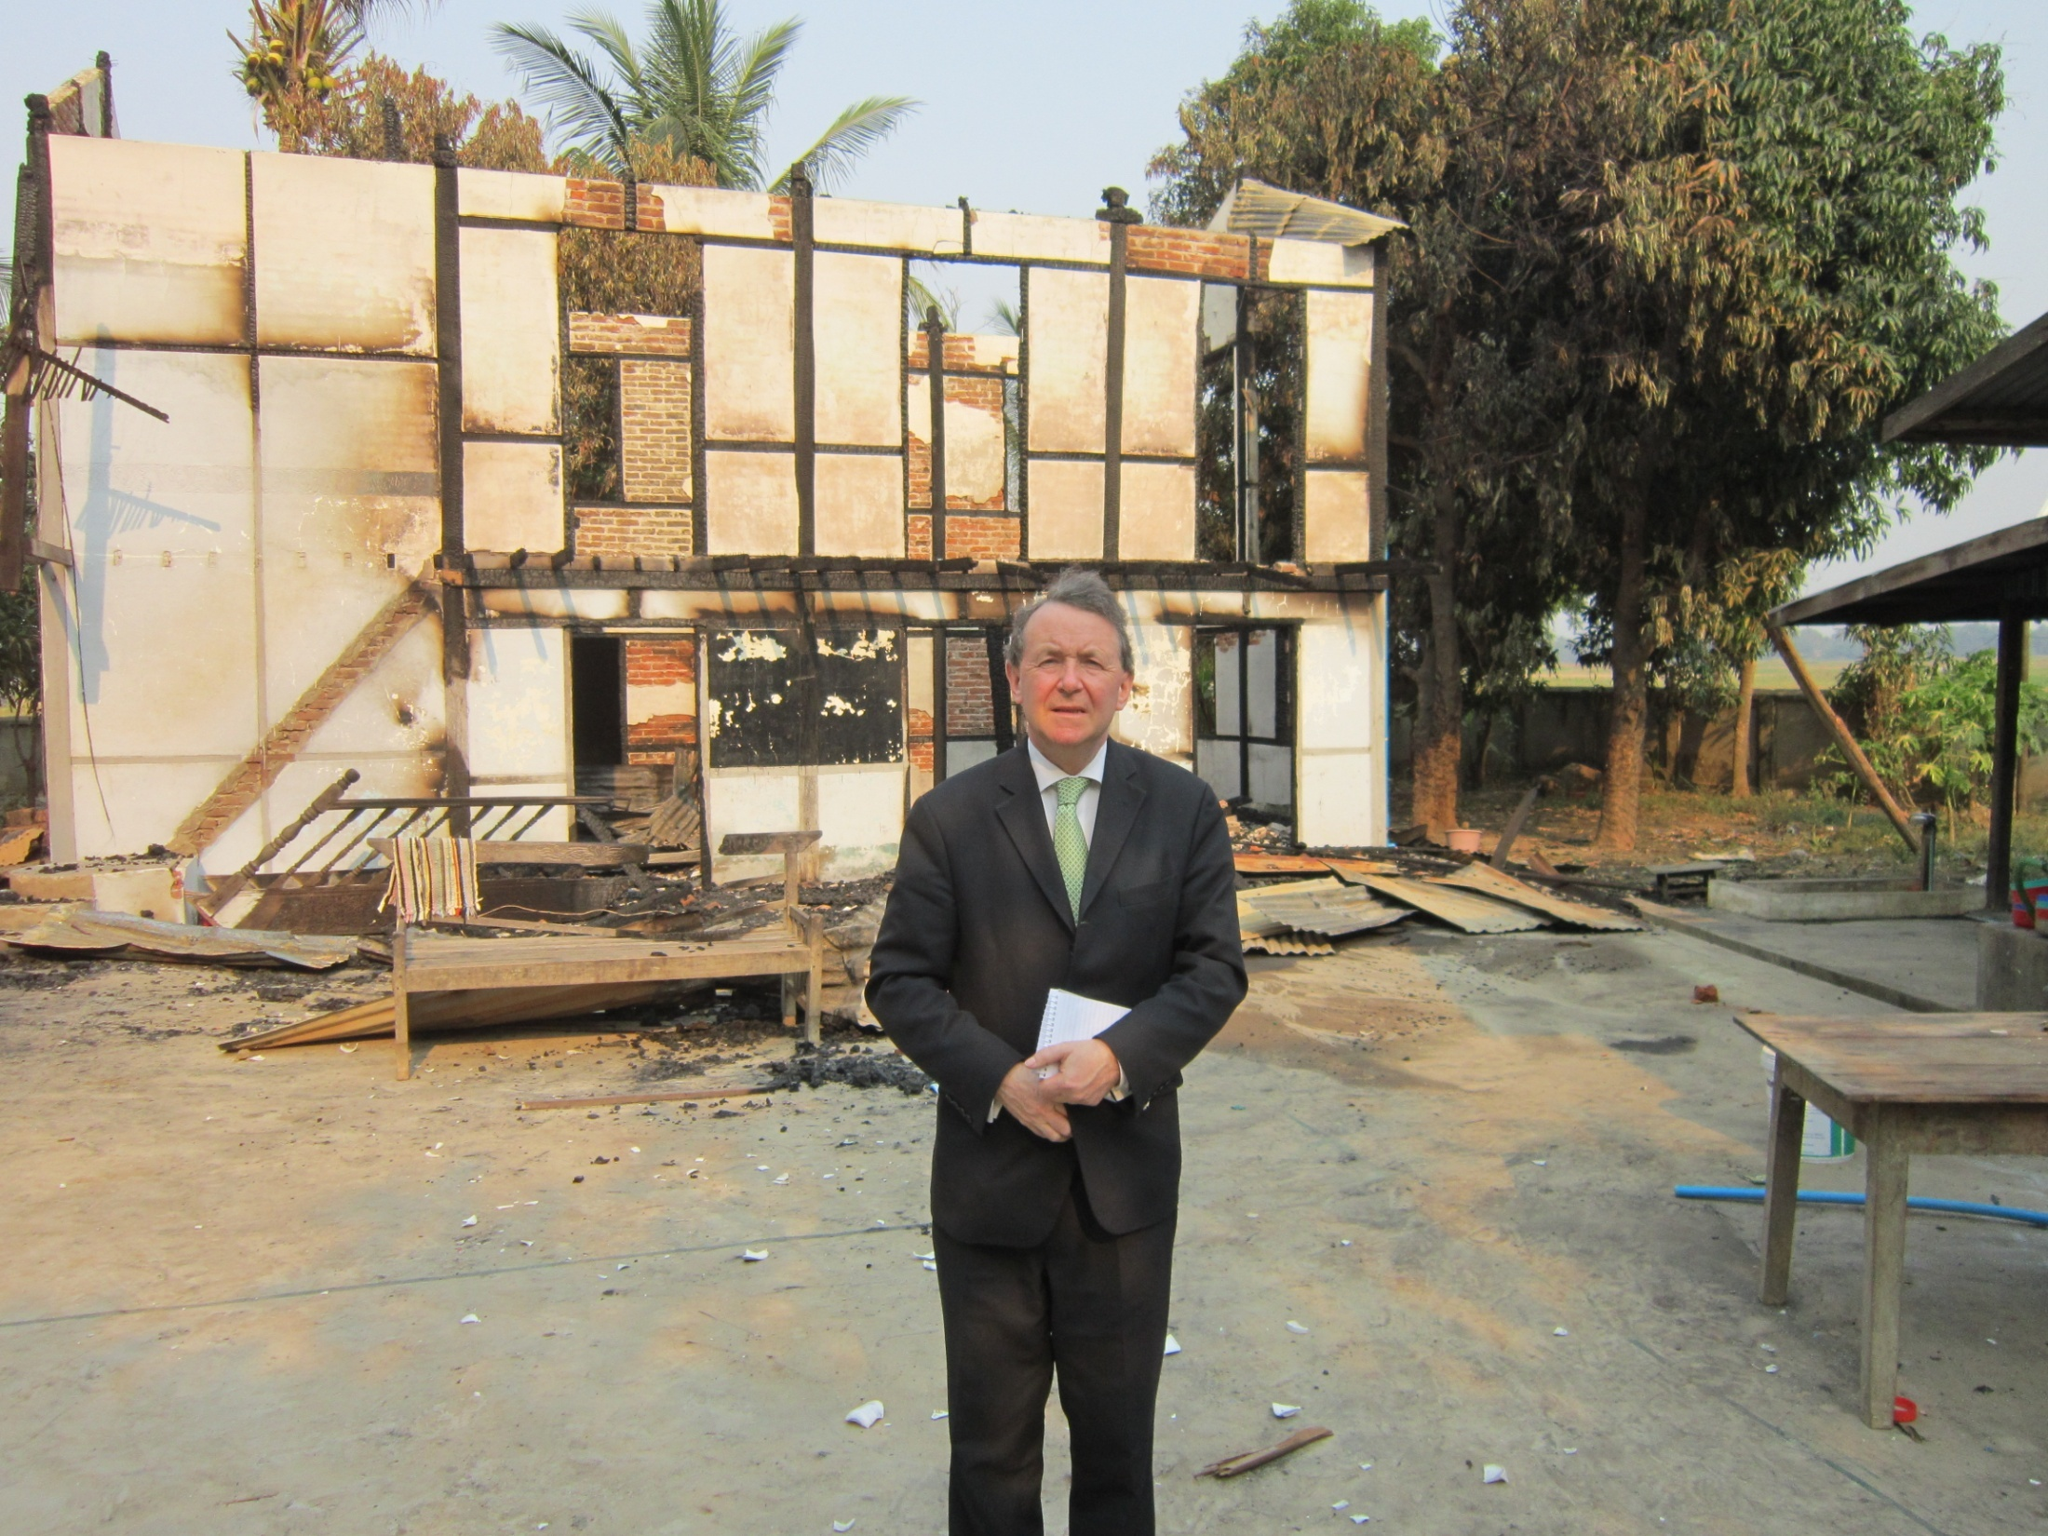

Slide 29
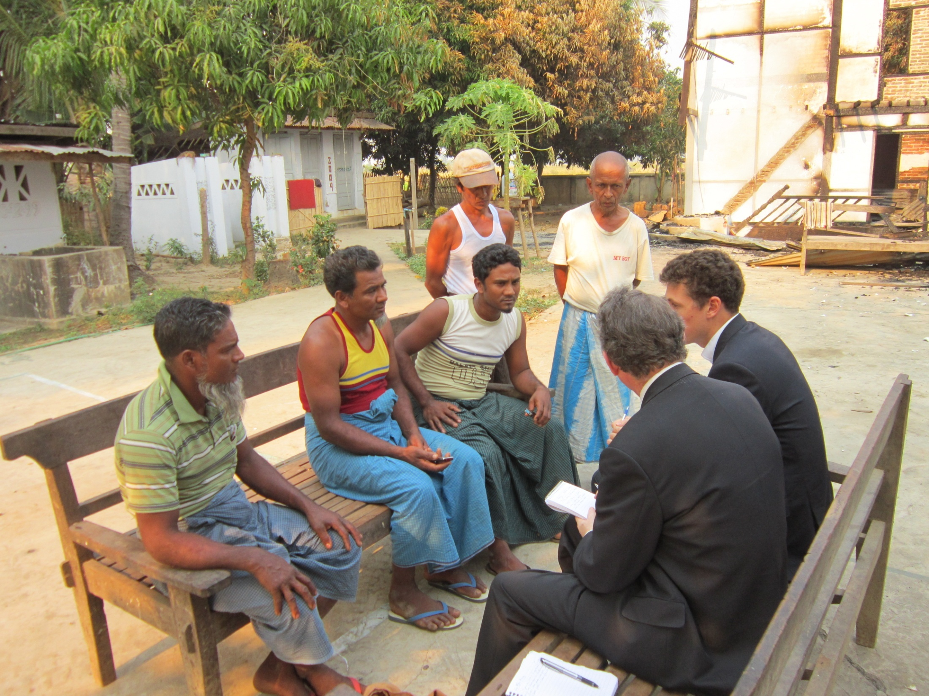

Slide 30
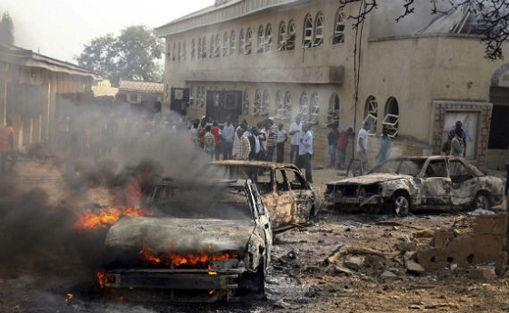
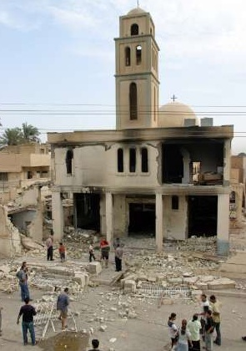
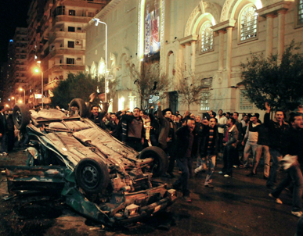
Nigeria, Syria, Egypt

Slide 31
The Silent Exodus of Syria’s Christians
Islamic Law Comes to Rebel-Held Syria and the establishment of Sharia courts
Christians slaughtered – the world yawns.
Sudanese Officials Bulldoze Christian Church
Nigerian Priest: Boko Haram Destroyed 50 Churches
Tanzania : Christians Threatened with Islamist Violence on Easter
East Asia and the Pacific
Chinese Activist, Now in U.S., Says His Relatives Remain Under Surveillance, Tells His Story of Abuse and Brutal Torture
Beijing Cautions New Pope on Meddling in China
Indonesian Officials Destroy Church in Front of Worshippers as Muslims Egg Them On
Three International NGOs Protest Legal Harassment of Buddhist Youth leader Le Cong Cau
Over 100 Buddhist monks burn them selves to death in self immolations.
Muslim Group Condemns Violence in Burma
House Church in Xinjiang Raided and Leaders Interrogated
Persecution Rises in China as Plan Begins to End House Churches

Slide 32
China Rights group lists 2012’s Top 10 Cases of Anti-Christian Persecution
MALAYSIA: Ibrahim Ali, The Head of Perkasa, Issues Appeal to Burn Bibles
Two North Korean Christians Killed for Their Faith
Vietnam’s New Religion Decree Restrictive
Vietnamese Authorities Tear Down Carmelite Monastery
Indonesia Man Receives 5 Year Sentence for Insulting Islam
Azerbaijan Mosque Loses Eight-Year Struggle for Religious Freedom
Egypt’s Coptic Christians Must Be Protected From Sectarian Violence
We Abandon Christians in the East At Our Peril
Torture Likely Led to Death of Egyptian Christian in Libya, Sources Say
Iraq’s Endangered Christians
McMecca: The Strange Alliance of Clerics and Businessmen in Saudi Arabia
Only 57 Churches Left in Iraq
UN Special Rapporteur on Freedom of Religion or Belief Discusses New Report on Violence Against Baha’is in Iran
Iranian Pastor in Prison Needs Help of White House, Panel Told; Pastor’s Wife: “I am disappointed that the west has not fully engaged in this case. … I expect more from our government.”
St. Mark’s Coptic Church in Benghazi Torched
Outrage Spreads As Islam’s Most Holy Relics Are Being Demolished in Mecca
Copts Protest Church Attack in Egypt — Church Attacked Again
Egyptian Court Sentences Christian Family to 15 Years for Converting from Islam
Egypt’s Constitution Threatens Religious Freedom
In Libya, Two Religious Communities Forced Out

Slide 33
In Art and Education, Saudi Arabia Teaches Muslims Should “Triumph” Over Jews and Christians
Yemen’s Persecuted Christians
Sufi Mystics Warn of More Islamist Violence
Iran’s Religious Crackdown
South and Central Asia
Pakistani Minorities See New Threats
Report: Kazakhstan Court Orders Burning of Religious Books, Possibly a First for Their Government
Appeal Sent by Catholic Congregations in Pakistan for Revision of Blasphemy Law
Almost 90 Killed in Attack Targeting Pakistan’s Shi’a Muslims
BANGLADESH: 20,000-strong mob attacks, Ahmadi festival
Violence Against Christians Spreading in India
Shiites Demand Protection
BRUTAL MURDER IN BALUCHISTAN: Christian Refuses to Convert to Islam
Kazakhstan’s authorities raid at least eight separate worship meetings

Slide 34
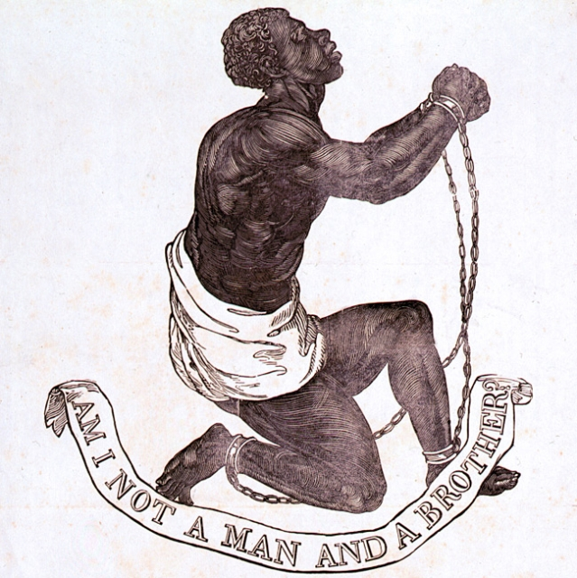

Slide 35
Contemporary Slavery
27 million people enslaved today
ILO say this includes 8.4 million children
700,000 trafficked every year
Debt Bondage affects 20 million people
Forced labour, child labour, economic servitude, racially motivated and caste based slavery all still persist throughout the world

Slide 36
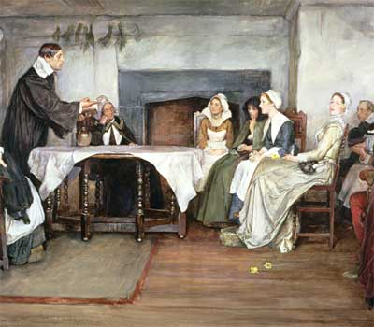
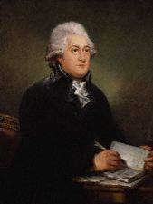
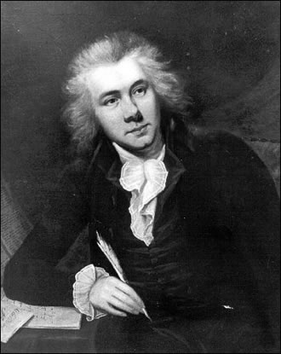
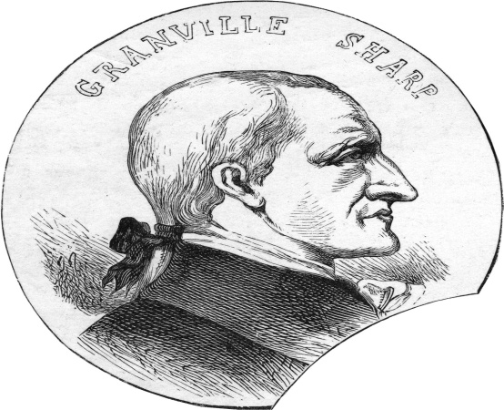
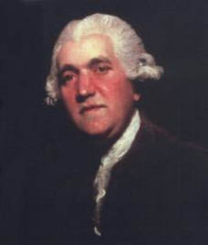
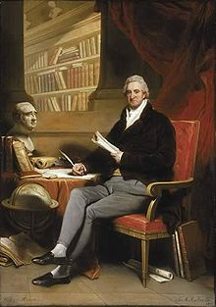
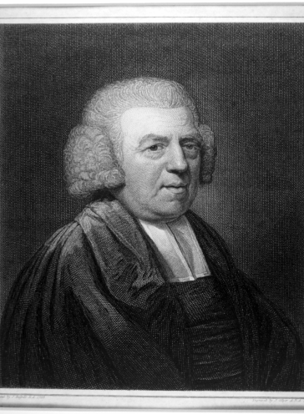
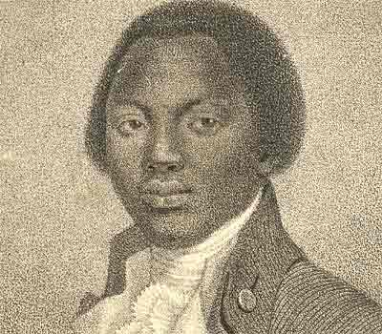
A coalition of Quakers, William Wilberforce, Thomas Clarkson, Granville Sharpe, Olaudah Equiano, Josiah Wedgewood, John Newton, and others ended slavery but it was preceded by religious revival

Slide 37
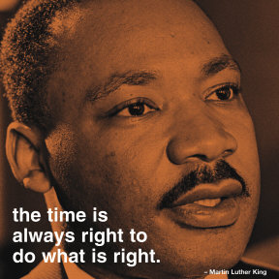
“Our lives begin to end the day we become silent about things that matter

Slide 38
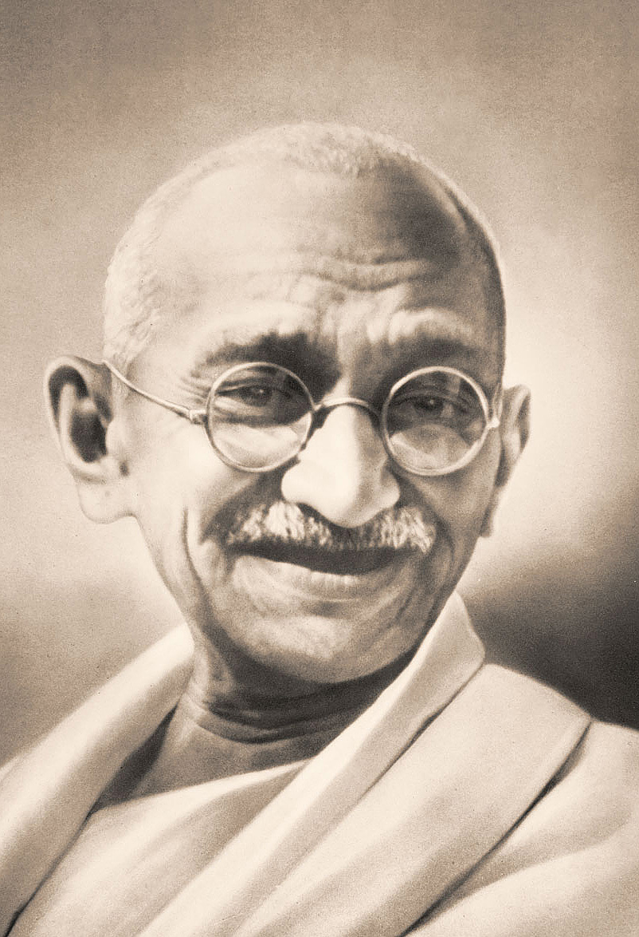
Mahatma Gandhi
“You must be the change you want to see in the world”

Slide 39
“Let no one be discouraged by the belief there is nothing one person can do against the enormous array of the world's ills, misery, ignorance, and violence. Few will have the greatness to bend history, but each of us can work to change a small portion of events. And in the total of all those acts will be written the history of a generation.” Robert Kennedy

Slide 40
“faith in the public square” – Pope Benedict XVI”

Slide 41
As Thomas More would put it, two thousand years later, standing trial in Westminster Hall, it was the desire “to be the king’s good servant, but God’s first.”

Slide 43
Pakistan’s murdered Minister for Minorities: Shabaz Bhatti and Governor Salman Taseer
Bhatti said that his stand would “send a message of hope to the people living a life of disappointment, disillusionment and despair” adding that his life was dedicated to “the oppressed, the down-trodden and the marginalised” and to “the struggle for human equality, social justice, religious freedom and the empowerment of religious minorities’ communities.”

Slide 45
Catholic Opposition Leader Kim Dae Jung – jailed for six years – becomes South Korea’s President and a Nobel Peace Prize laureate

Slide 46
“Warsaw, Moscow, Budapest, Berlin, Prague, Sofia and Bucharest have become stages in a long pilgrimage toward liberty.
It is admirable that in these events, entire peoples spoke out — women, young people, men, overcoming fears, their irrepressible
thirst for liberty speeded up developments, made walls tumble down and opened gates. “
And he said of the fall of Communism…
“… It fell as a consequence of its own mistakes and abuses. It proved to be a medicine more dangerous than the disease itself.
It did not bring about true social reform, yet it did become a powerful threat and challenge to the entire world.
But it fell by itself, because of its own inherent weakness."
Lech Walesa at Gdansk's Lenin Shipyard
and with Pope John Paul II

Slide 47
“Good is never accomplished except at the cost of those who do it,
truth never breaks through except through the sacrifice of those who spread it” –
“If a man waited until he was perfect he would wait for ever.”
John Henry Newman

Slide 48
John Henry Newman
“We are not born for ourselves , but for our kind, for our neighbours, for our country: it is but selfishness, indolence, a perverse fastidiousness, an unmanliness, and no virtue or praise, to bury our talent in a napkin”

Slide 49
Doing Good Now...don’t wait until you are perfect.
“A man would do nothing if he waited until he could do it so well that no one could find fault.”Cardinal John Henry Newman

Slide 50
Albert Einstein warned of the consequences of doing nothing:
“The world is a dangerous place to live, not because of the people who are evil, but because of the people who don't do anything about it.”

Slide 51
That was what Esther discovered and it is what we too must discover for just such a time as this. www.davidalton.net

Slide 52
"I wish it need not have happened in my time," said Frodo."So do I," said Gandalf, "and so do all who live to see such times. But that is not for them to decide. All we have to decide is what to do with the time that is given us."

Slide 53
We have been the silent witnesses of evil deeds.
What we shall need is not geniuses, or cynics, or misanthropes, or clever tacticians, but plain, honest, straightforward men.”

Slide 54
“Silence in the face of evil is itself evil” - Bonhoeffer

Slide 55
No one in the world can change Truth. What we can do and should do is to seek truth and to serve it when we have found it.
The real conflict is the inner conflict. Beyond armies of occupation and the hecatombs of extermination camps,
there are two irreconcilable enemies in the depth of every soul: good and evil, sin and love.
And what use are the victories on the battlefield if we ourselves are defeated in our innermost personal selves?"
www.davidalton.net

