Slide 1
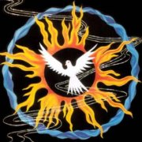
For Just Such A Time As This
Celebrate 2013
www.davidalton.net

Slide 2
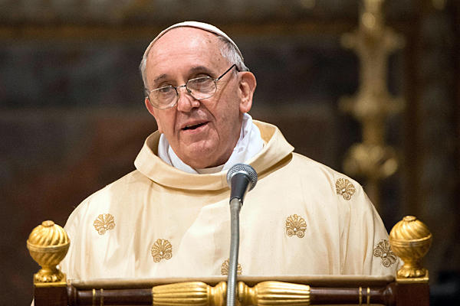
Pope Francis

Slide 3
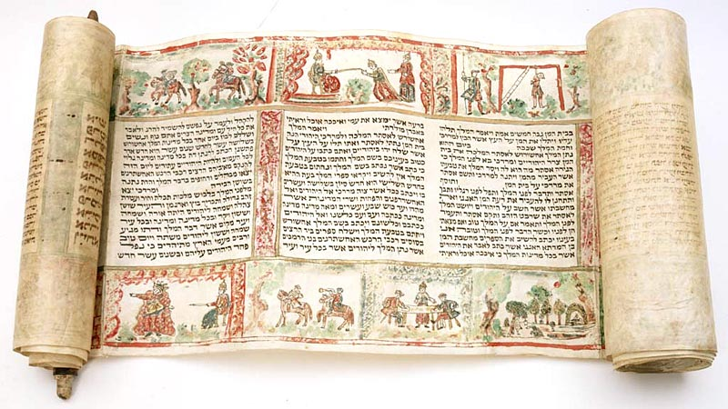
“for just such a time as this” – the Book of Esther (4:14)

Slide 4
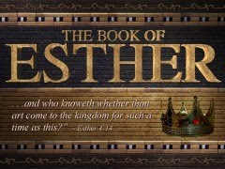
1. Firstly, to recount the story of Esther;
2. Secondly, to examine the
lessons of the story; and
3. Thirdly, what are the
challenges “for just such a time as this.”

Slide 5

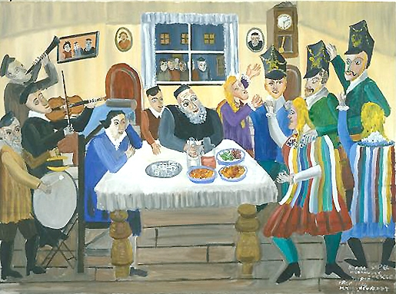
Like Passover, Purim records a moment of deliverance from mortal danger, and is part of Israel’s collective memory, but it is also the powerful account of a young woman who risks all to save her people.

Slide 6
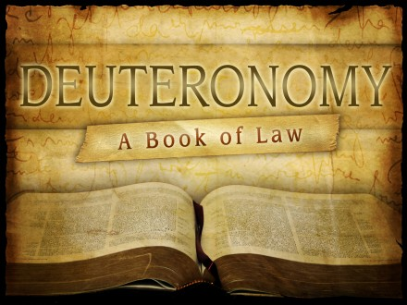
“Remember the days of old, Consider the generations long ago; Ask your father to recount it, And your elders to tell you the tale” (Deuteronomy:32:7)

Slide 7


Jews hold dear the Haggadah – which means “to relate, to tell, to expound.” Its derivation is from a Hebrew word which also means “to bind, to join, to connect.” By reciting and retelling the stories – in the case of the Pesach narrative, journey to freedom from Egypt at the seder meal – Jewish people remain connected throughout history and throughout time; wherever they are and certain of their future and destiny. They understand that when we fail to tell our stories we lose a sense of who we are and undergo an identity crisis; it underlines the proposition that history has meaning and that we are not condemned endlessly to repeat the tragedies and mistakes of the past

Slide 8
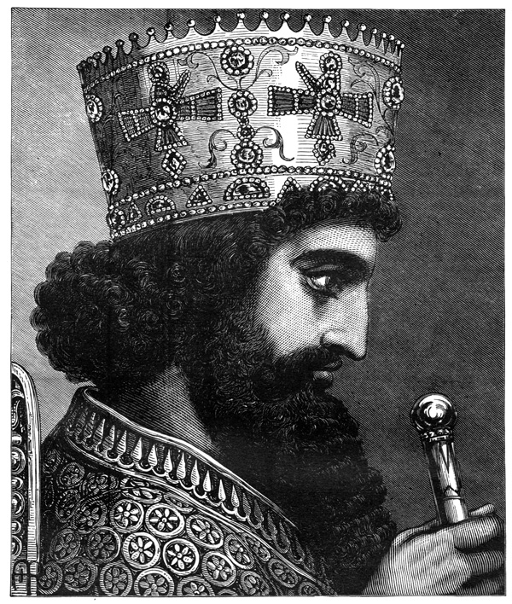
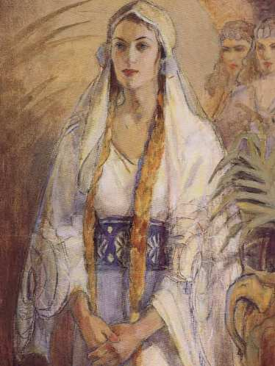
Persian King Xerxes and the Jewish girl, Esther

Slide 9
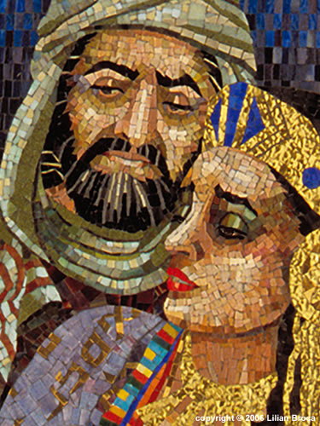
Mordecai is a Jewish official at Xerxes’ court. The daughter of Mordecai’s uncle, Esther, had been orphaned by the death of her parents and Mordecai had taken Esther into his home.

Slide 10
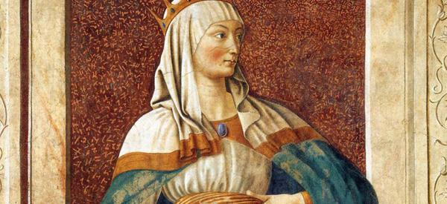
Queen Vashti is banished

Slide 11
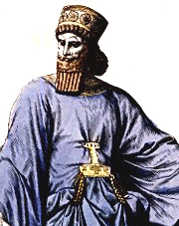
Haman uses the moment to characterise Jews as people whose loyalties are at best divided and, at worst, treasonous..

Slide 12

At this wretched turn of events Mordecai dresses in sackcloth and as he fasts he puts himself in God’s hands. It is now that he says to Esther:
“And who knows whether you have come to the kingdom for just such a time as this?” copyright
copyright

Slide 13
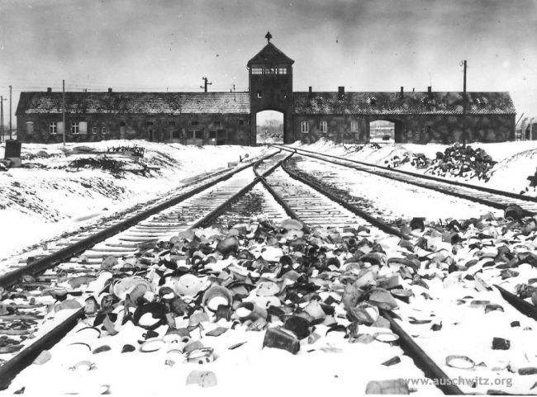
“Do not ask where was God at Auschwitz, ask where was man.”.

Slide 14
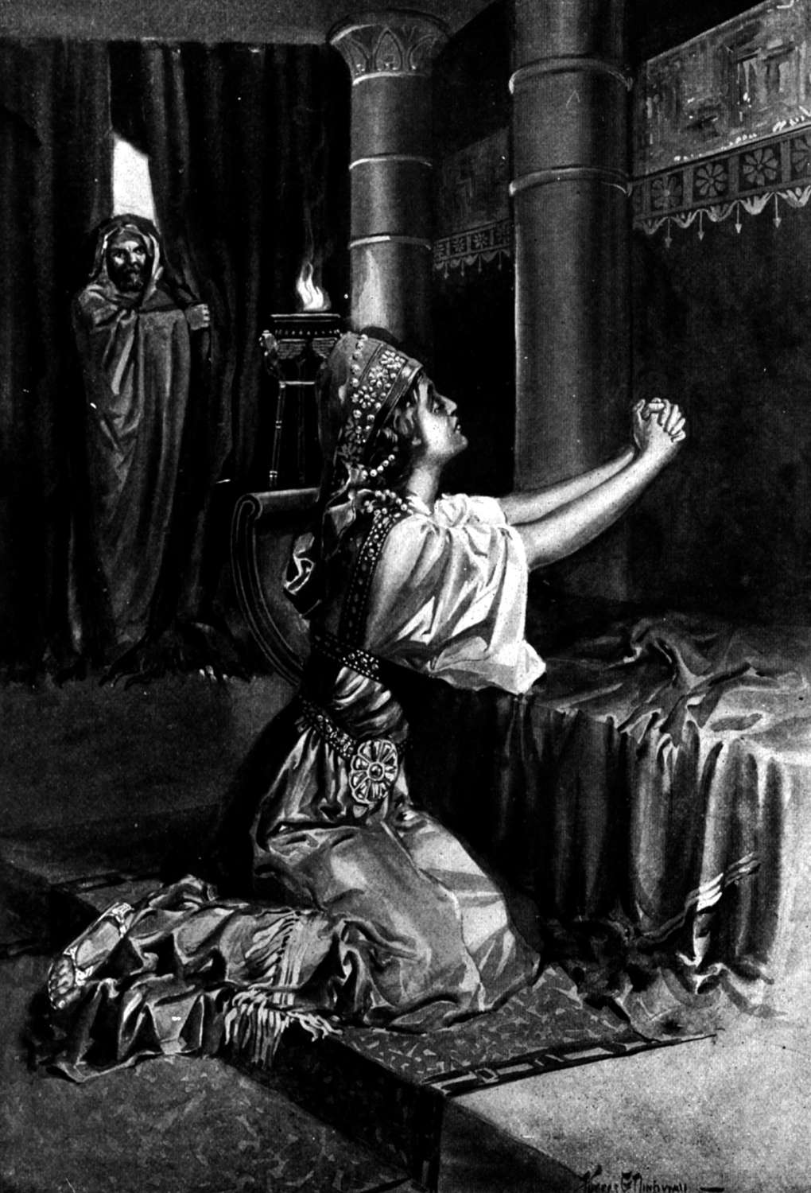
Esther fasts and prays

Slide 15
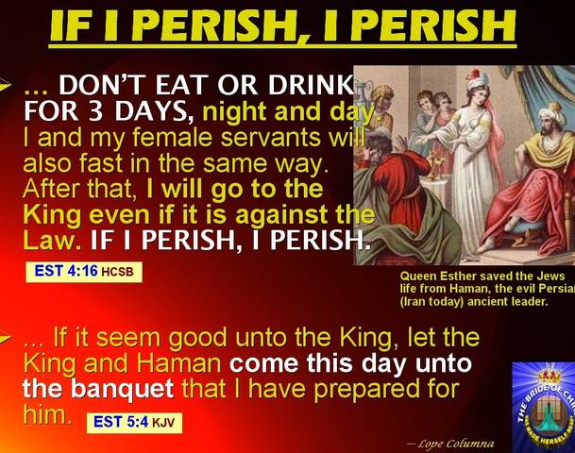
Esther’s willingness to risk all – “If I perish, I perish” - turns history on its head. She begs the king and says: “how can I look on, while my people suffer what is in store for them? How can I bear to witness the extermination of my race?”
Esther’s willingness to risk all – “If I perish, I perish” - turns history on its head. She begs the king and says: “how can I look on, while my people suffer what is in store for them? How can I bear to witness the extermination of my race?”
Esther’s willingness to risk all – “If I perish, I perish” - turns history on its head. She begs the king and says: “how can I look on, while my people suffer what is in store for them? How can I bear to witness the extermination of my race?”

Slide 16
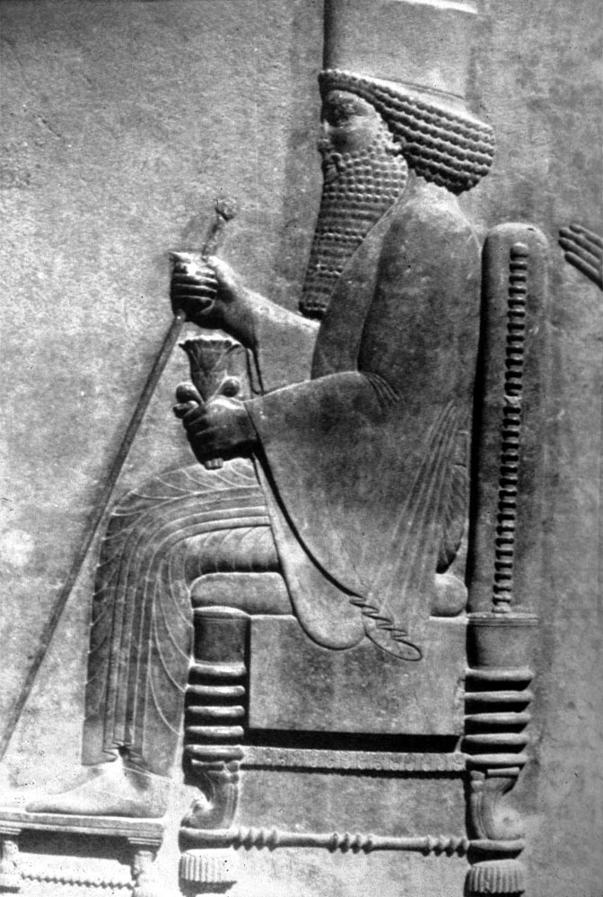
“we find that the Jews, marked out for annihilation by this arch scoundrel are not criminals; they are in fact governed by the most just of laws.
“They are Sons of the Most High, the great and living God to which we and our ancestors owe the continuing prosperity of our realm….Put up copies of this letter everywhere, allow the Jews freedom to observe their own customs, and come to their help against anyone who attacks them.”
- Xerxes.

Slide 17
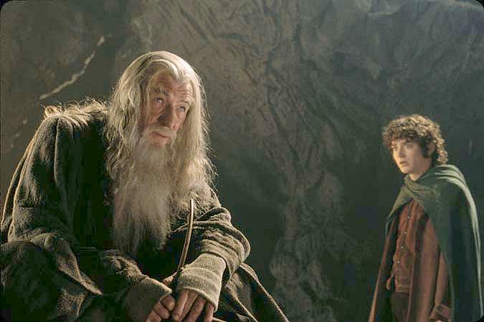
"I wish it need not have happened in my time," said Frodo.
"So do I," said Gandalf, "and so do all who live to see such times. But that is not for them to decide. All we have to decide is what to do with the time that is given us."
"I wish it need not have happened in my time," said Frodo."So do I," said Gandalf, "and so do all who live to see such times. But that is not for them to decide. All we have to decide is what to do with the time that is given us."

Slide 18
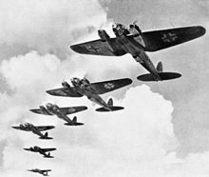
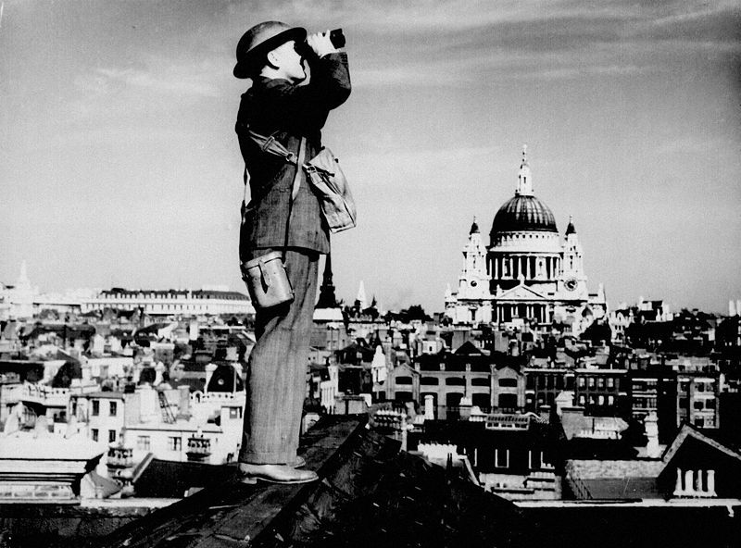
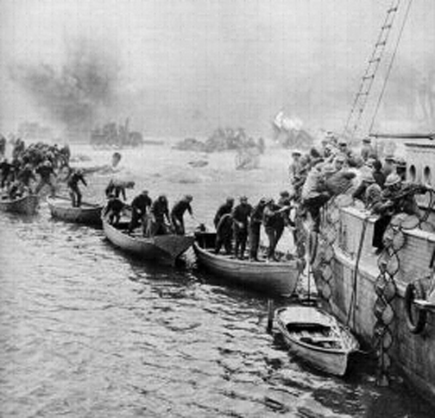
2. Let’s Examine The Lessons of The Story;
‪

Slide 19
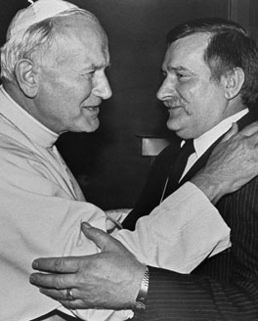
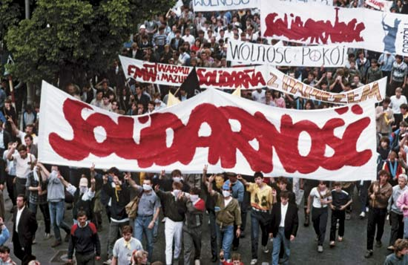
“Warsaw, Moscow, Budapest, Berlin, Prague, Sofia and Bucharest have become stages in a long pilgrimage toward liberty.
“It is admirable that in these events, entire peoples spoke out — women, young people, men, overcoming fears, their irrepressible thirst for liberty speeded up developments, made walls tumble down and opened gates”
– John Paul II
And he said of the fall of Communism…
“… It fell as a consequence of its own mistakes and abuses. It proved to be a medicine more dangerous than the disease itself.
It did not bring about true social reform, yet it did become a powerful threat and challenge to the entire world.
But it fell by itself, because of its own inherent weakness."
Lech Walesa at Gdansk's Lenin Shipyard
and with Pope John Paul II

Slide 20
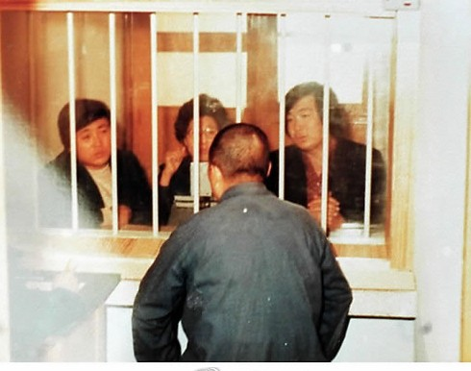
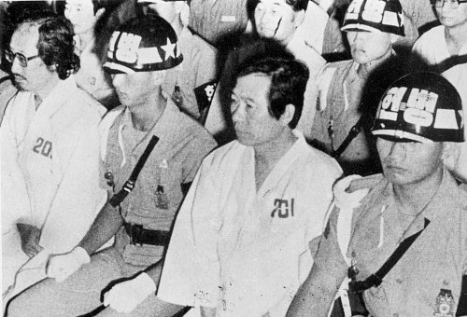
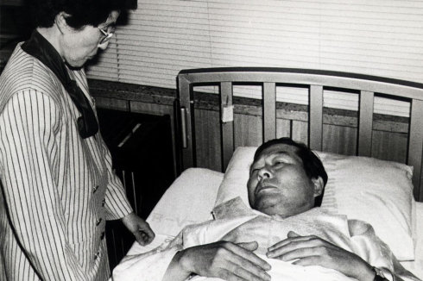
Catholic Opposition Leader Kim Dae Jung – jailed for six years – becomes South Korea’s President and a Nobel Peace Prize laureate: at this time pray for Korea as it faces grave new dangers.

Slide 21
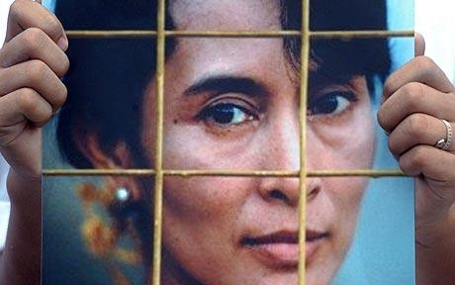
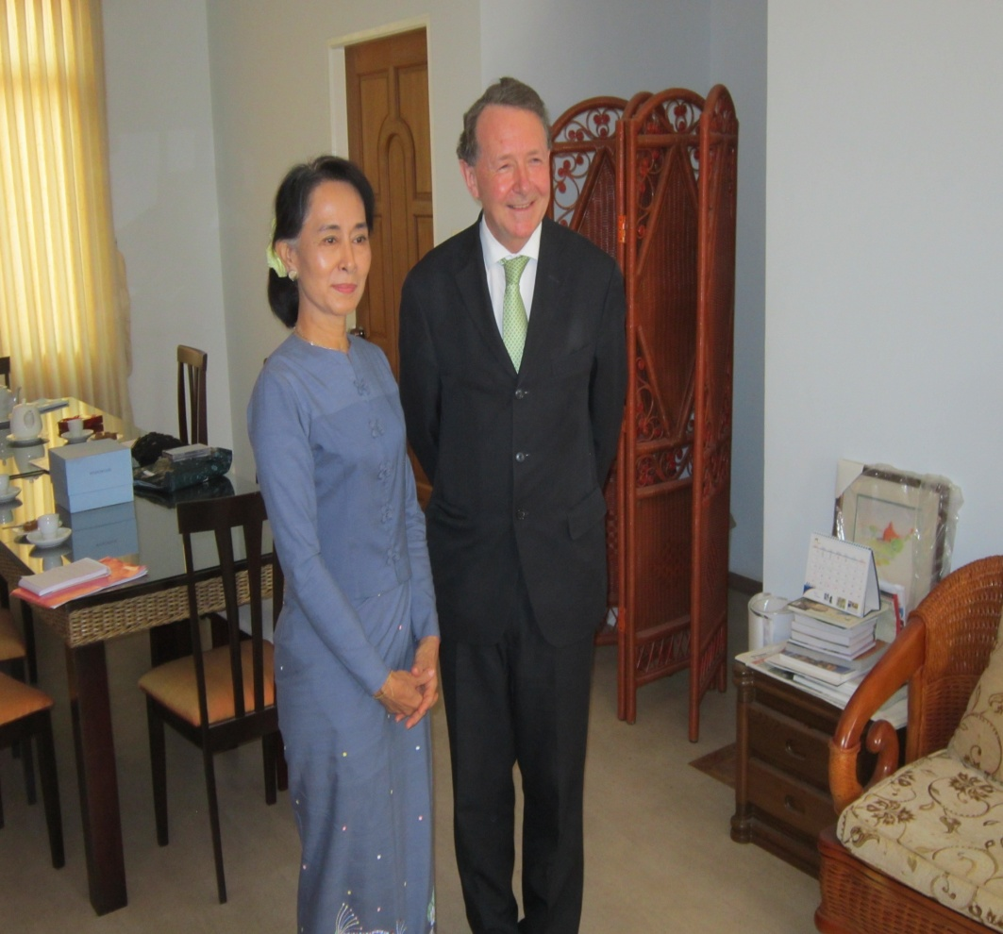
Daw Aung San Suu Kyi: under house arrest for nearly two decades. Holy Week 2013 - her request to English Catholics: “Please continue to pray for Burma.”

Slide 22
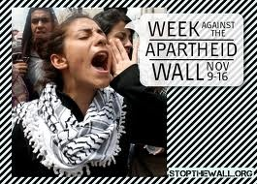
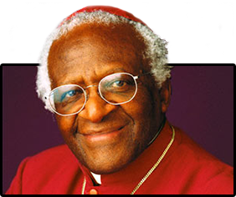
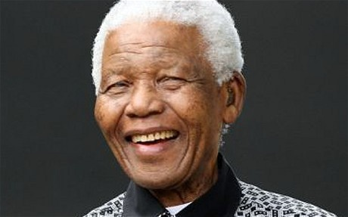

Slide 23

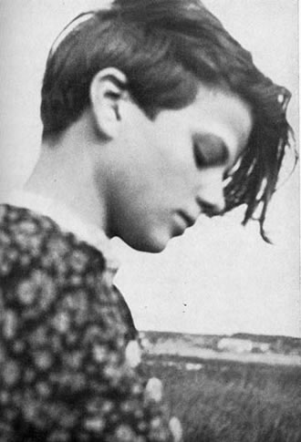
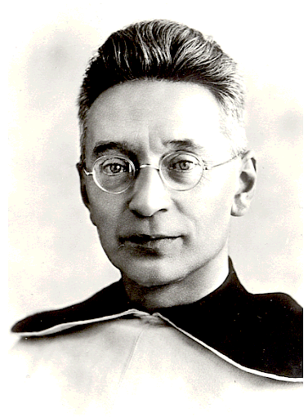
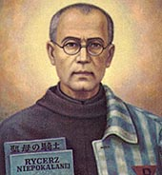

Slide 24
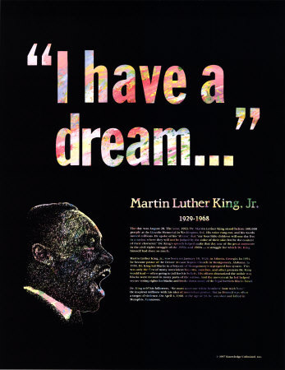
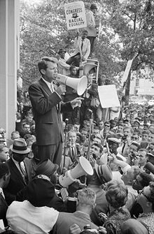
Robert Kennedy and Dr.Martin Luther King Jnr.

Slide 25
“Let no one be discouraged by the belief there is nothing one person can do against the enormous array of the world's ills, misery, ignorance, and violence. Few will have the greatness to bend history, but each of us can work to change a small portion of events. And in the total of all those acts will be written the history of a generation.”
Robert Kennedy

Slide 26
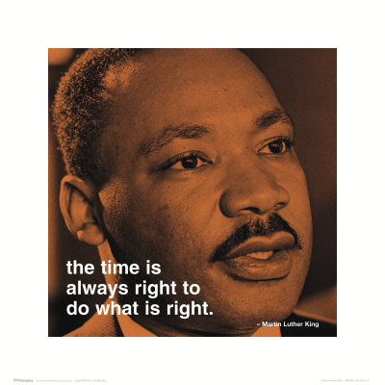
“Our lives begin to end the day we become silent about things that matter

Slide 27
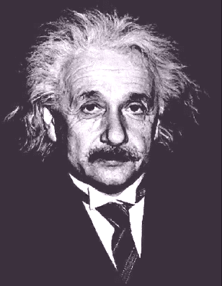
Albert Einstein warned of the consequences of doing nothing:
“The world is a dangerous place to live, not because of the people who are evil, but because of the people who don't do anything about it.”

Slide 28
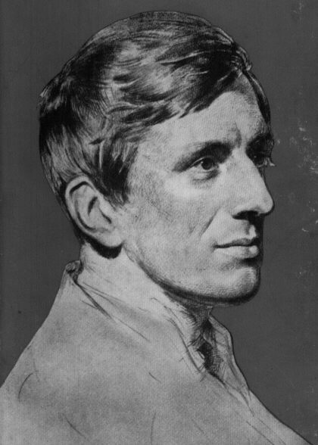
Doing Good Now...don’t wait until you are perfect.
“A man would do nothing if he waited until he could do it so well that no one could find fault.”Cardinal John Henry Newman

Slide 29
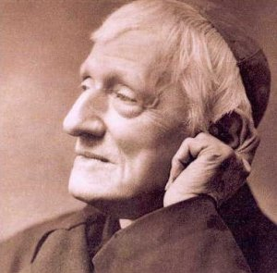
John Henry Newman
“We are not born for ourselves , but for our kind, for our neighbours, for our country: it is but selfishness, indolence, a perverse fastidiousness, an unmanliness, and no virtue or praise, to bury our talent in a napkin”

Slide 30

Don’t delay. Don’t prevaricate. Carpe Diem – seize the day.

Slide 31
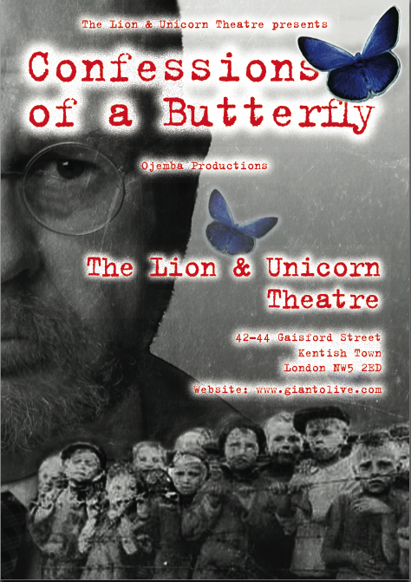
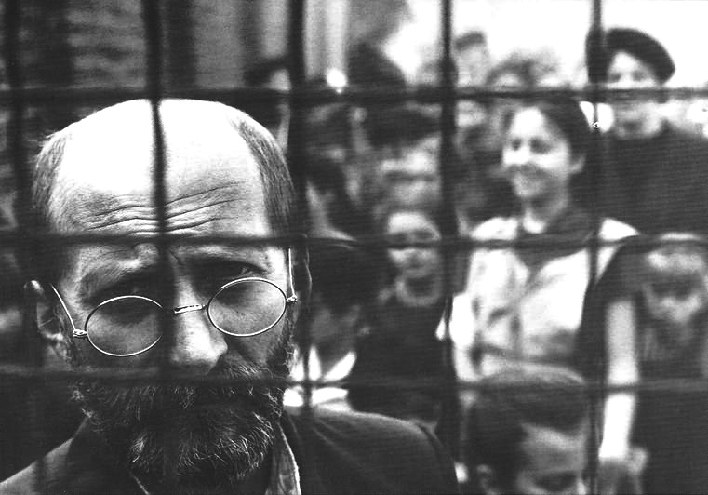
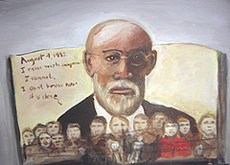
Jonathan Salt and Janusz Korczak

Slide 32
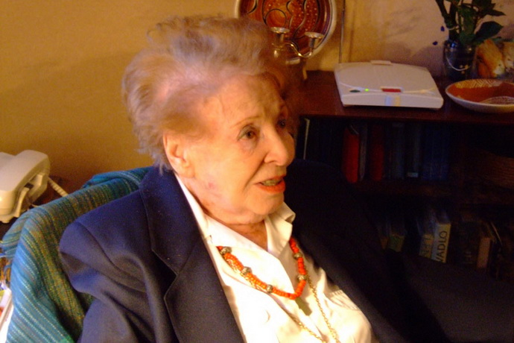
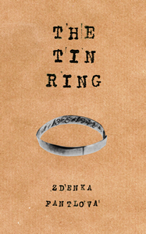
Jane Arnfield and Zdenka Fantlová: The Tin Ring,

Slide 33
“My Lord, our king, the only one,
Come to my help, for I am alone
And have no helper but you
And am about to take my life in my hands.
“I have been taught from my earliest years, in the bosom of my family, that you, O Lord, chose
Israel out of all the nations; and our ancestors out of all the people of old times to be your heritage for ever; and that you have treated them as you promised.”

Slide 34
“As for me, give me courage,
King of gods and master of all power.
Put persuasive words into my mouth
When I face the lion;
Change his feelings into hatred for our enemy,
That the latter and all like him may be brought to their end….
… O God, whose strength prevails over all, listen to the voice of the desperate, save us from the hand of the wicked, and free me from my fear.”

Slide 35
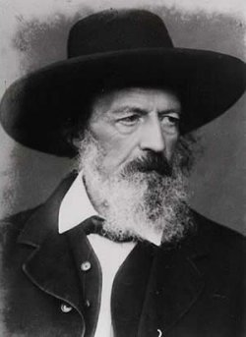
Never forget the power of prayer. When we simply rely on our own strength we are lost.
“More things are wrought by prayer than this world ever dreams of ” - Tennyson

Slide 36
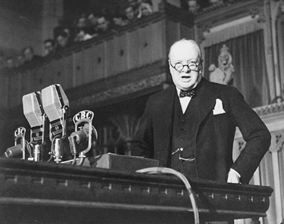
When Churchill announced that “the Battle of France is over. I expect that the Battle of Britain is about to begin. The British army is encircled and our troops are proceeding to its annihilation’.

Slide 37
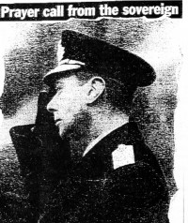
‘The British army is encircled and our troops are proceeding to its annihilation’.
On May 26th 1940 King George VI called the nation to prayer and repentance

Slide 38
3. Having considered the story of Esther and what lessons we might draw from it, what are some of the challenges “for just such a time as this”?

Slide 39

The Children Test
“The test of the morality of a society is what it does for its children”

Slide 40
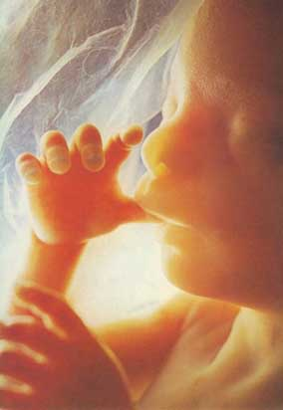
The latest abortion statistics reveal that taxpayers spent £118m on abortions in one recent year, of which £75m went to private clinics; that of 6.3 million abortions, just 143 were where a woman’s life was in danger; and that 48,000 people have had more than one abortion– some as many as eight. There have been 42 million abortions annually throughout the world ; 115,000 every day; 600 in Britain every day; in the past 12 months there were 189,574 abortions.
The latest abortion statistics reveal that taxpayers spent £118m on abortions in one recent year, of which £75m went to private clinics; that of 6.3 million abortions, just 143 were where a woman’s life was in danger; and that 48,000 people have had more than one abortion– some as many as eight. There have been 42 million abortions annually throughout the world ; 115,000 every day; 600 in Britain every day; in the past 12 months there were 189,574 abortions.
The latest abortion statistics reveal that taxpayers spent £118m on abortions in one recent year, of which £75m went to private clinics; that of 6.3 million abortions, just 143 were where a woman’s life was in danger; and that 48,000 people have had more than one abortion– some as many as eight. There have been 42 million abortions annually throughout the world ; 115,000 every day; 600 in Britain every day; in the past 12 months there were 189,574 abortions.

Slide 41
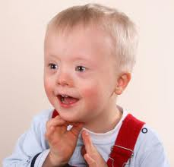
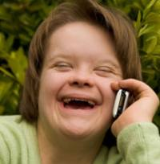
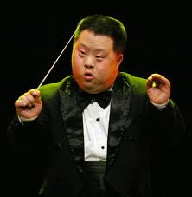
A Councillor from Cornwall was recently the centre of a row when he suggested it would be better that children with disabilities were “put down”. This is not as far-fetched or shocking as it sounds. According to Government figures, in the womb we now put down 90%of all babies with Down’s Syndrome and the law allow abortion up to birth on disabled children.

Slide 42

The Child In The Womb

Slide 43
Our society values the right to have access to pornography more highly than the protection of children. Five million images of child abuse are in circulation on the internet, featuring some 400,000 children. 70% of teenagers have viewed on line pornography.

Slide 44

Three-quarters of a million British children have no contact with their fathers following the breakdown of their parents’ relationships.

Slide 45
The UK has the worst problem with anti-social behaviour in Europe. More than 350,000children live with a parent who has a drug problem. 30% of teenagers binge drink weekly. There are 83,000 looked-after children in the UK. 23,528 under 18s (155 under 13s) in England use specialist substance misuse services. 50,552 children are on child protection registers or plans - up by 32,492 since 2006. In one recent year 16,846 sexual crimes were committed against children under 16 years.

Slide 46

Last year, Samaritans answered 4.6 million calls from people in despair, which is one call every seven seconds. Samaritans say that ‘A conservative estimate is that there are 24,000 cases of attempted suicide by adolescents (10-19 years) each year in England and Wales, which is one attempt every 20 minutes” As they grow up suicide accounts for 20 per cent of all deaths among young people aged 15 to 24

Slide 47
1 million young people are not in education, employment , or training, and over 2.6 million are without work – a 17 year high in a flat-lining economy; or the 3.9 million children living in poverty in the UK or the 4,000 who call Childline each day

Slide 48

Sharp Elbowed Britain – Devil Take The Hindmost Britain
Individuals now owe more in debt than the wealth generated by the entire country in a year. 331 people every day of the year will be declared insolvent or bankrupt.
Significantly increased student loans have triggered indebtedness and there has been a large increase in student suicides - a 50 increase in the last four years.

Slide 49
Crisis say that 2,309 people were reported by local councils across the country as sleeping rough on one night in Autumn 2012, up from 2,181 in the previous year’s count. This is on the previous year’s rise of 23%.

Slide 50
Gun crime in the United Kingdom claims 30 victims every day; the average lifespan for people who get involved in gun crime in Manchester is a mere 24 years; one woman in every four will be the victim of violence in her own home during the course of her lifetime.

Slide 51

1 million elderly living in toxic loneliness, don’t see a friend or a neighbour during the course of a typical week;
26% of British households comprise just one person and on present trends, by 2016, 36% of all homes will be inhabited by a single person – a trend accelerated by family breakdown and phenomenal divorce rates – the highest in Europe.

Slide 52


How we treat the elderly: better off dead
“why” Mother Teresa asked “does everyone sit looking at the door?”
She received the reply “It is because they are looking for the relatives who never come to visit them and who have no time for them”. Care and kill should never be used as synonyms and have no place in the healer’s art.

Slide 53

“If you’re demented, you’re wasting people’s lives - your family’s lives - and you’re wasting the resources of the NHS… putting it rather brutally, you’d be licensing people to put others down.”
.
- Baroness Warnock,
The October 10th 2008

Slide 54

How we treat the elderly: better off dead
In Belgium there are calls for euthanasia for prisoners and it is reported that they have been harvesting organs from people who have been euthanized.

Slide 55
In Holland statistics indicate that the number of euthanasia deaths in 2011 in the Netherlands increased by 18% to 3,695. This follows increases of 13% in 2009 and 19% in 2010. A 2005 House of Lords Inquiry predicted that Dutch-style Liberal Democrat laws would lead to 13,000 euthanasia deaths annually in Britain.

Slide 56
Britain 2013:
In times such as this, when a faithless society has become an indebted, atomised, lonely, and selfish society; a faithless society has become a culturally diminished society; a faithless society has become a fatherless society and a broken family society; a faithless society has become an anti-life society, there is a desperate need for a Mordecai and an Esther – both understanding the scale and nature of that which threatens us and the necessity of a brave response which draws together the practical and the spiritual.
Notes:
In times such as this, when a faithless society has become an indebted, atomised, lonely, and selfish society; a faithless society has become a culturally diminished society; a faithless society has become a fatherless society and a broken family society; a faithless society has become an anti-life society, there is a desperate need for a Mordecai and an Esther – both understanding the scale and nature of that which threatens us and the necessity of a brave response which draws together the practical and the spiritual.

Slide 57








Man’s Inhumanity To Man

Slide 58



Nigeria, Syria, Egypt

Slide 59


Pakistan’s murdered Minister for Minorities: Shabaz Bhatti and Governor Salman Taseer
Bhatti said that his stand would “send a message of hope to the people living a life of disappointment, disillusionment and despair” adding that his life was dedicated to “the oppressed, the down-trodden and the marginalised” and to “the struggle for human equality, social justice, religious freedom and the empowerment of religious minorities’ communities.”

Slide 60


Slide 61






Slide 62

Life and Death on The North Korean Border
The Perils Of Escaping Across The River Tumen

Slide 63



Slide 64





The Plight of Men, Women and Children – 200,000 in the gulags of North Korea

Slide 65

Broken or Crushed: The Dalits and the Caste System
170 million people remain in India as Dalits, in addition to the 400,000 in our own country.
March 4th 2013 in the House of Lords:
“ When the House considers that every single day in India every 18 minutes a crime is committed against a Dalit; every day three Dalit women are raped; two Dalits are murdered; two Dalit houses are burned; 11 Dalits are beaten; that many are impoverished; some half of Dalit children are under-nourished; 12% die before their fifth birthday; vast numbers are uneducated or illiterate; and 45% cannot read or write it is quite clear that we do not need more inquiries or studies.”

Slide 66

It’s not the terracotta pots that need breaking but the caste system. But human rights are violated and denied in innumerable ways.

Slide 67

Mahatma Gandhi
“You must be the change you want to see in the world”

Slide 68
“Good is never accomplished except at the cost of those who do it,
truth never breaks through except through the sacrifice of those who spread it” –
“If a man waited until he was perfect he would wait for ever.”
John Henry Newman

Slide 69








A coalition of Quakers, William Wilberforce, Thomas Clarkson, Granville Sharpe, Olaudah Equiano, Josiah Wedgewood, John Newton, and others ended slavery but it was preceded by religious revival

Slide 70

We have been the silent witnesses of evil deeds.
What we shall need is not geniuses, or cynics, or misanthropes, or clever tacticians, but plain, honest, straightforward men.”

Slide 71
“Silence in the face of evil is itself evil”- Bonhoeffer”

Slide 72
That was what Esther discovered and it is what we too must discover for just such a time as this. www.davidalton.net

