Slide 1
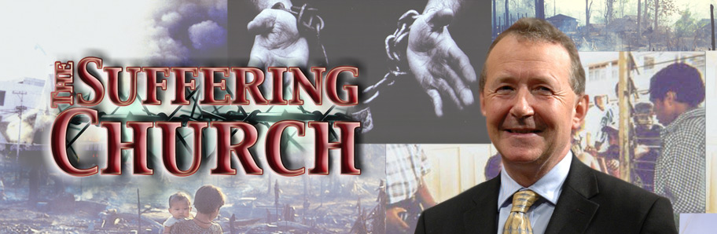
Celebrate 2012
The Pain Of The Suffering Church
www.davidalton.net

Slide 2
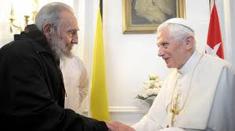
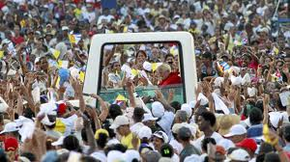
Pope Benedict with Fidel Castro and in Cuba’s Revolution Square – March 2012

Slide 3
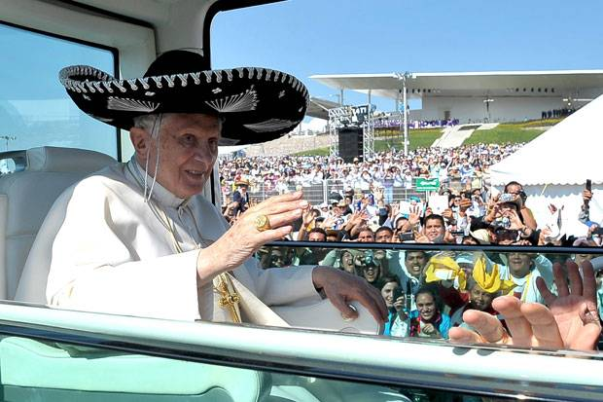
Shadrach, Meshach, and Abed-Nego (Daniel 3)
“defied the order of the king” preferring “to face death by fire rather than betray their conscience and their faith”.

Slide 4
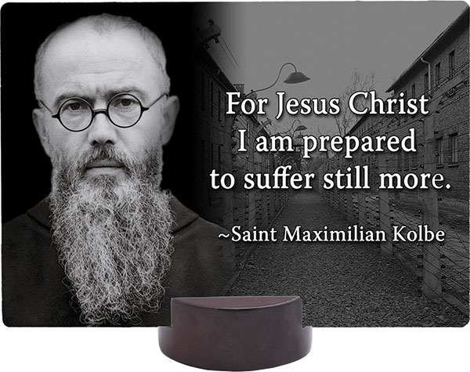
No one on the world can change truth…

Slide 5
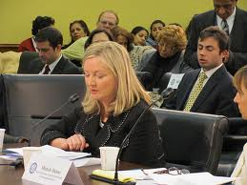
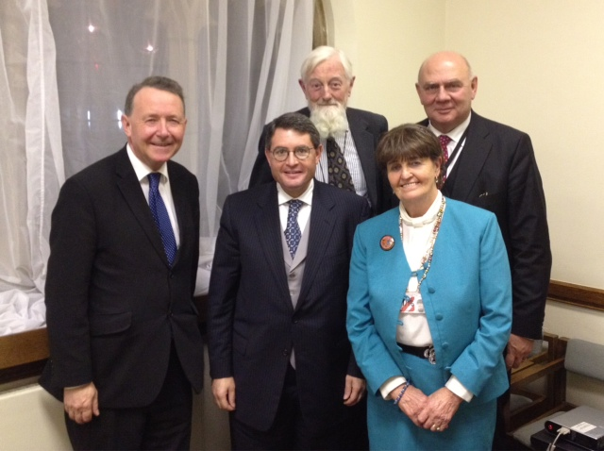
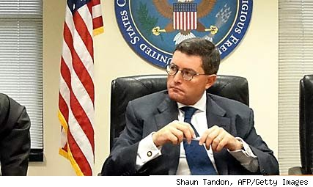
US Commission on International Religious Freedom
16 countries Listed -Burma, China, Egypt, Eritrea, Iran, Iraq, Nigeria, North Korea, Pakistan, Saudi Arabia, (north) Sudan, Tajikistan, Turkey, Turkmenistan, Uzbekistan, and Vietnam.

Slide 6
Article 18 of the 1948 U.N.Declaration on Human Rights
“Everyone has the right to freedom of thought, conscience and religion; this right includes freedom to change his religion or belief, and freedom, either alone or in community with others and in public or private, to manifest his religion or belief in teaching, practice, worship and observance.”

Slide 7
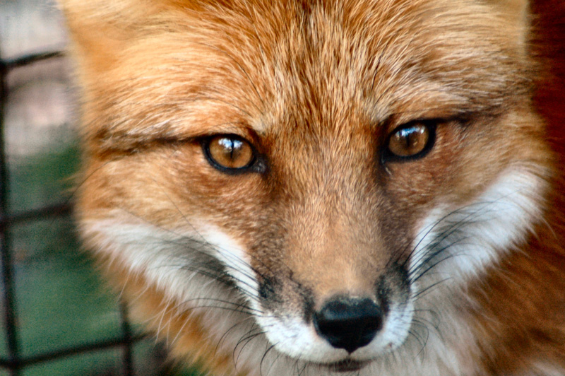
Save The Human Race….

Slide 8


200 million Christians in over 60 countries face some degree of discrimination

Slide 9
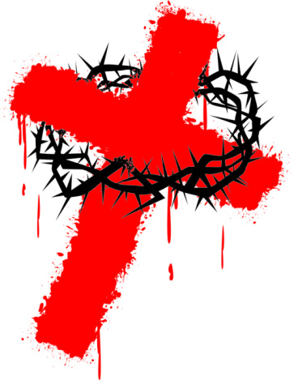
“the right to freedom of thought, conscience and religion is a fundamental component of the universal and indivisible human rights framework that applies to all people everywhere, as laid out in international law.”
“Restrictions on religious freedoms, as well as other freedoms including social, cultural and linguistic freedoms, can often lead to other human rights violations such as the imprisonment of prisoners of conscience or even death”
- Amnesty International

Slide 10
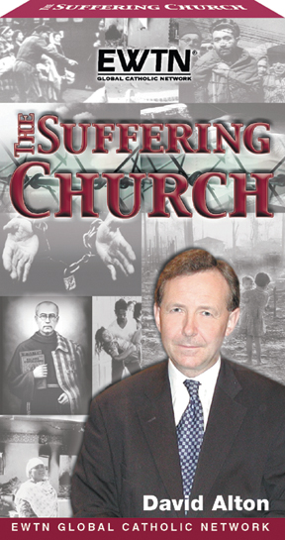
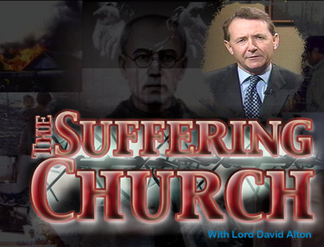

Slide 11
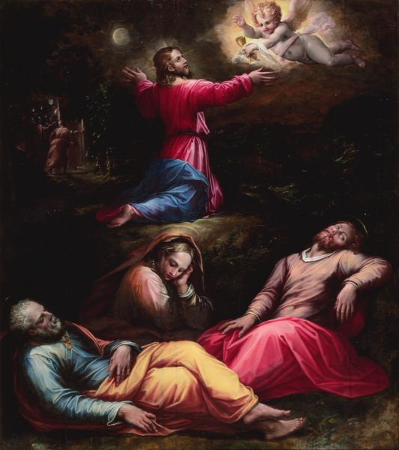
The Gethsemane Christians – who fell asleep when they were needed

Slide 12
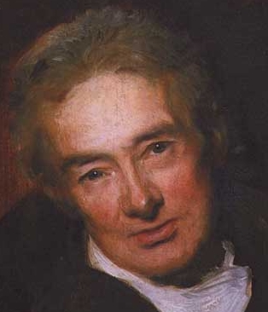
“We can no longer plead ignorance. We cannot turn aside”.

Slide 13
Three themes…
The history of persecution and suffering.
2. The present situation in some of the countries of most concern.
3. Examples of creeping intolerance in our own back yard.

Slide 14
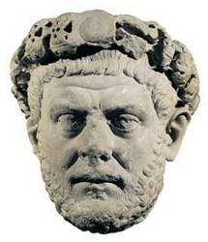
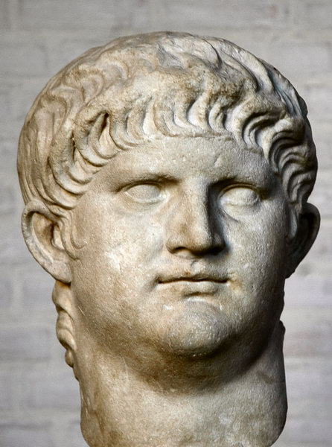
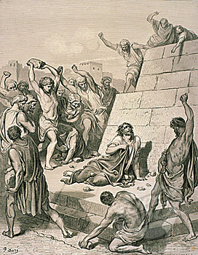
1. The History of Persecution and Suffering

Slide 15
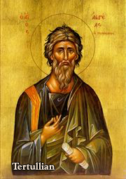
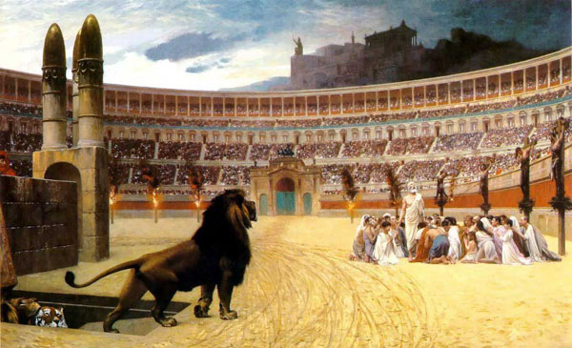
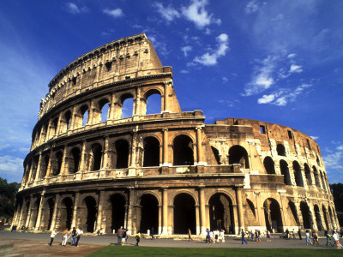
“the blood of the martyrs is the seed of the church” – as many as 100,000 may have died refusing to renounce their religion

Slide 16
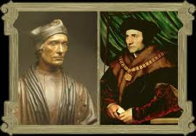
English Reformation 1534

Slide 17
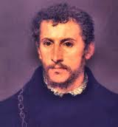


Slide 18
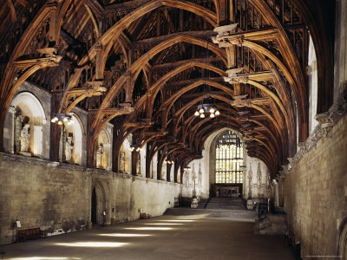

Slide 19
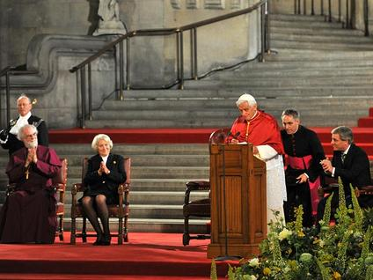
"the countless men and women down the centuries who have played their part in the momentous events that have taken place within these walls and have shaped the lives of many generations of Britons, and others besides.”

Slide 20
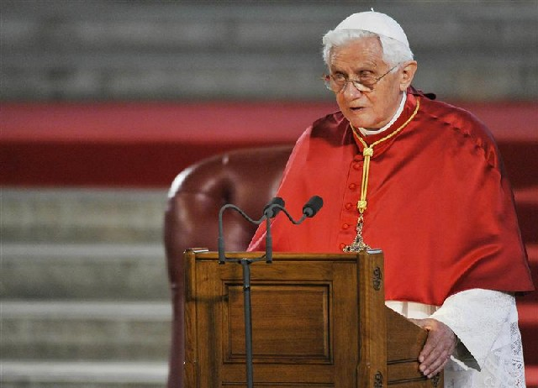
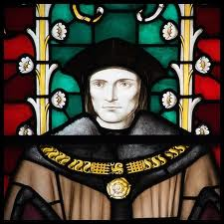
"In particular, I recall the figure of St. Thomas More, the great English scholar and statesman, who is admired by believers and non-believers alike for the integrity with which he followed his conscience, even at the cost of displeasing the sovereign whose 'good servant' he was, because he chose to serve God first.
“The dilemma which faced More in those difficult times, the perennial question of the relationship between what is owed to Caesar and what is owed to God”

Slide 21
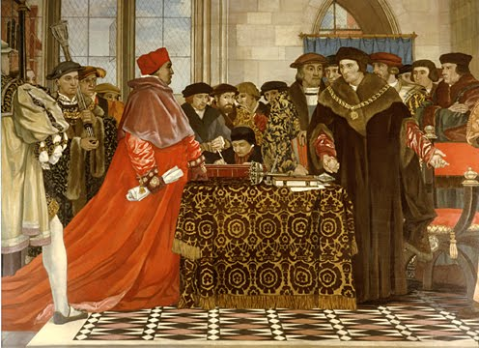
The King’s Good Servant But God’s First
"Religion, in other words, is not a problem for legislators to solve, but a vital contributor to the national conversation.”

Slide 22


Slide 23
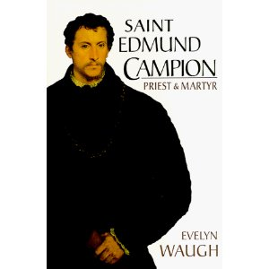
“I protest before God and His holy angels, before Heaven and earth, before the world and this bar whereat I stand,
which is but a small resemblance of the terrible judgment of the next life,
that I am not guilty of any part of the treason contained in the indictment, or of any other treason whatever.”

Slide 24
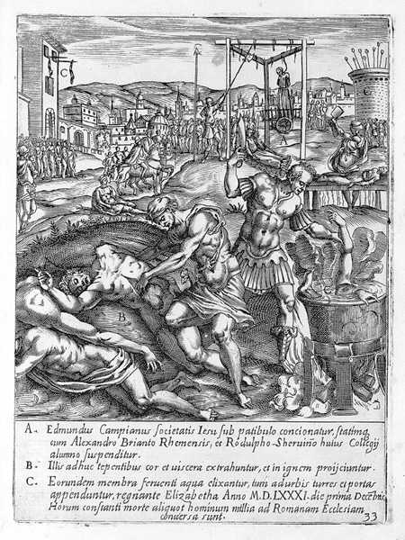
“The only thing that we now have to say is, that if our religion do make us traitors, we are worthy to be condemned; but otherwise are and have been, as good subjects as ever the Queen had. In condemning us, you condemn all your own ancestors, all our ancient bishops and kings, all that was once the glory of England -- the island of saints, and the most devoted child of the See of Peter.
"God lives; posterity will live; their judgment is not so liable to corruption as that of those who are now going to sentence us to death.”

Slide 25
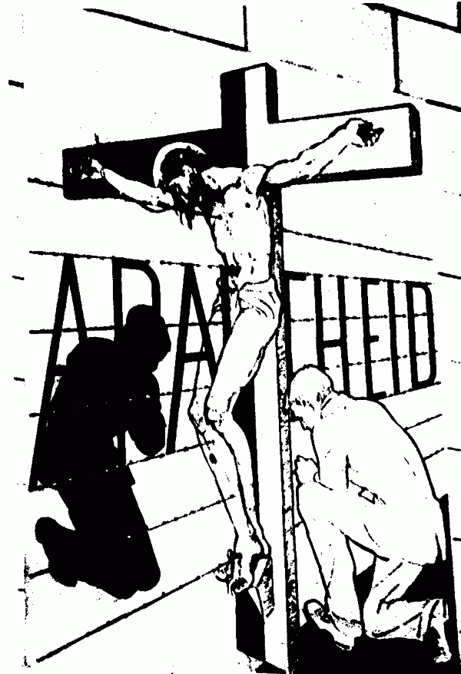

Slide 26
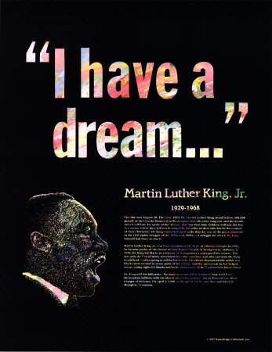

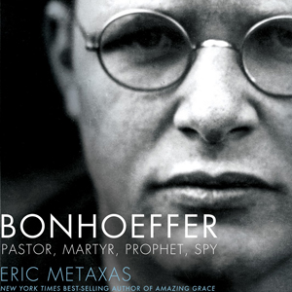

Slide 27
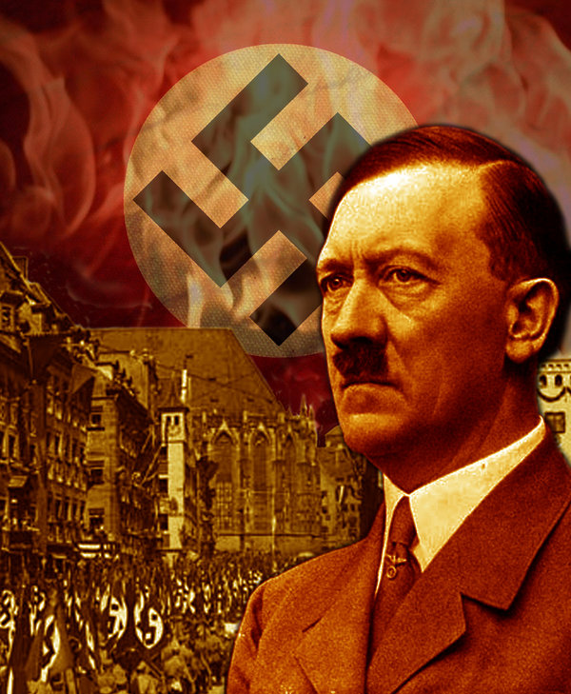
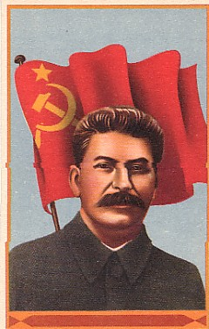
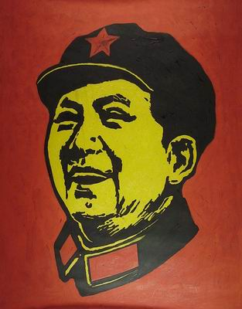

Slide 28
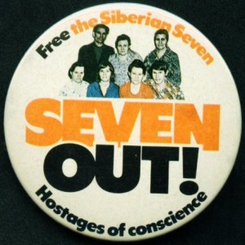
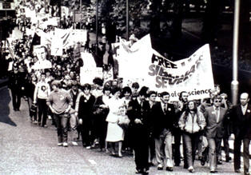

Slide 29
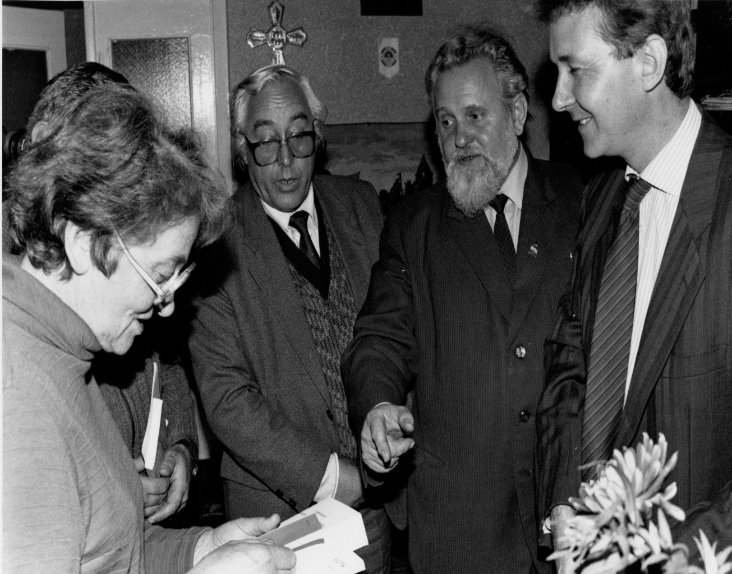
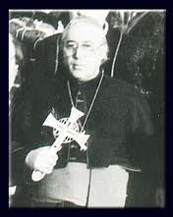
Ukraine: with Ivan gel and Bishop Vasylyk

Slide 30
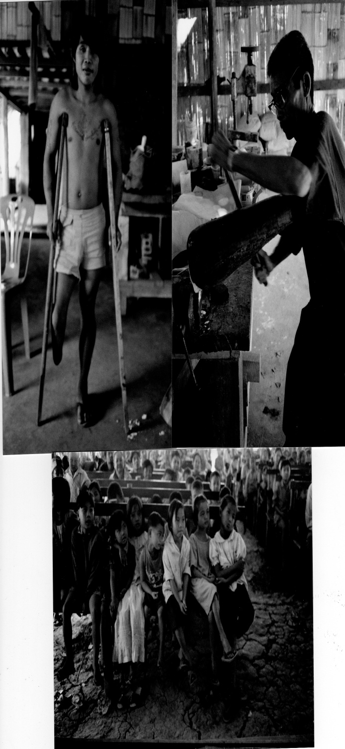
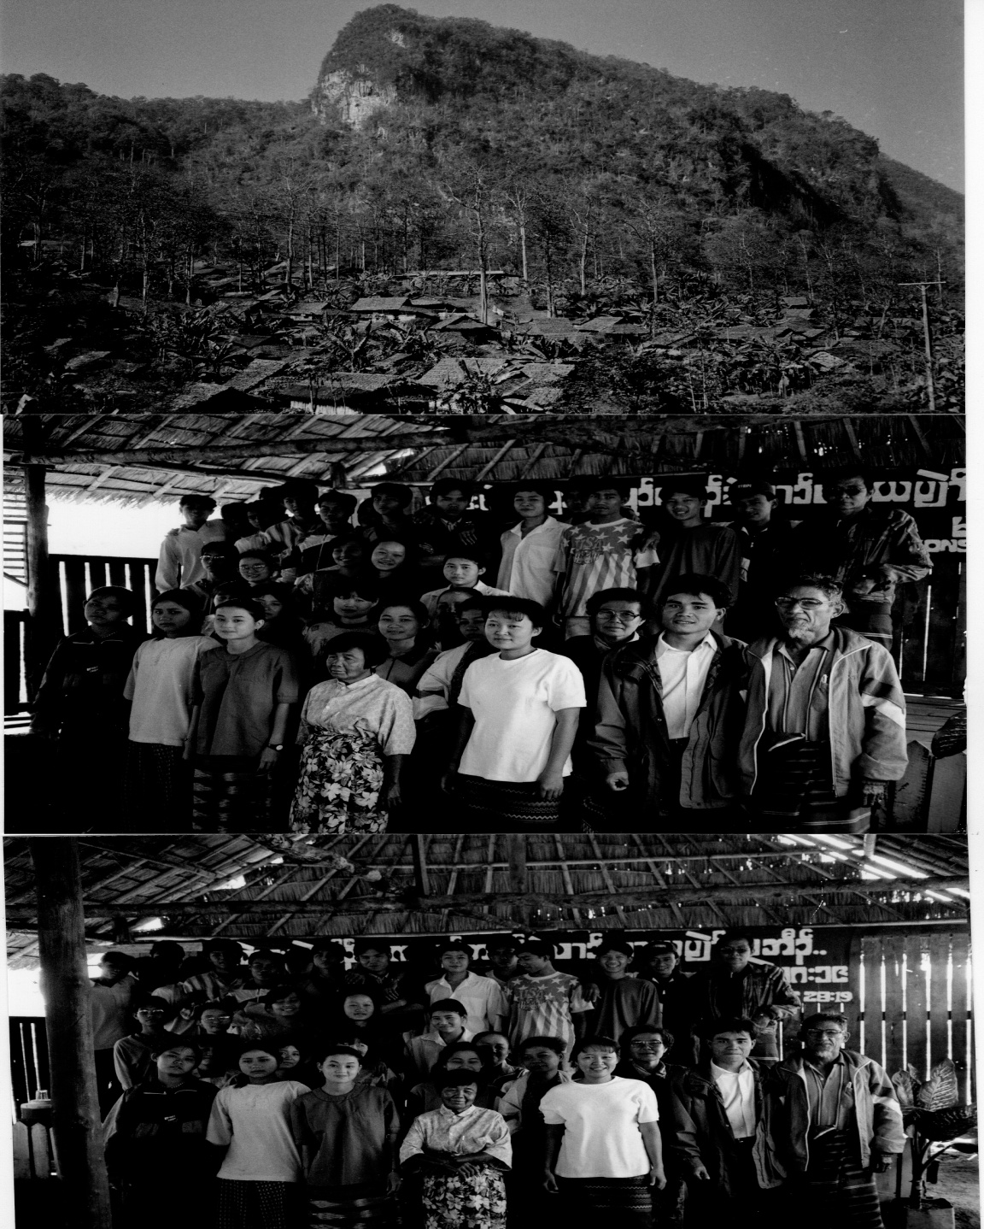

Slide 31
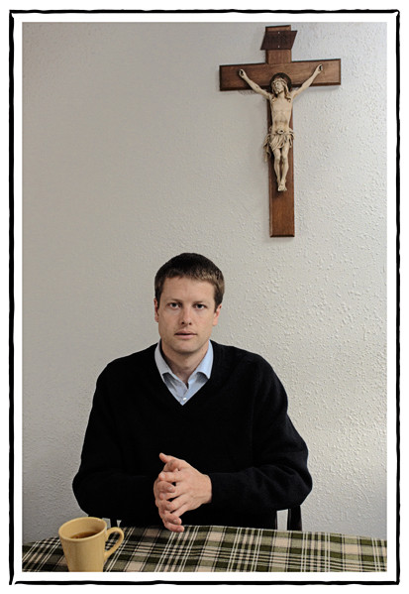
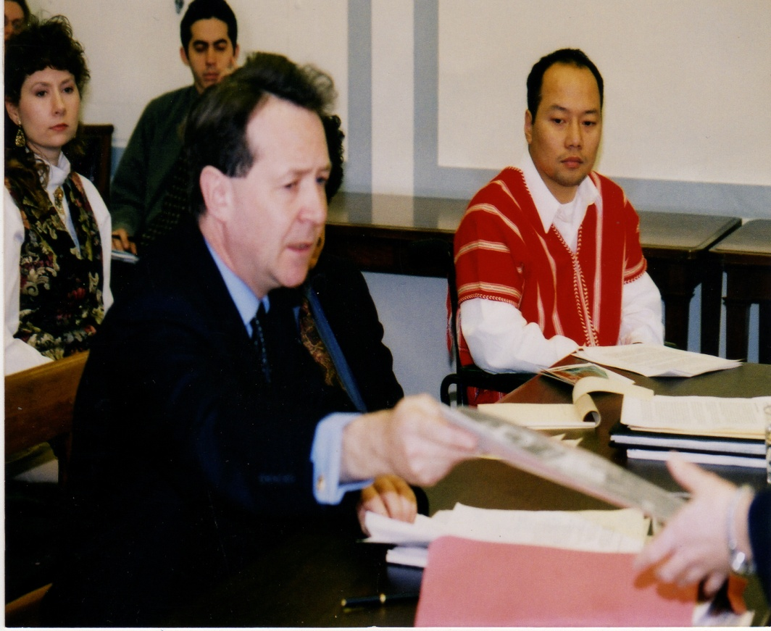
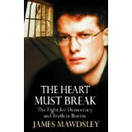

Slide 32
2. The present situation in some of the countries of most concern.
Three examples: Pakistan; the Middle East, North Korea

Slide 33
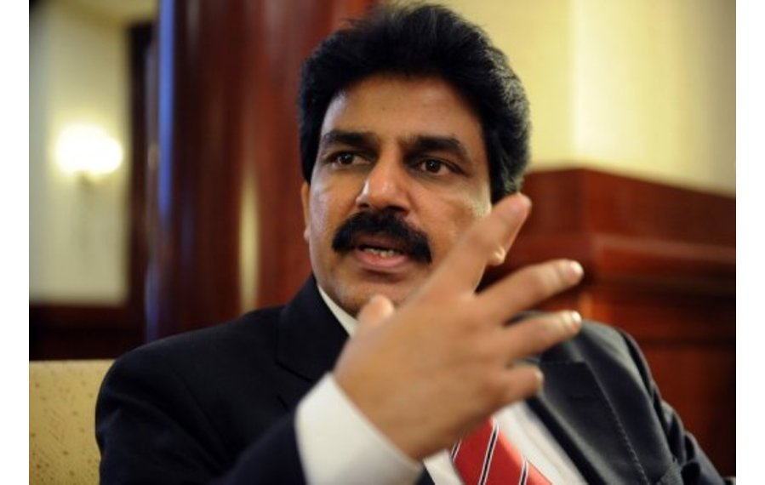
Shahbaz Bhatti

Slide 34
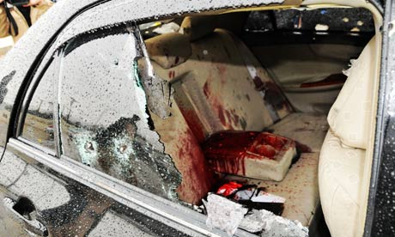
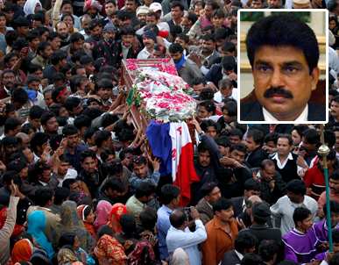

Slide 35
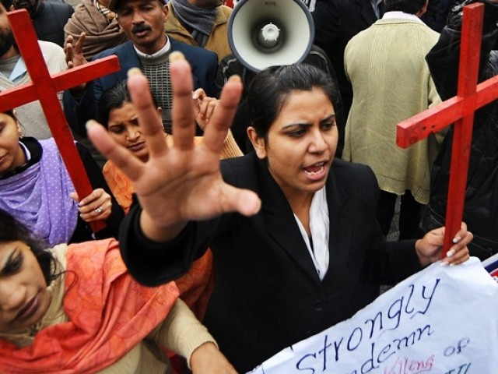
In a population of over 172 million people, only about 1.5% (3 million) is Christians -half Catholic, half Protestant.

Slide 36
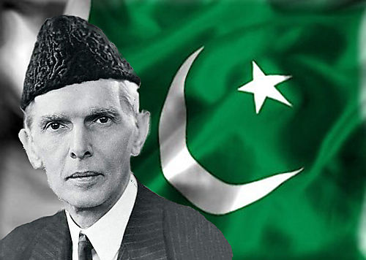
“Minorities, to whichever community they may belong, will be safeguarded. Their religion, faith or belief will be secure. There will be no interference of any kind with their freedom of worship. They will have their protection with regard to their religion, faith, their life and their culture. They will be, in all respects, the citizens of Pakistan without any distinction of caste and creed.” - Jinnah

Slide 37
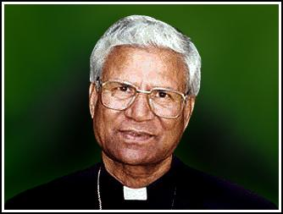
Bishop John Joseph took his own life

Slide 38

Shahbaz Bhatti said his stand would “send a message of hope to the people living a life of disappointment, disillusionment and despair” adding that his life was dedicated to “the oppressed, the down-trodden and the marginalised” and to “the struggle for human equality, social justice, religious freedom and the empowerment of religious minorities’ communities.”

Slide 39


Salman Taseer – Governor of the Punjab

Slide 40


The Prime Minister, David Cameron, called Shahbaz Bhatti’s murder “absolutely brutal and unacceptable”
Cardinal Keith O’Brien sharply contrasted the rhetoric with the reality:
"To increase aid to the Pakistan government when religious freedom is not upheld and those who
speak up for religious freedom are gunned down is tantamount to an anti-Christian foreign policy."

Slide 41

“I ask the Lord Jesus that the moving sacrifice of the life of the Pakistani minister Shahbaz Bhatti may arouse in people’s consciences the courage and commitment to defend the religious freedom of all men and, in this way, to promote their equal dignity.” - Pope Benedict
http://www.youtube.com/watch?v=3TEOBIlZs1I

Slide 42


The city of Homs, the third largest in Syria, has now seen almost its entire Christian population of 50,000 to 60,000 flee for safety as fighting continues in that stricken country.
The number of Christians left in the city has reportedly fallen to below 1,000

Slide 43

"Churches in the Middle East are threatened in their very existence” – Pope Benedict

Slide 44

Palestinian Christians now constitute just 0.5 per cent of the population, and in Lebanon, they have declined from 75 per cent to 32 per cent.

Slide 45


Iran: 300 arrests in 48 cities. Youcef Nadarkhani sentenced to death

Slide 46


Iraq: “the attacks on Christians continue and the world remains totally silent

Slide 47

Since June 2004, 71 churches in Iraq have been attacked-42 in Baghdad, 20 in Mosul, eight in Kirkuk and one in Ramadi. In March 2008, the body of Archbishop Paulos Faraj Rahho was found dumped in a shallow grave in the city. Since 2003, up to 585 Christians have been killed and there have been large-scale atrocities.

Slide 48


In October 2010, 58 Christians were killed during evening mass at Our Lady of Perpetual Help, the Syrian Catholic cathedral in Baghdad: 1.4 million Christians reduced to 150,000.

Slide 49


Egypt 2011: as worshippers were leaving a midnight service at the Church of the Two Saints, in Alexandria at least 21 were killed and 79 were injured.

Slide 50

More than 100,000 Copts have left Egypt during nine months last year

Slide 51

"Copts are not emigrating voluntarily; they are coerced into that by threats and intimidation of hard-line Salafists, and the lack of protection they are getting from the Egyptian regime".

Slide 52


South Kordofan – Sudan – the second genocide of the 21st century.

Slide 53


Nigeria: Boko Haram openly say their interim goal is "to eradicate Christians from certain parts of the country.“ 250 killed already in 2012.

Slide 54

Korea is "a community unique in the history of the church” – John Paul II

Slide 55

Korea, 1785: Thomas Kim, was so badly injured during interrogation that he died of the injuries. He became the first of 10,000 witnesses for the faith. In 1801 alone more than 300 Christians were executed.

Slide 56



Laurent Imbert, Peter Yu, Andrew Kim

Slide 57

Monsignor Richard Rutt: “Martyrs of Korea”

Slide 58



Slide 59


Changchung Cathedral Pyongyang

Slide 60


Slide 61



PUST and Dr.James Kim

Slide 62


Dr. Kim says “tell about the eagerness and hope for the future among the young people here. Tell about the great talent, about the bright enthusiastic students studying here and who will be among the leaders for tomorrow. If we outsiders demonstrate our own peaceful ways, it will make it easy for the people of the DPRK to reciprocate these peaceful efforts.”

Slide 63
3. Religious Liberties in the UK and Creeping Intolerance In Our Own Back Yard.

Slide 64


Scottish Catholic midwives ordered to take part in abortions

Slide 65

In January 2009 a poll showed that more than four out of five churchgoers
(84 per cent) think that religious freedoms,
of speech and action, are at risk in the UK. A similar proportion (82 per cent)
feel it is becoming more difficult to live as a Christian in an increasingly secular country.

Slide 66


Slide 67


Oxford Council bans Christmas and substitutes “Winter Light Festival”

Slide 68

Yorkshire College removes Easter and Christmas from the calendar in case it offends people; Perth Hospital told to remove Communion Table; Bideford Council told to ban prayers.

Slide 69


British Airways go to Court to stop Nadia Eweida from wearing a cross around her neck

Slide 70

"The Christian's right to wear a cross must be defended as fiercely as any other religious liberty… the struggle for religious freedom has been strongly connected with the struggle for democracy itself",

Slide 71

"Marginalisation not only shows how deeply British elites are alienated from the national religion".
"This is not yet, but it comes close to, self-hatred ... It represents the breakdown of an identity, and nothing good can come of it".
Britain set out with a commitment to value all cultures,
"then it became valuing all cultures equally, a completely different proposition. Then it became valuing all cultures except your own. That is when it becomes pathological. You cannot value all cultures but your own”

Slide 72
I have directed my remarks to three areas – historic persecution; contemporary persecution;
and increasing erosion of religious liberty in the UK.
Although the horrors outlined in the first two sections are clearly of a different order to
religious discrimination in the UK,
we would be deluded
if we did not see a connection.

Slide 73

“Strengthening religious freedom consolidates social bonds, nourishes the hope of a better world, and creates favourable conditions for peace and harmonious development, while at the same time establishing solid foundations for securing the rights of future generations.”

Slide 74
“There are those who wrongly interpret this search for the truth, leading them to irrationality and fanaticism; they close themselves up in ‘their truth,’ and try to impose it on others. These are like the blind scribes who, upon seeing Jesus beaten and bloody, cry out furiously, Crucify him! ( Jn 19:6). Anyone who acts irrationally cannot become a disciple of Jesus. Faith and reason are necessary and complementary in the pursuit of truth. God created man with an innate vocation to the truth and he gave him reason for this purpose. Certainly, it is not irrationality but rather the yearning for truth which the Christian faith promotes.”
-Benedict XVI

Slide 75


"A society which promotes religious freedom will be enlivened and enriched; one that doesn't will decay".
-Dignitatis Humanae, 1965

Slide 76
Celebrate 2012
The Pain Of The Suffering Church
www.davidalton.net

